Slide 1
Garbage Hunters
Pınar KARADUMAN
Selinay Fatıma ARI
Senem GURAKAR
Aysu SUSLU

Slide 2
ABSTRACT
Plastic, metal and cigarette waste remain in these natural areas. These products have a long extinction time in nature. Therefor, it would be in the best interest of nature to dispose of the wastes disposed of by humans. The aim of the project is to raise environmental cleanliness to the largest unit and to raise awareness of environmental cleanliness starting from the smallest unit.

Slide 3
To create awareness for the people who see us while we are implementing this Project in Izmir and to contribute to the cleanliness of the natural ones in Izmir. To convey the importance of a clean environment to future generations. To inspire young university students in other provinces.
While we were doing the project, a few people came to us and said that we should enlarge this project and they wanted to join us. Of course, there were those who congratulated us. This project attracted great attention especially in the middle age group. People said they thought the environment was too messy Finally, while cleaning the neighborhood Balatçık young people were exposed to bad words.

Slide 4
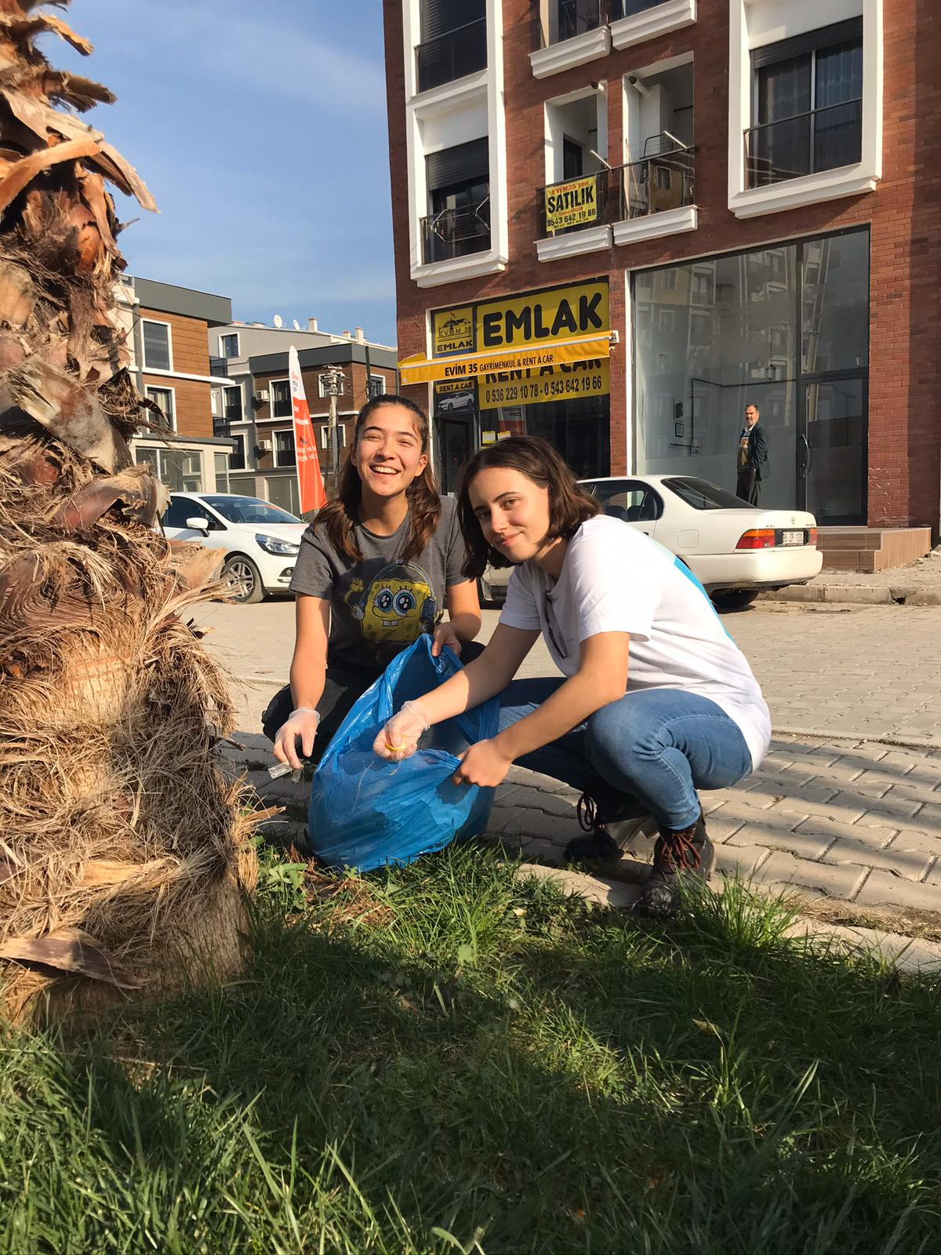
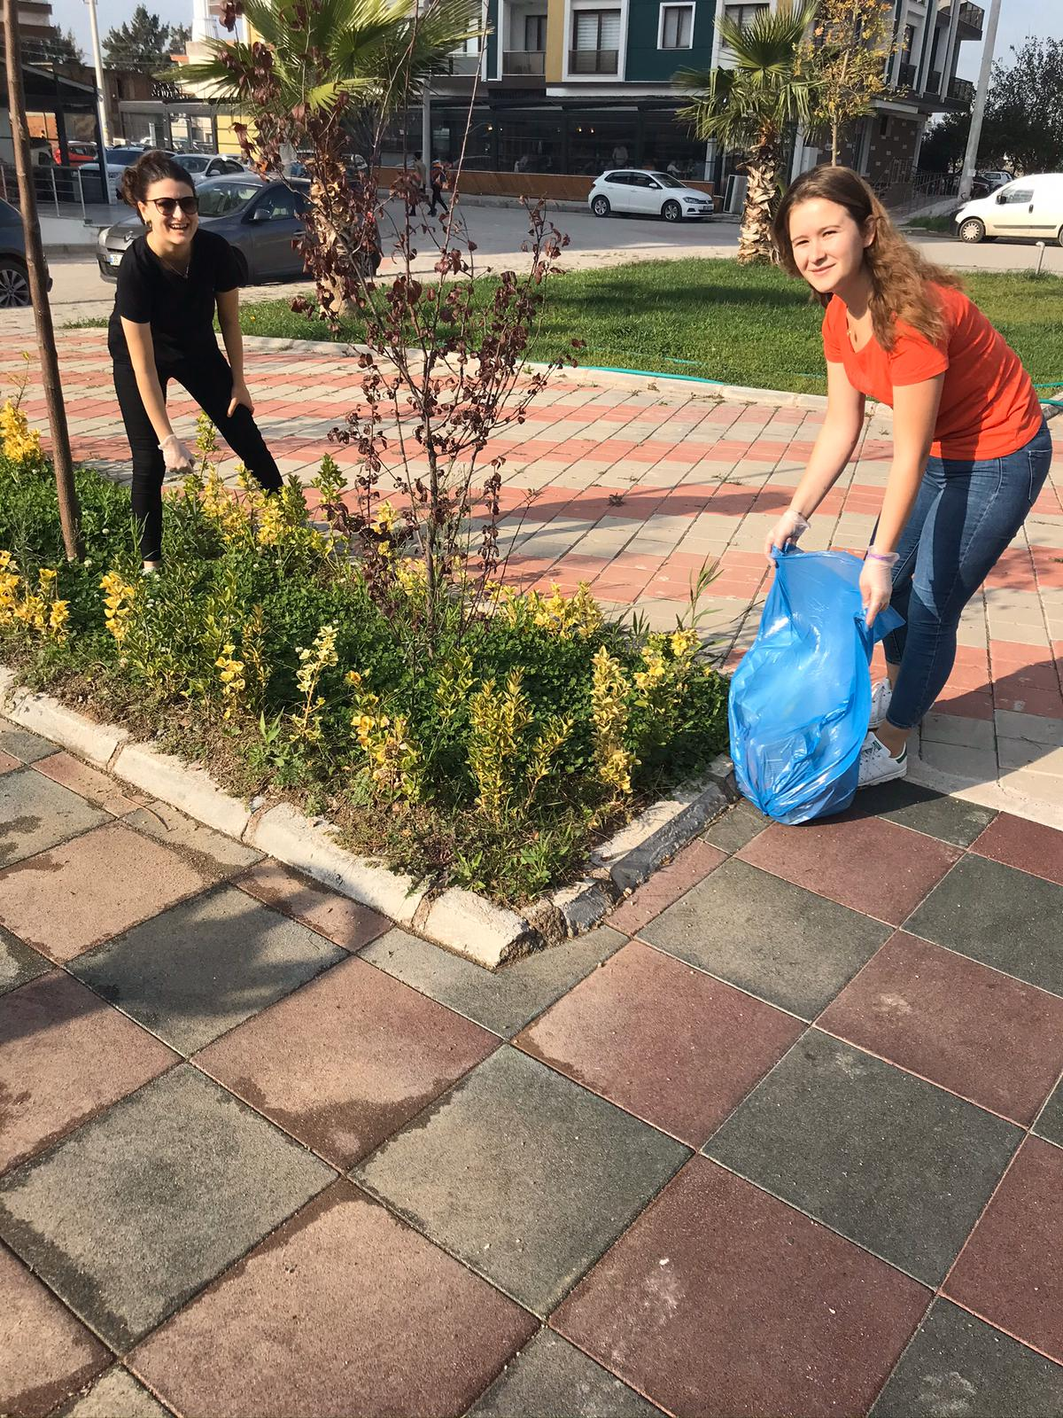

Slide 5
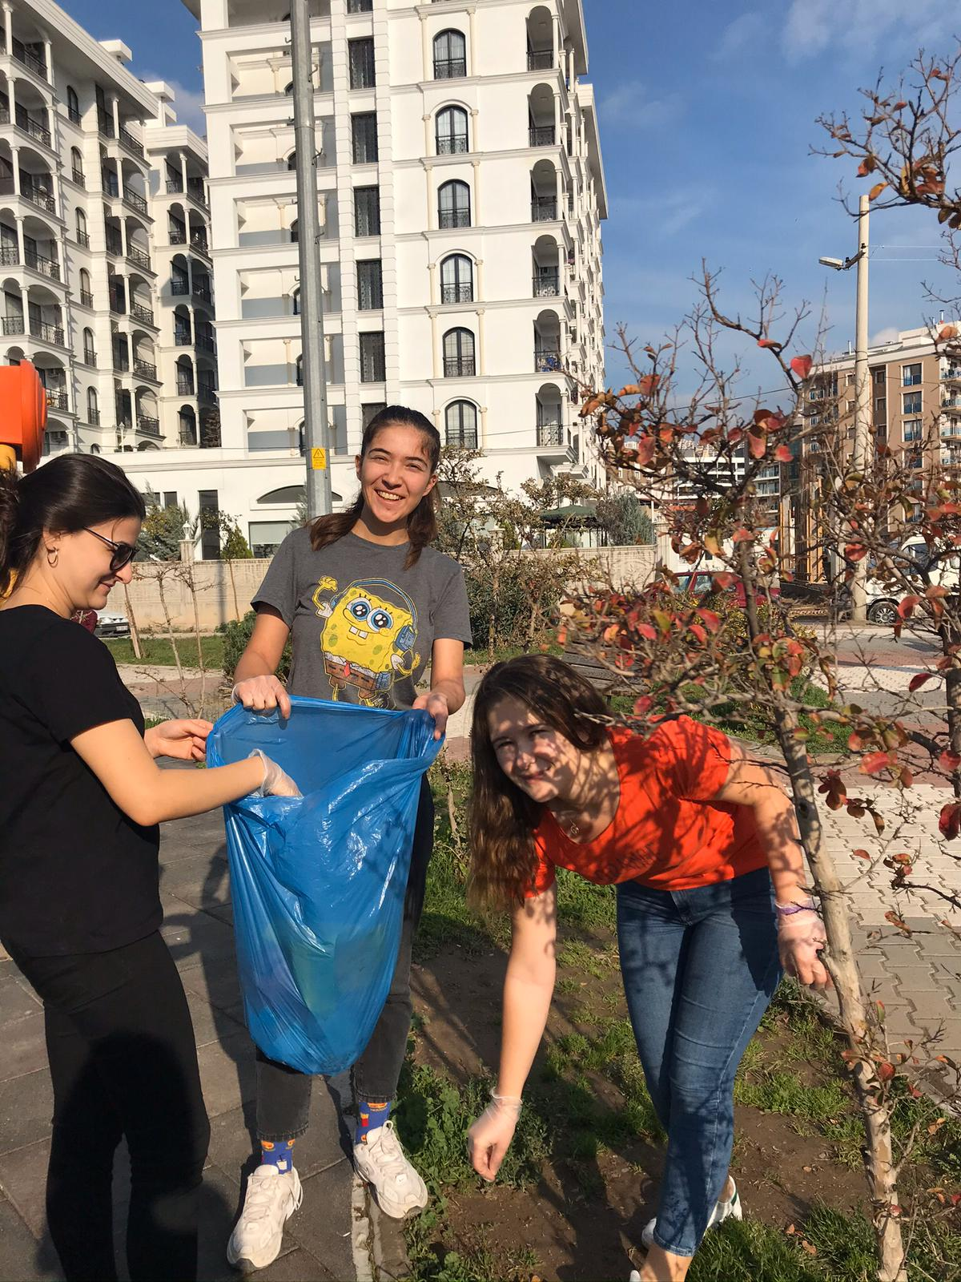

Slide 7
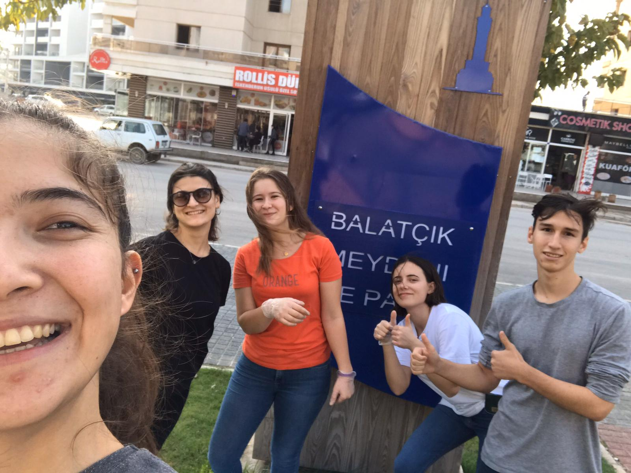
He wanted to join us.

Slide 8
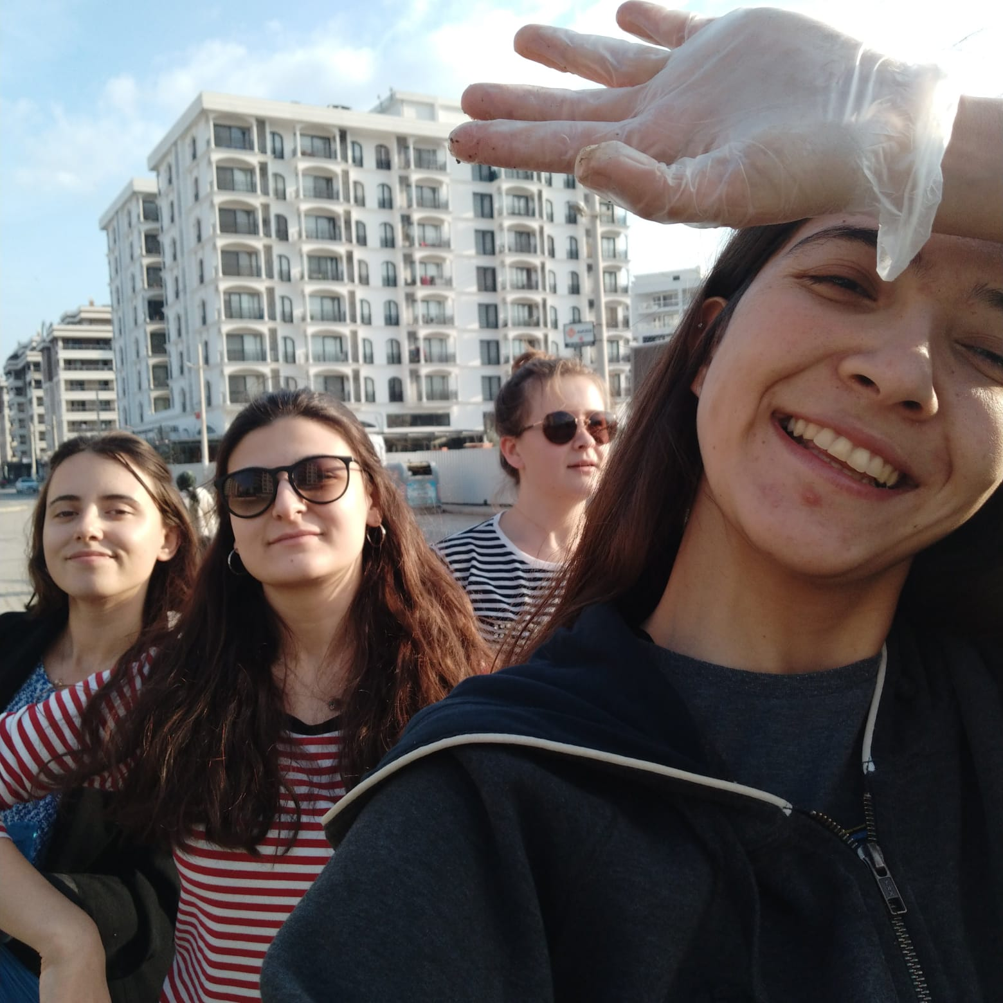

Slide 9
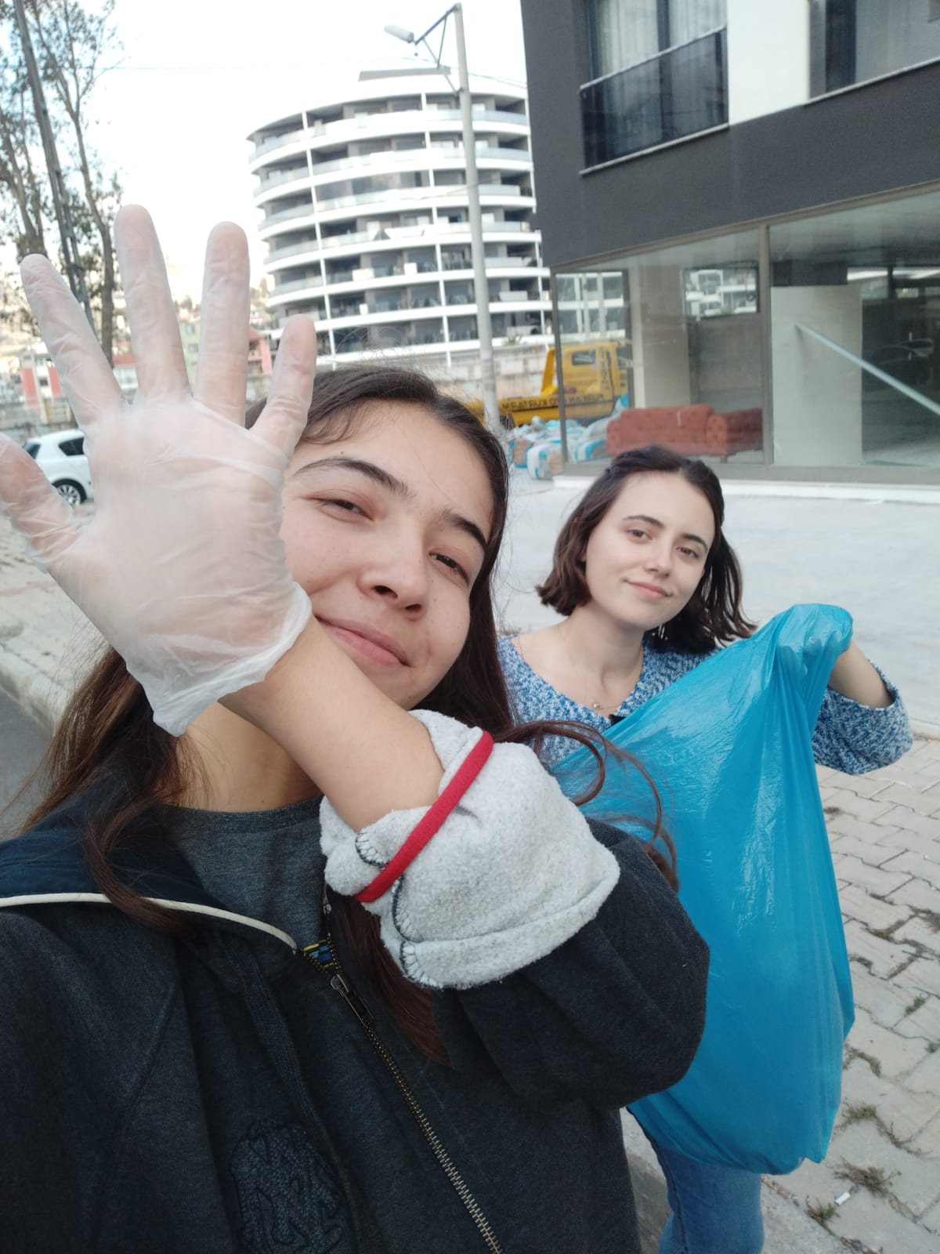
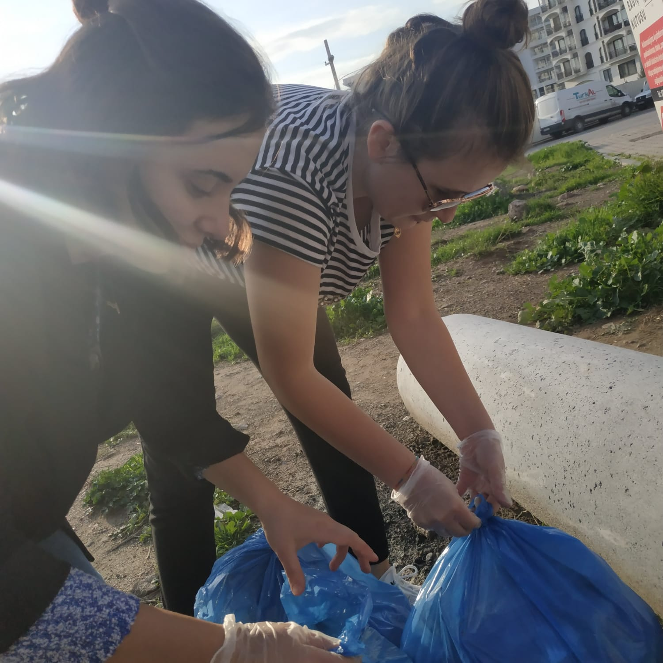

Slide 10
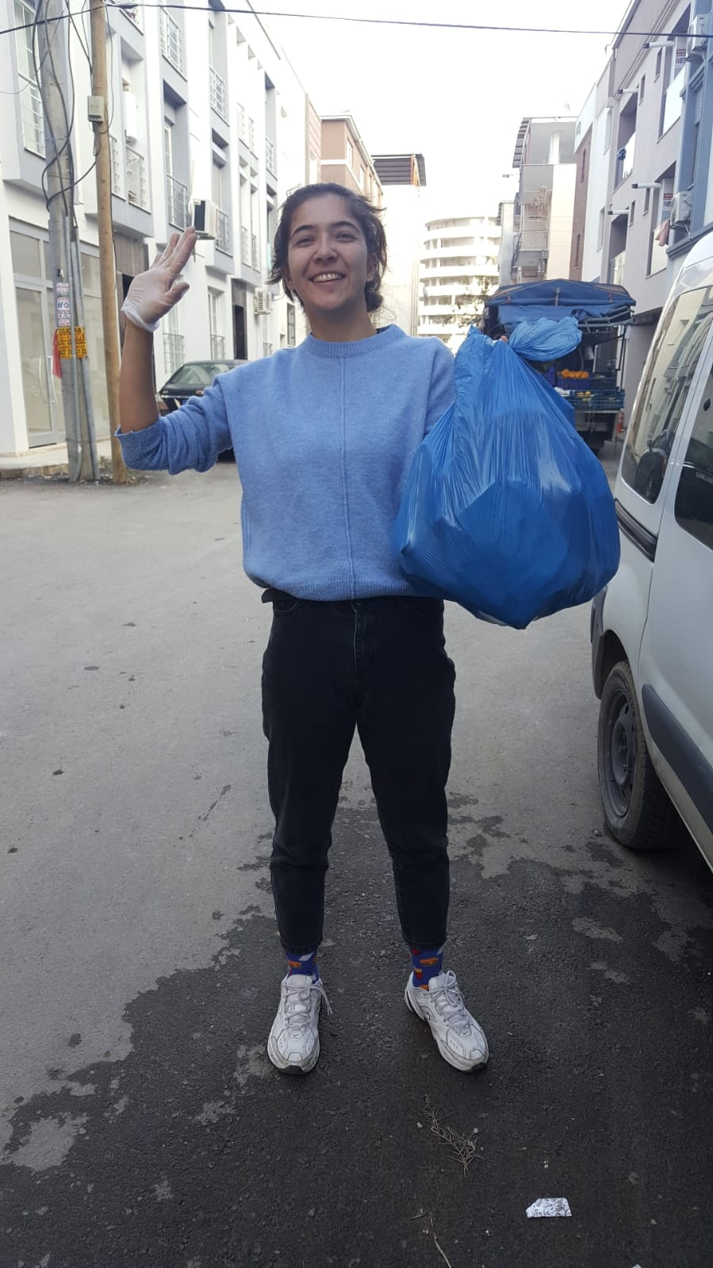
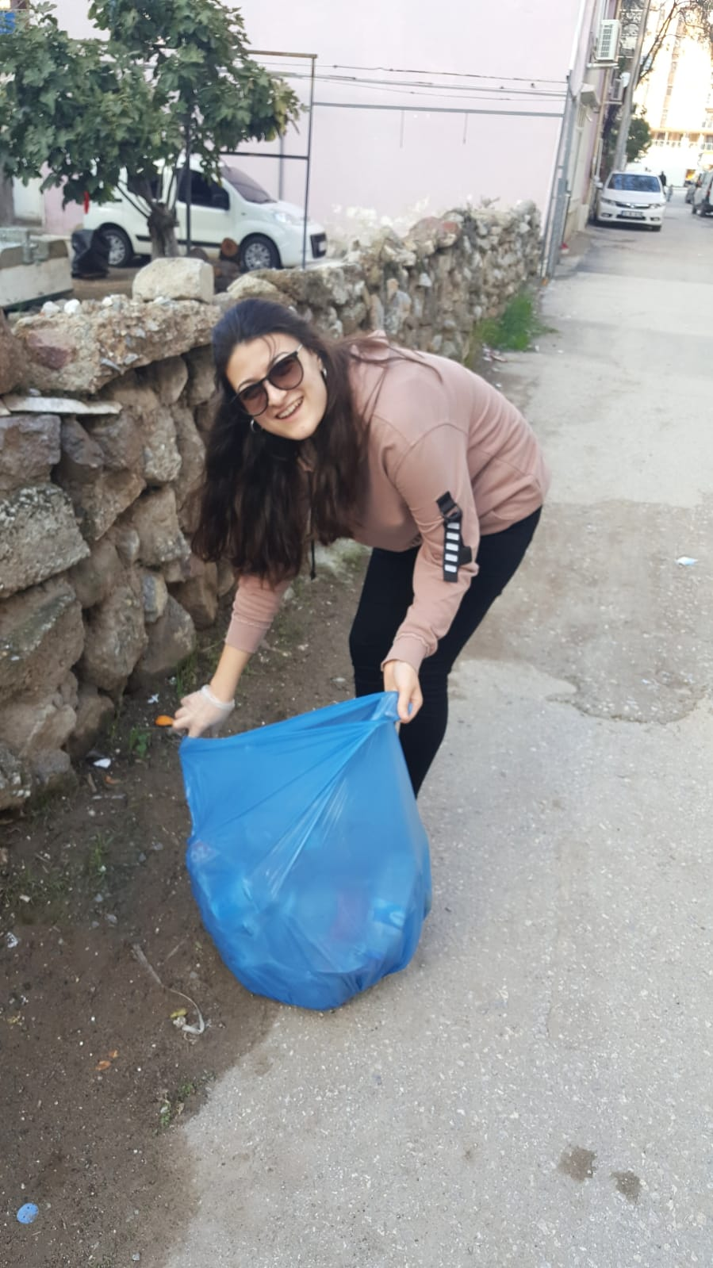

Slide 11
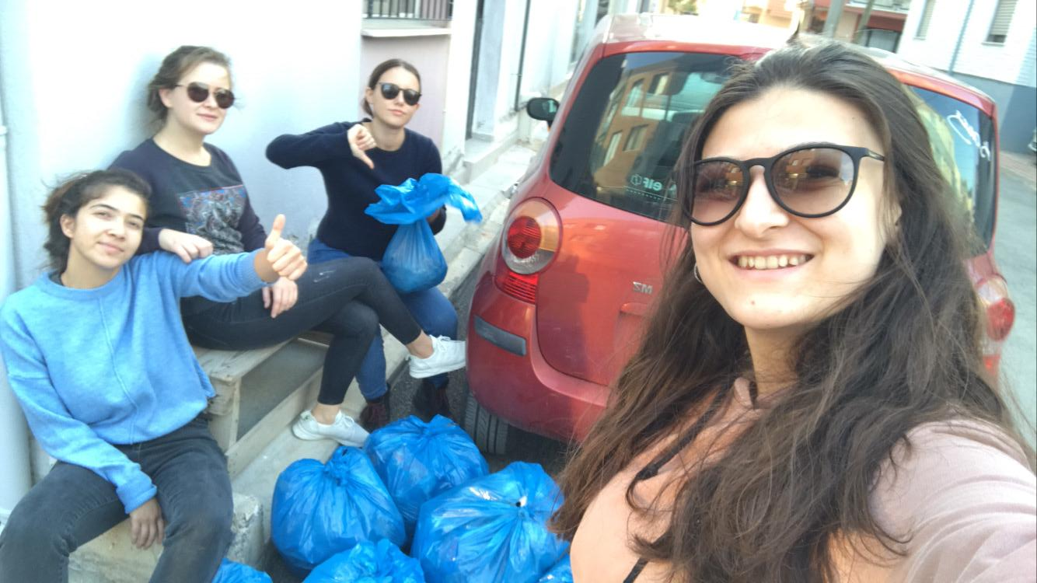

Slide 12
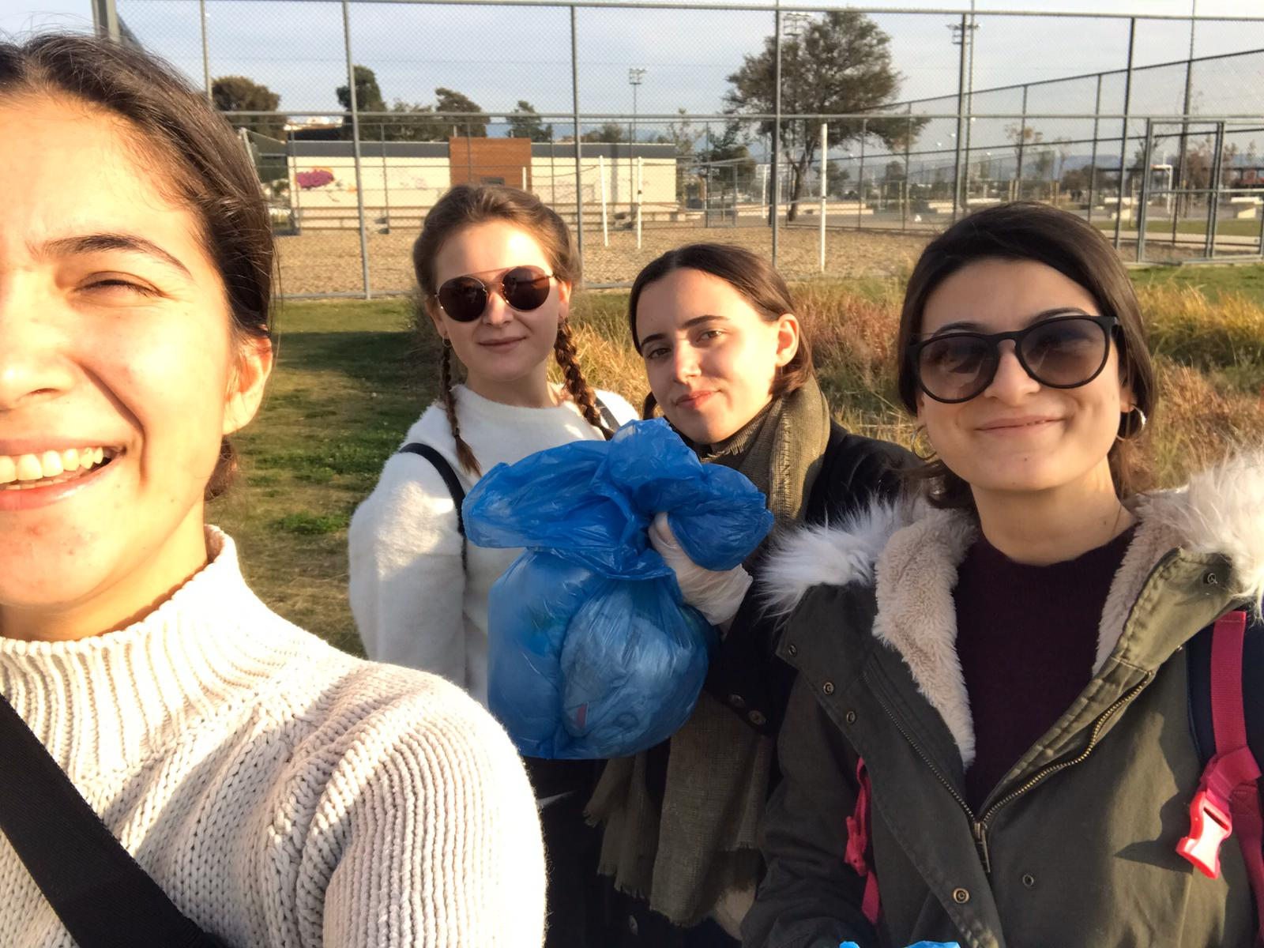

Slide 13
We did not forget our animal friends.

Slide 14
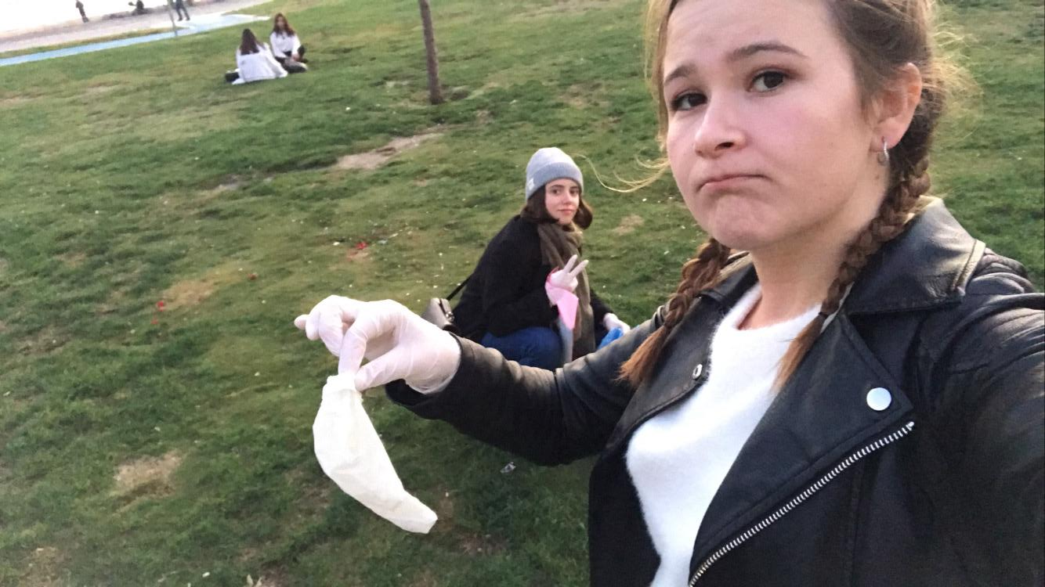

Slide 15
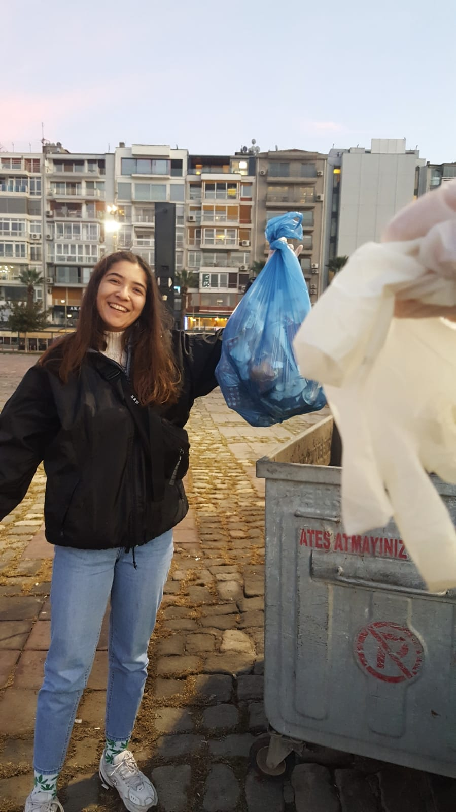

Slide 16
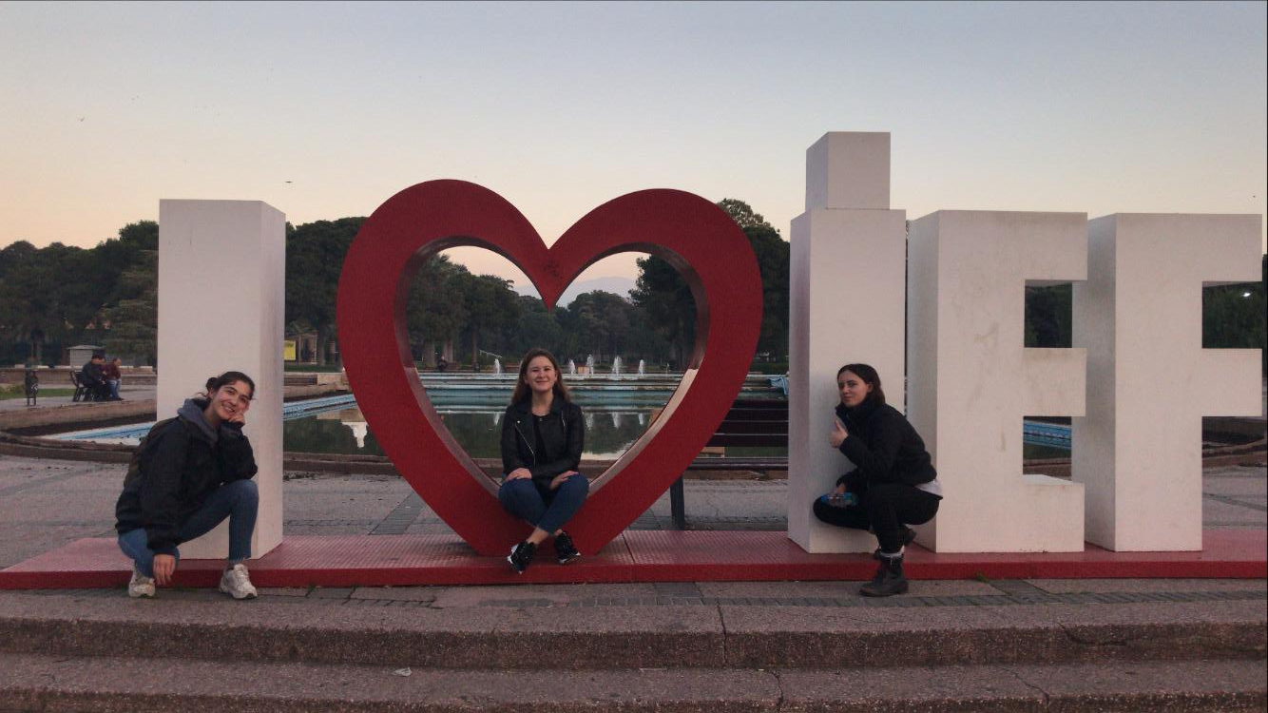

Slide 17
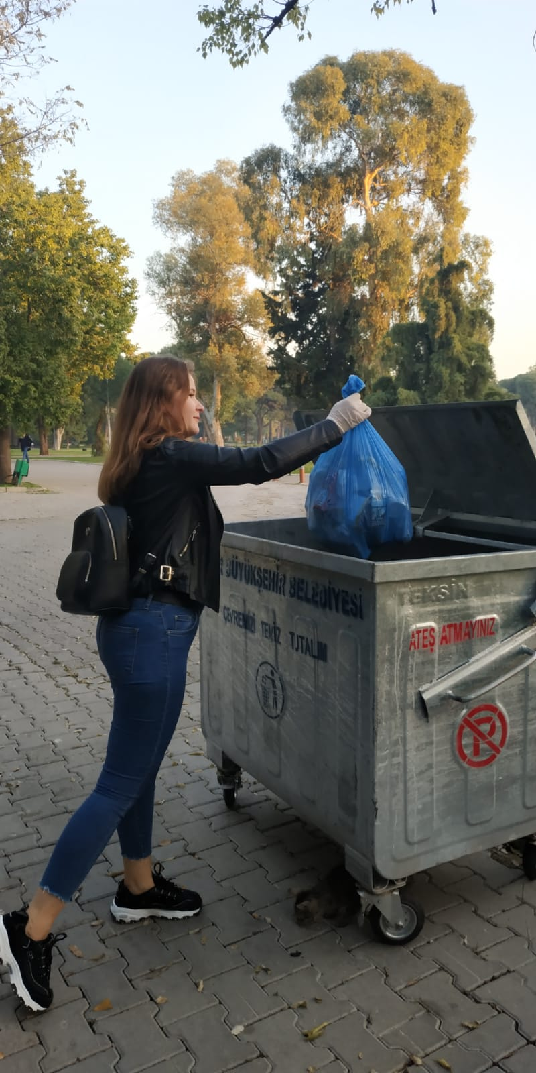
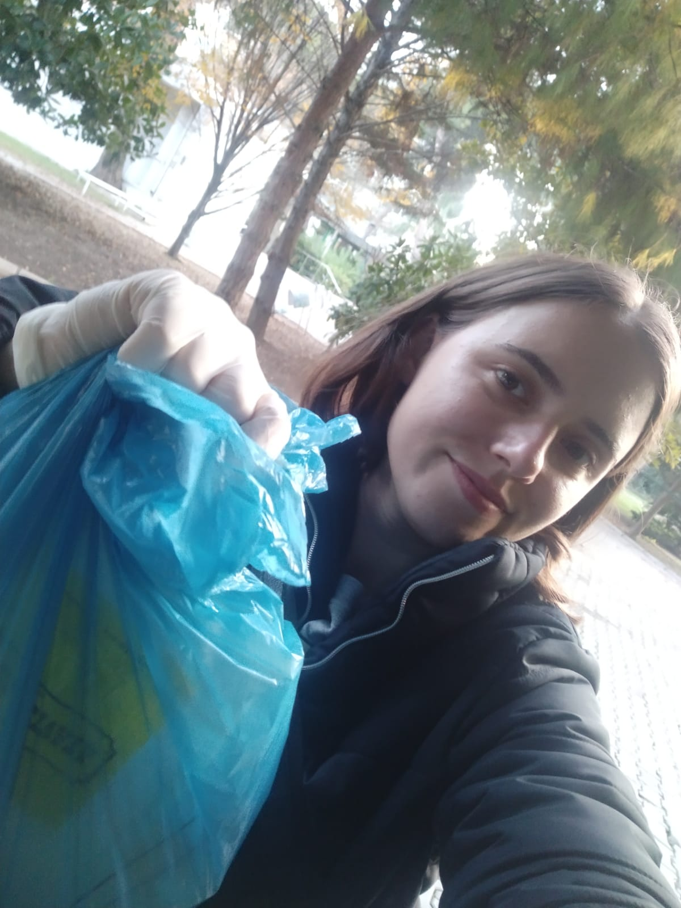

Slide 18
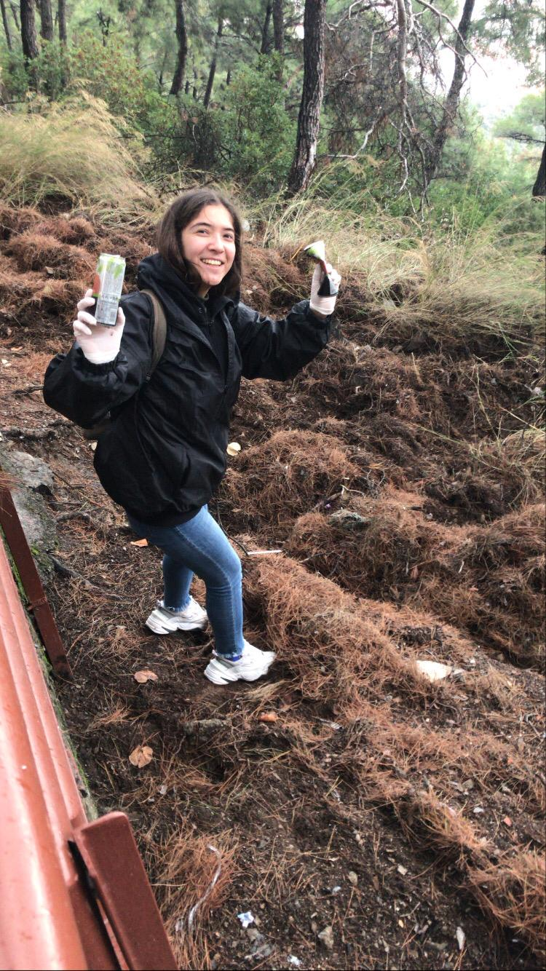
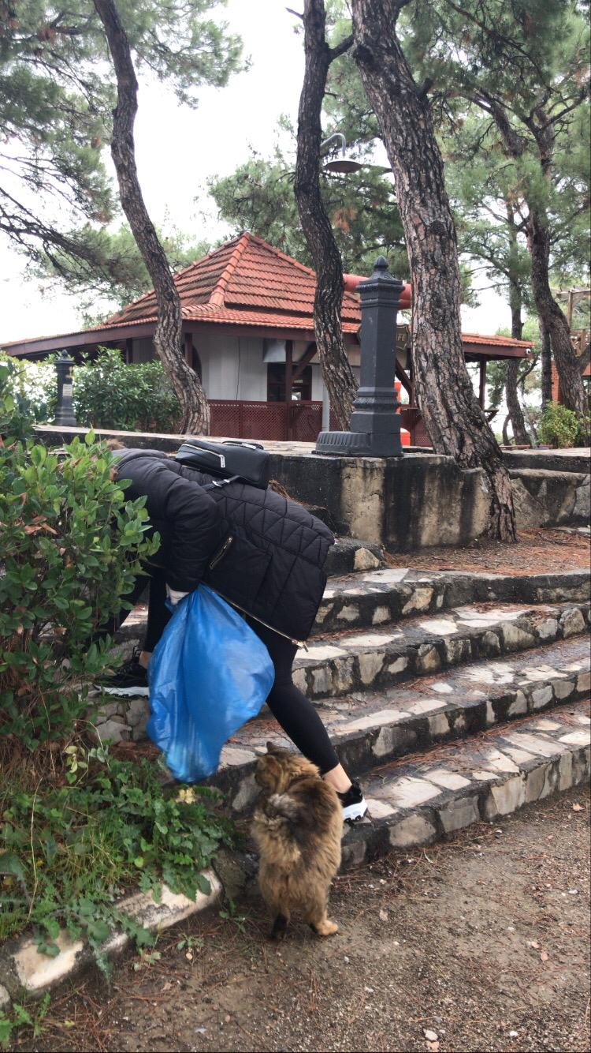

Slide 20
RESULTS
As a result, we realized that there is a low level of litter in the region where education and culture levels are high. Two of our group members were throwing cigarette butts on the floor. Thanks to the Project, our friends became more sensitive and stopped throwing their butts and garbage to the ground. We’ve noticed the difficulty of collecting garbage.

Slide 21
THANK YOU!

