Slide 1
CIBUTT

Slide 2
TABLE OF CONTENTS
Information about Project
Why This Project
Field Study
Summary

Slide 3
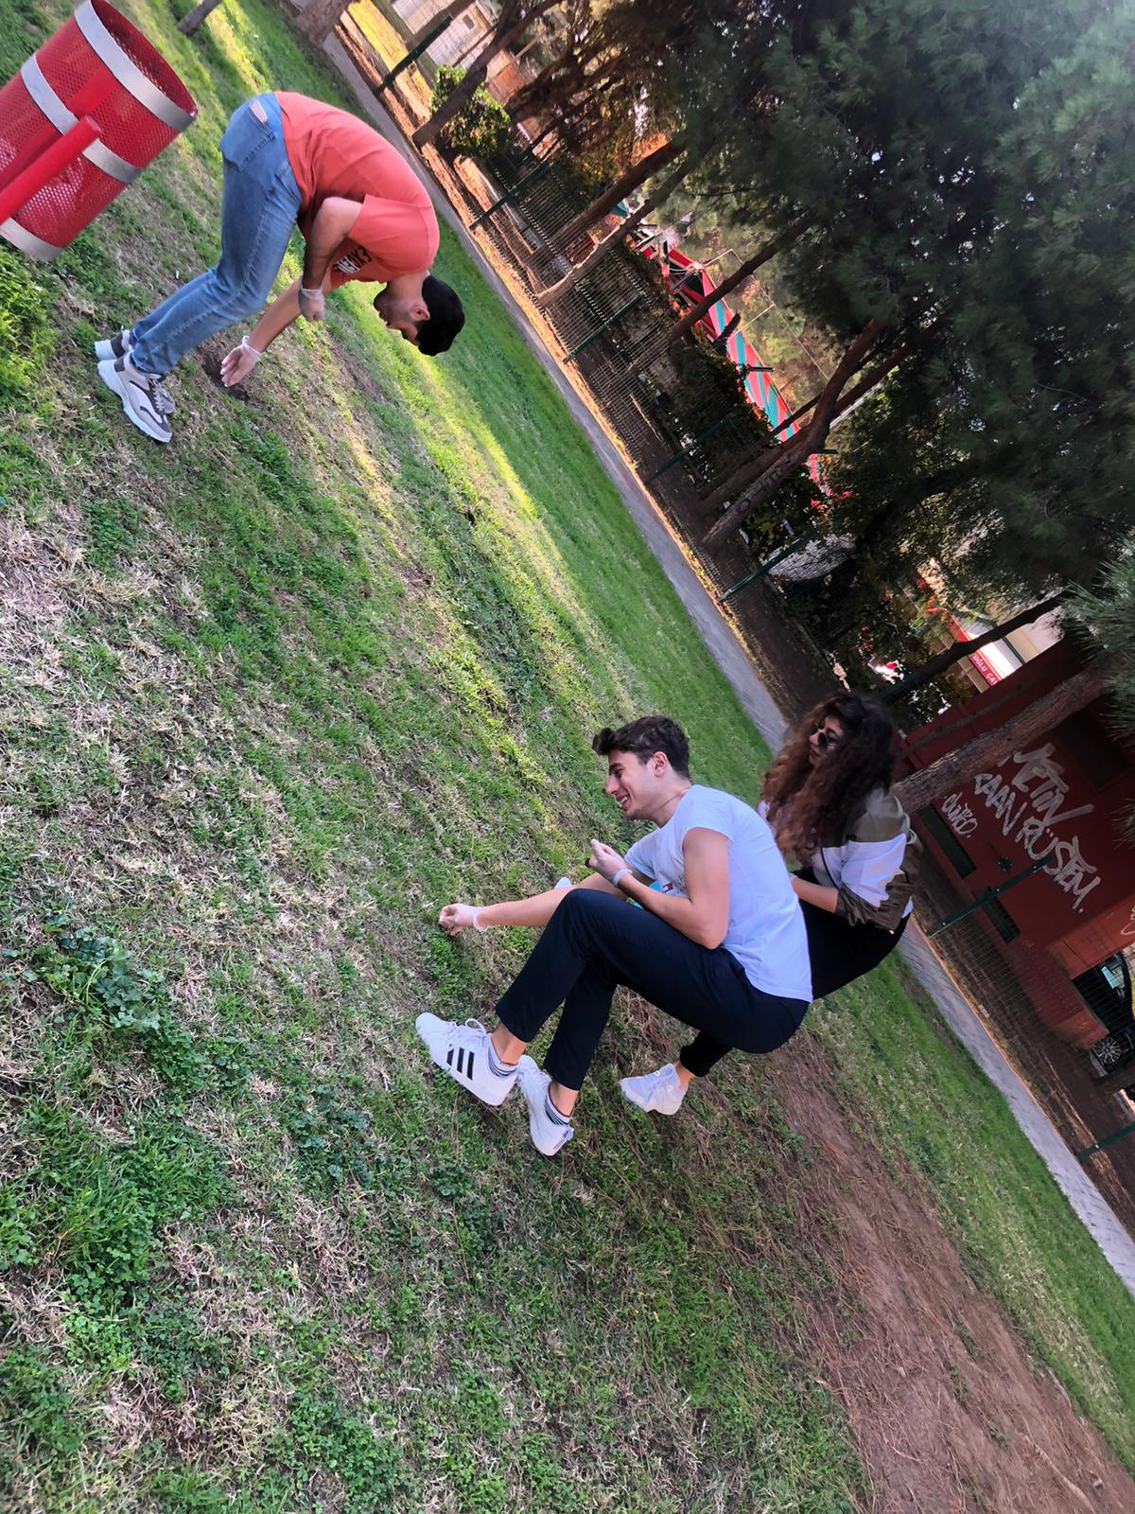
Information
The project is a project that is started for a cleaner park and the future for our children by cleaning bad materials such as butts that will give bad behavior to children in children's parks. Within the scope of the project, we collected butts from parks in certain locations in Izmir and posted posters to inform people.

Slide 4
Why this project ?
The main purpose of choosing this project was to remove the new generation from the harmful smoking habit and increases the awareness of their families.

Slide 5
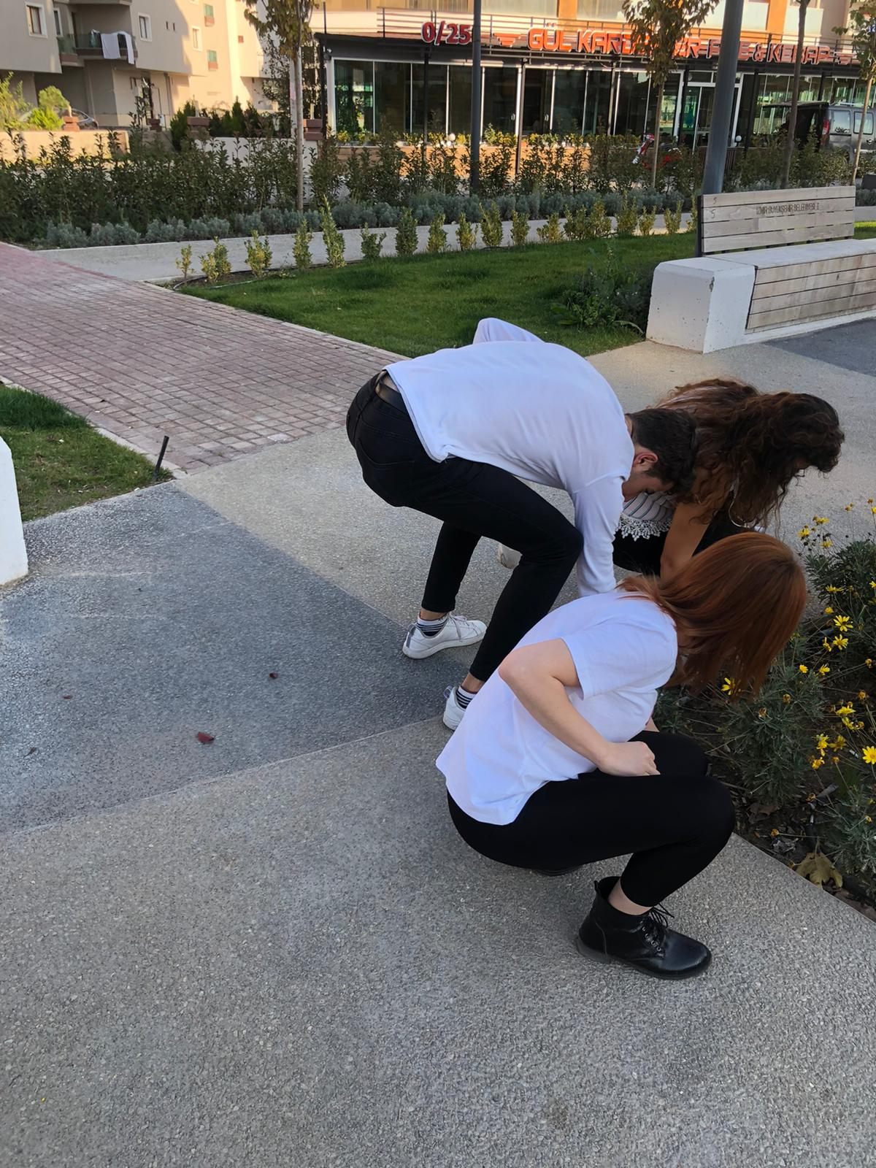

Slide 6
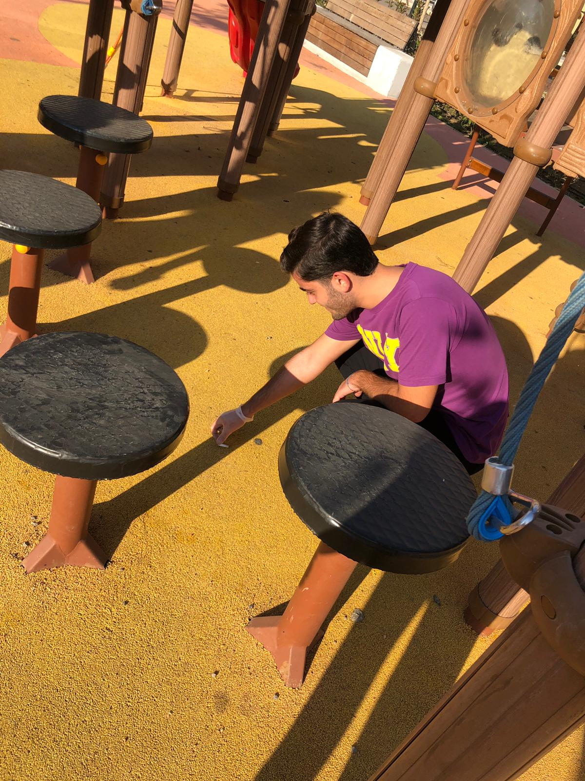

Slide 7
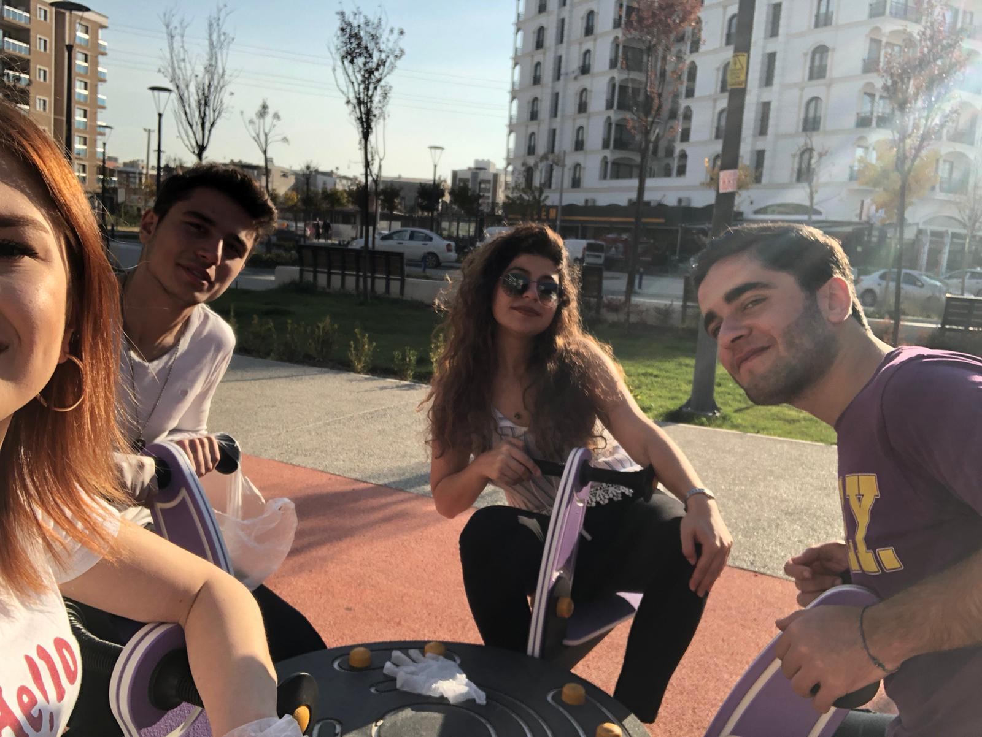

Slide 8
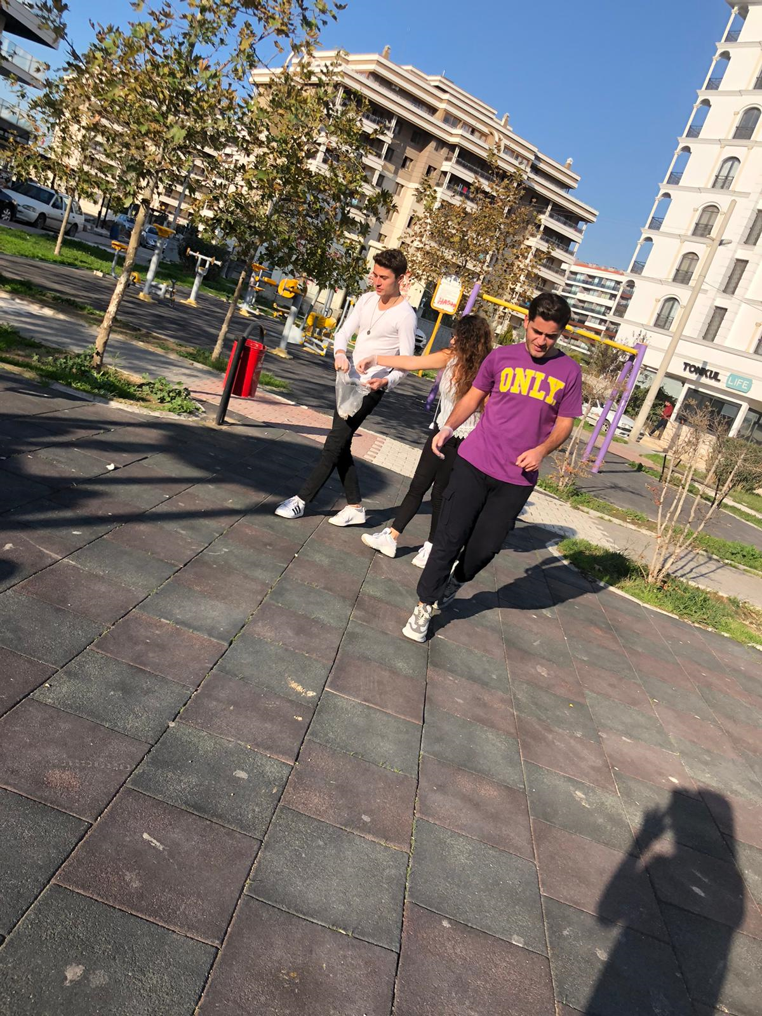

Slide 9
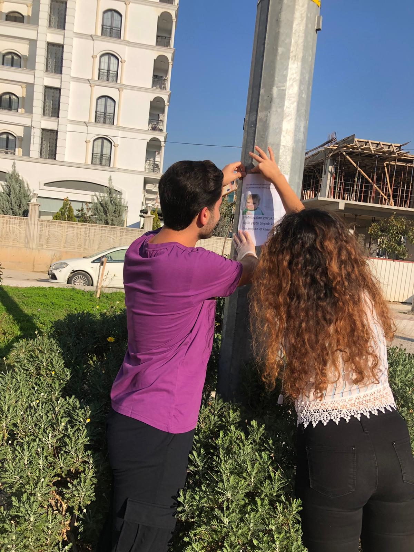

Slide 10
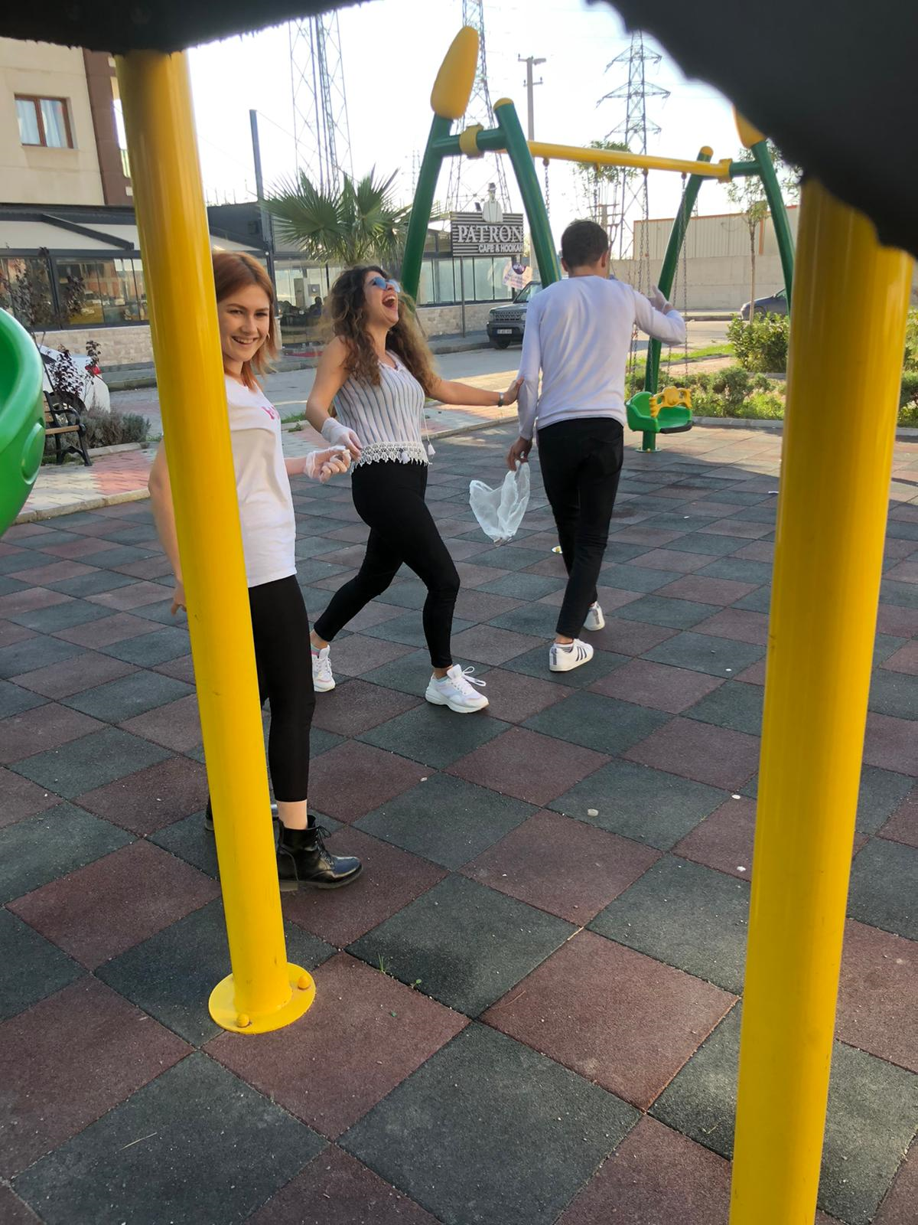

Slide 11
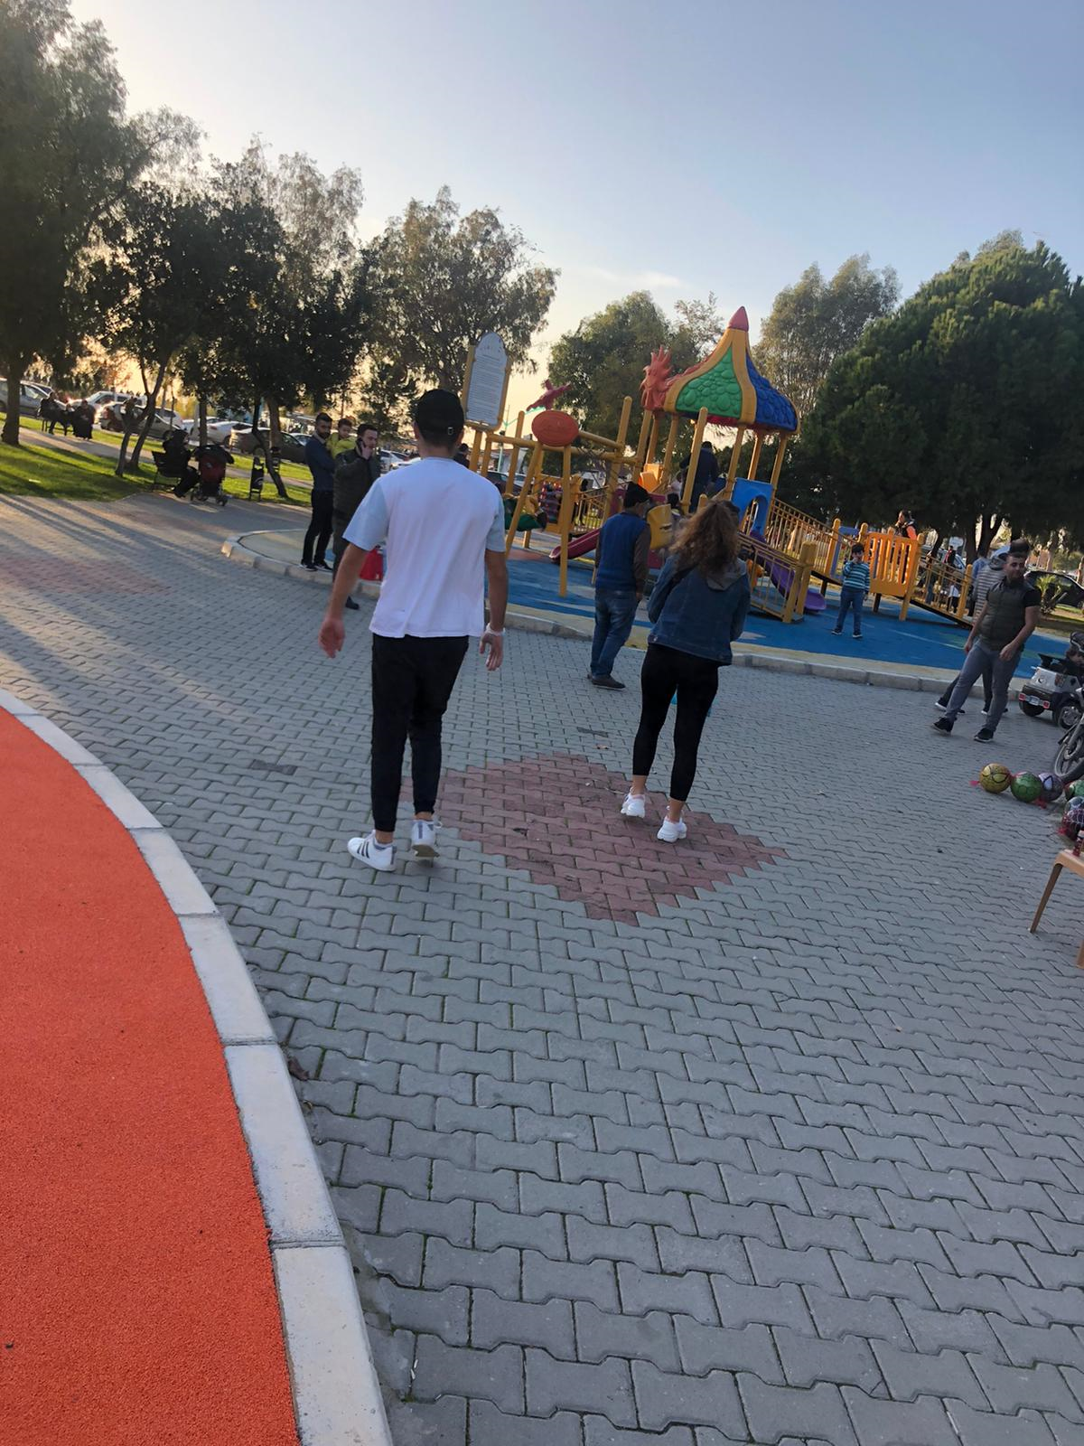

Slide 12
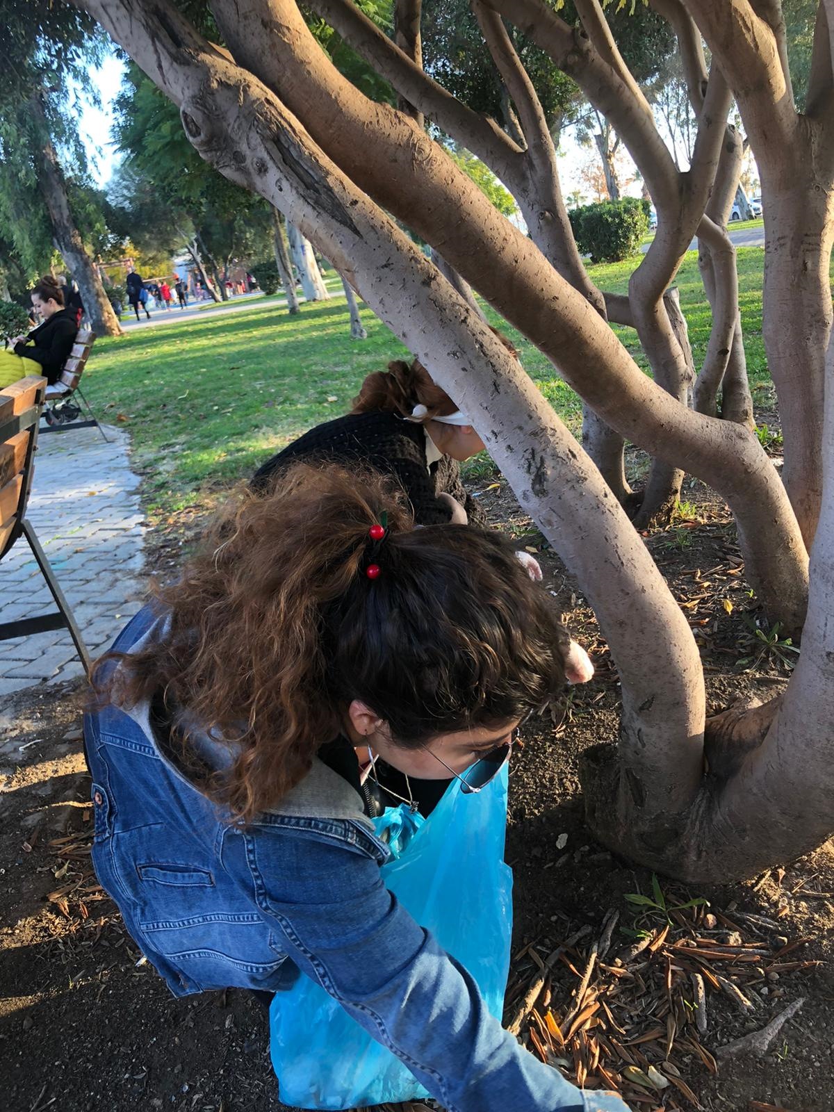

Slide 13
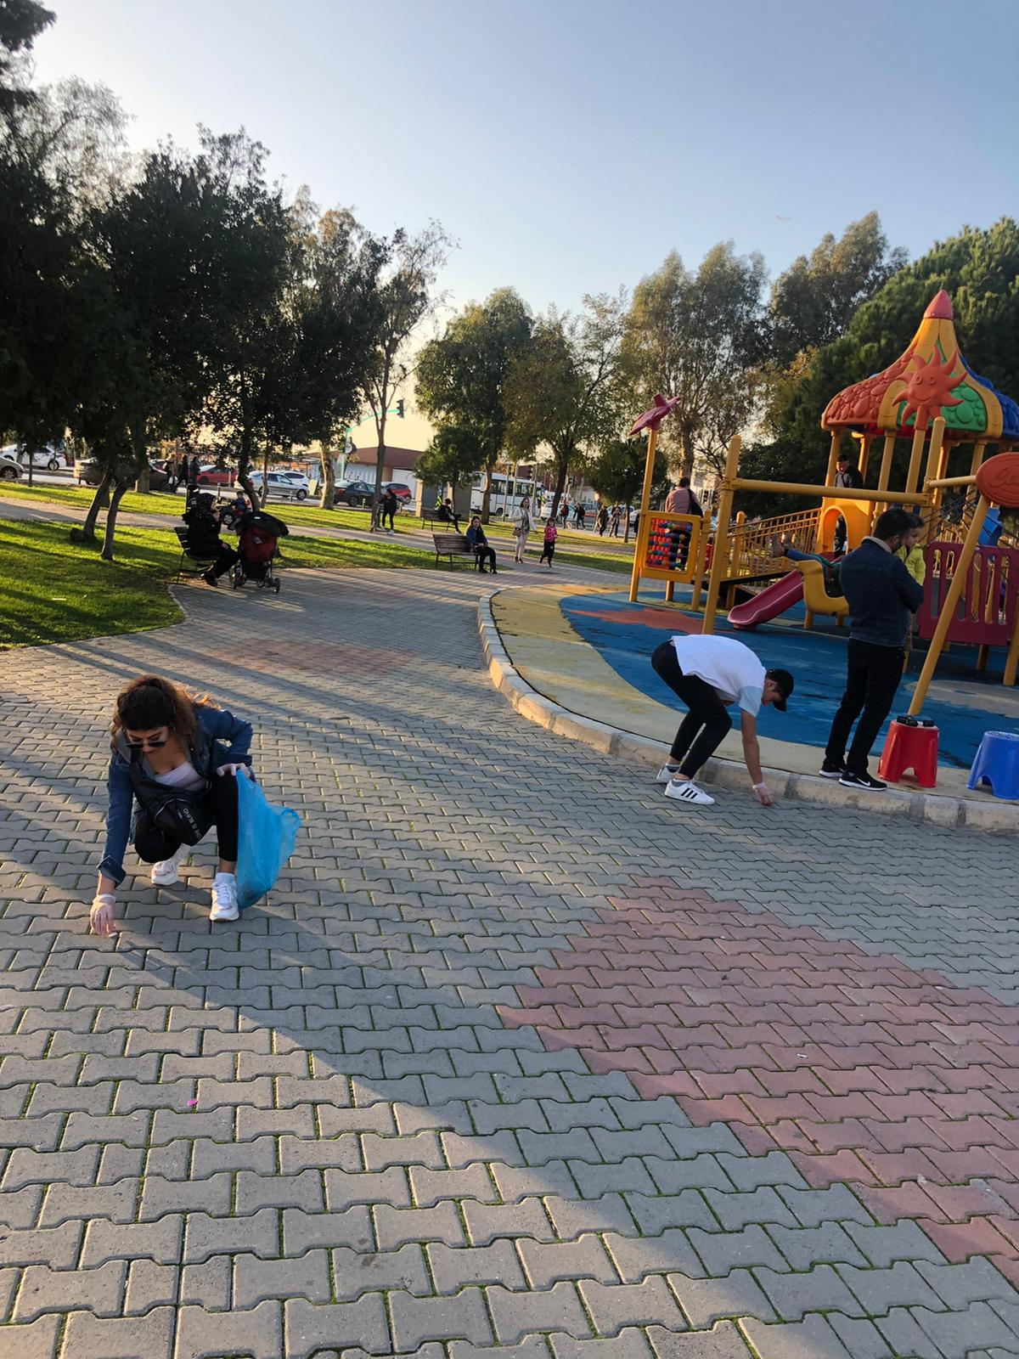

Slide 14
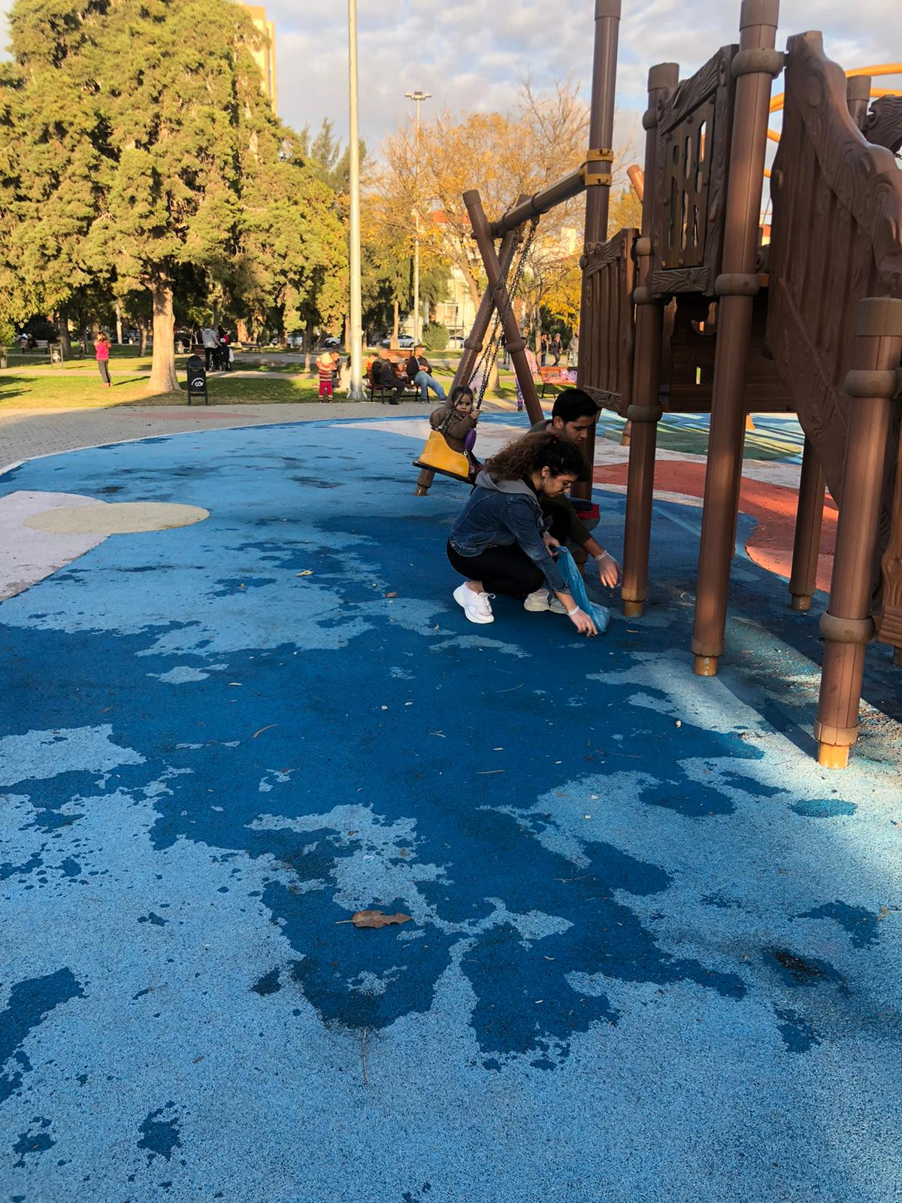

Slide 16
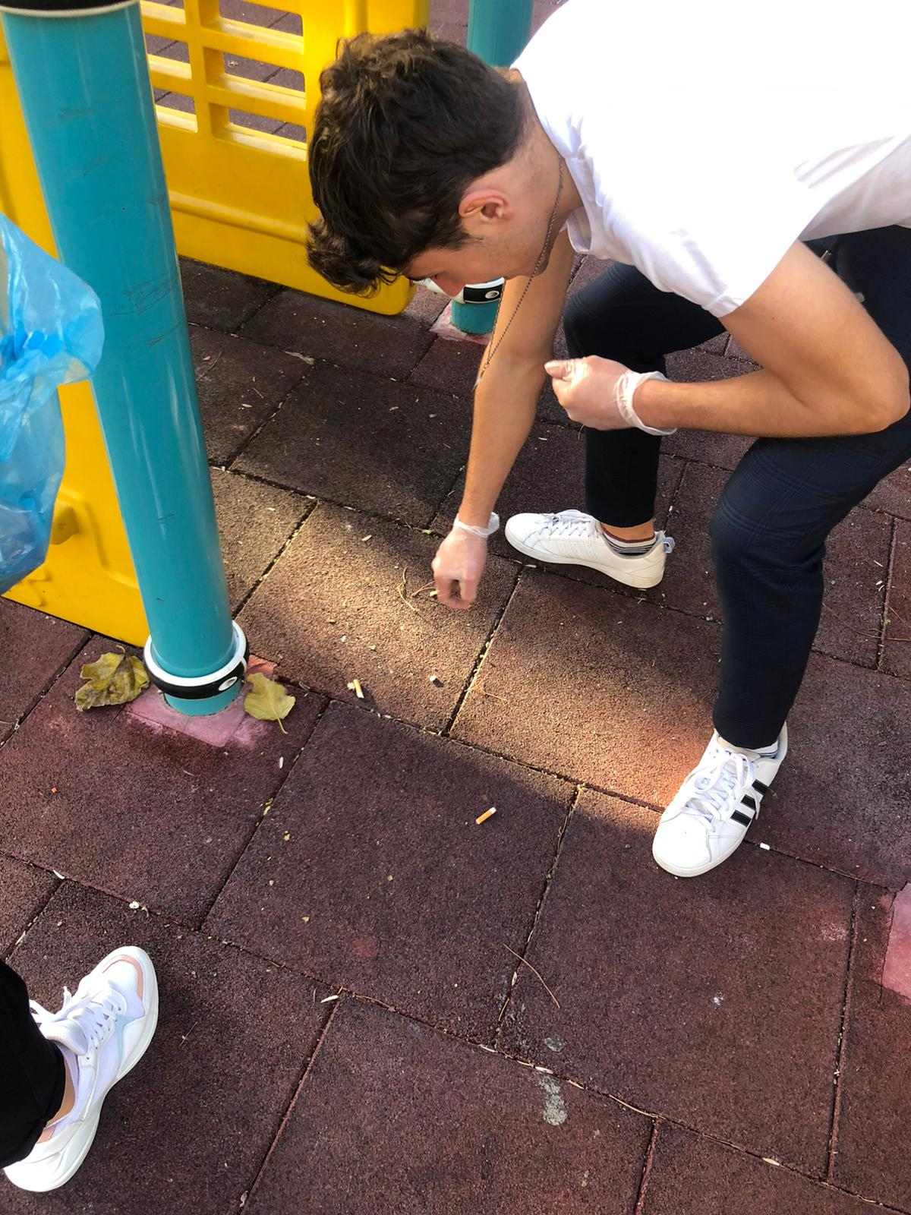

Slide 17
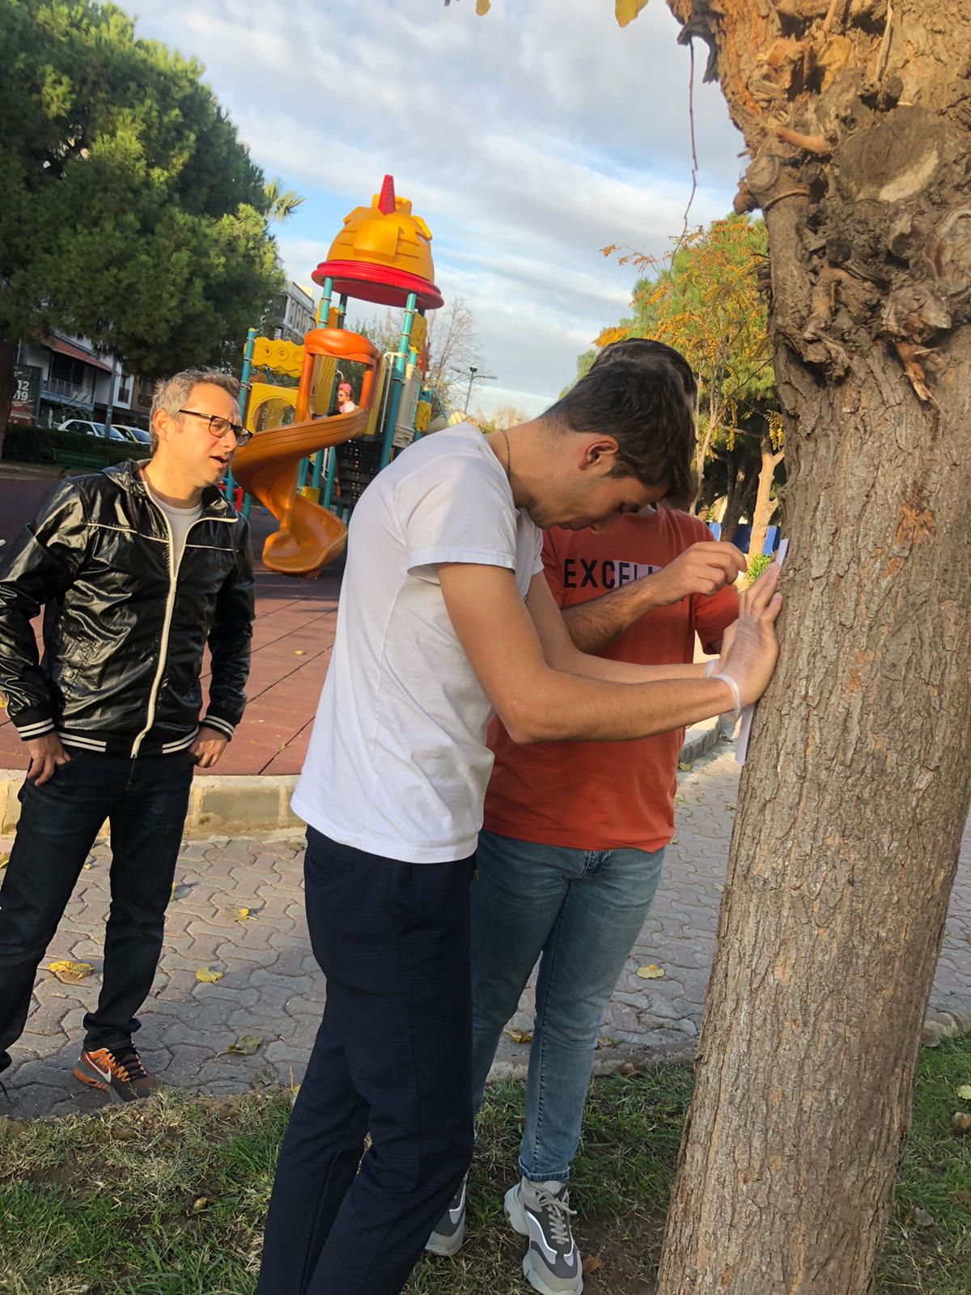

Slide 18
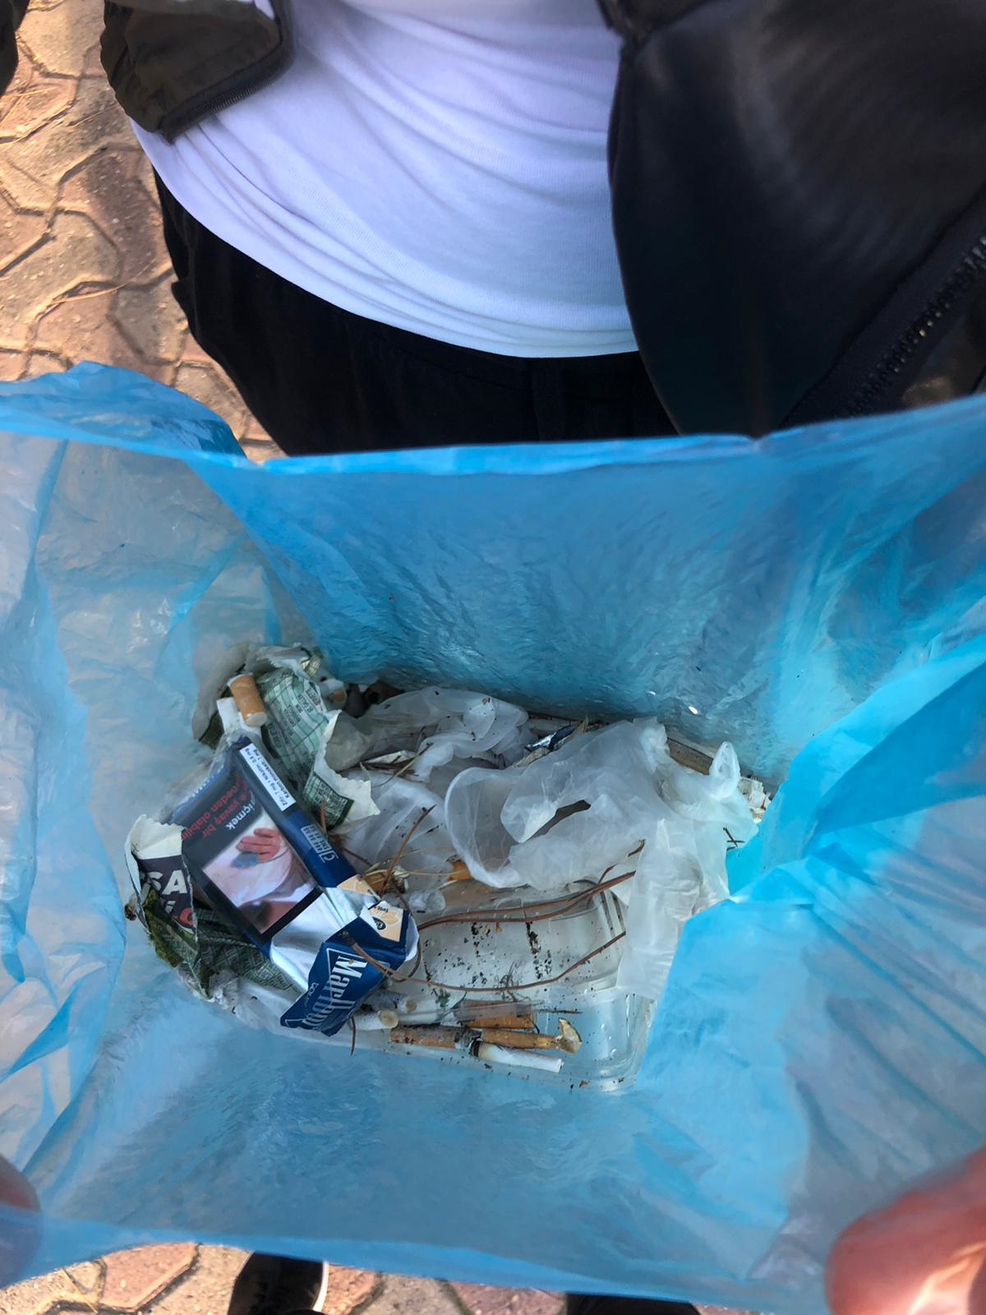

Slide 19
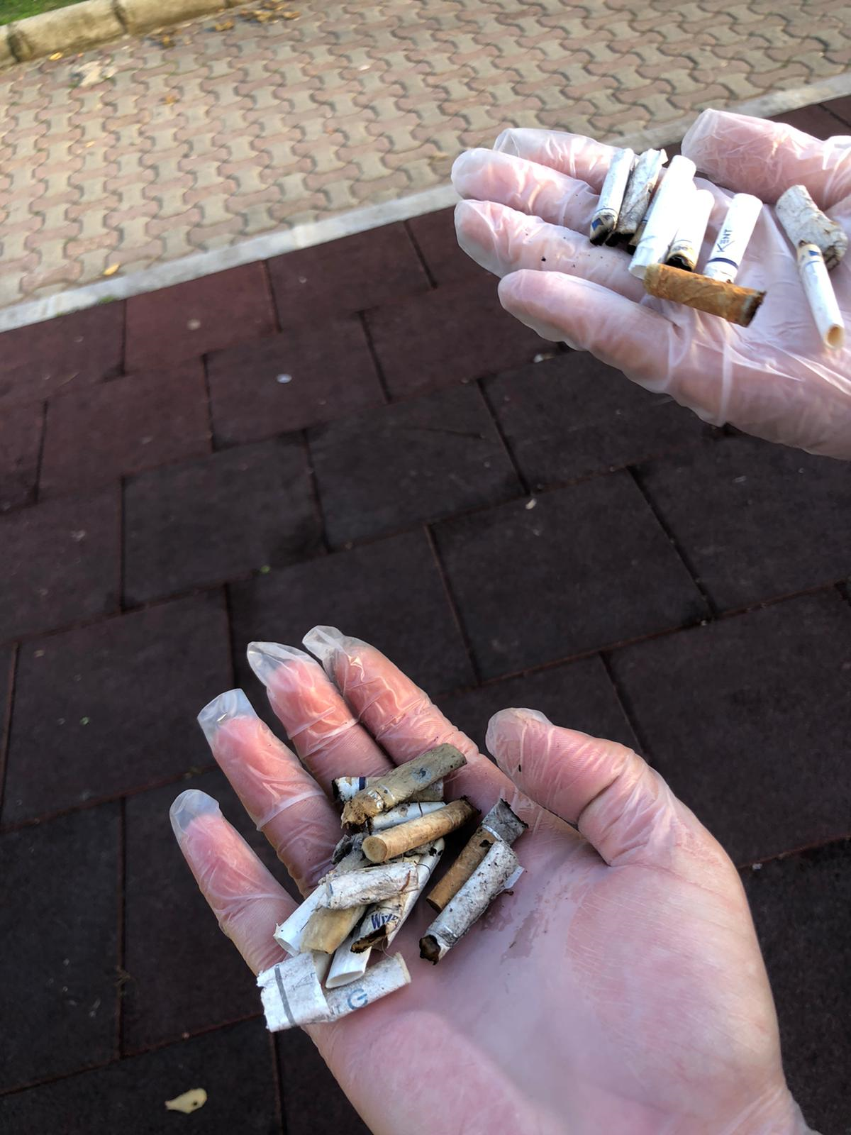

Slide 20
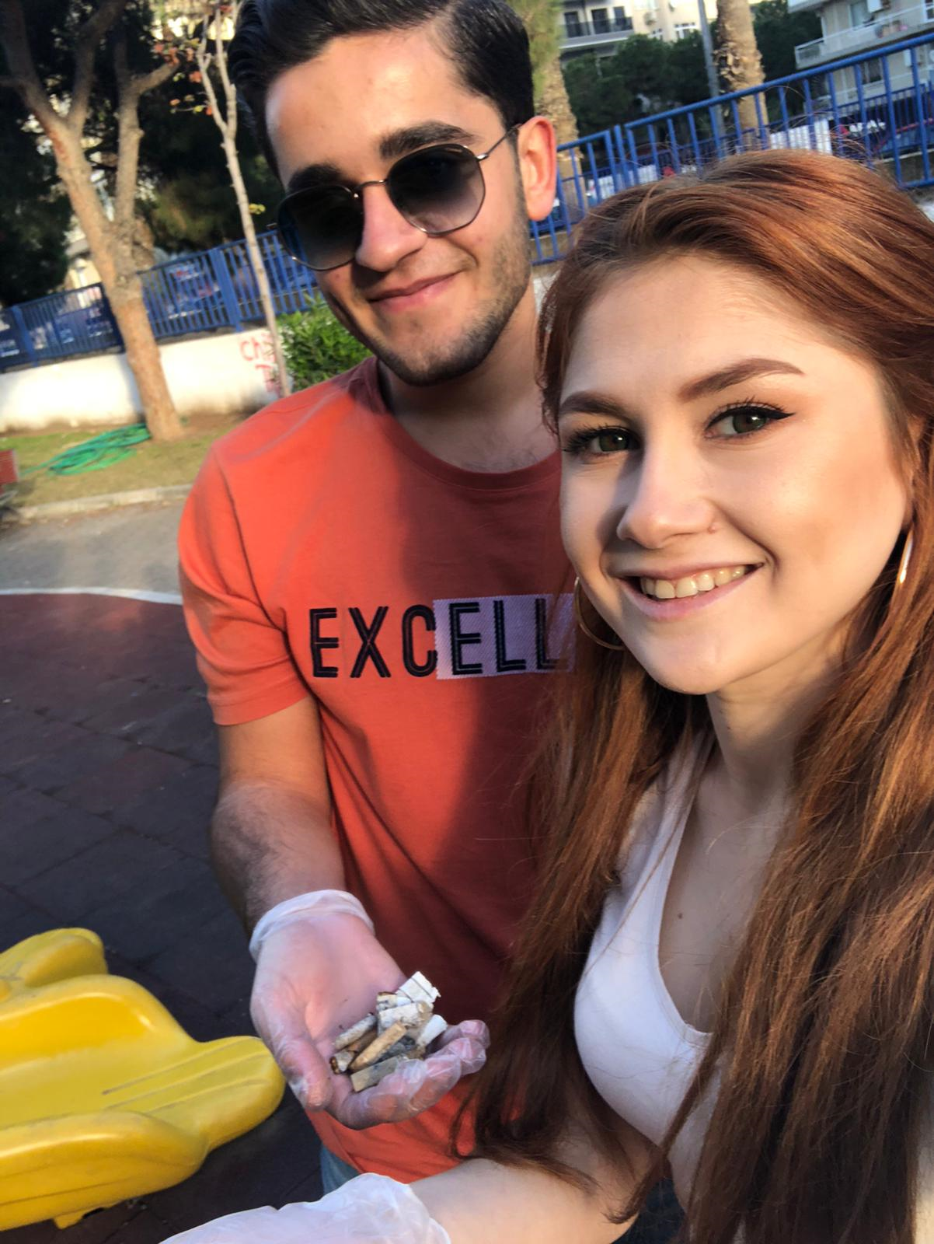

Slide 21
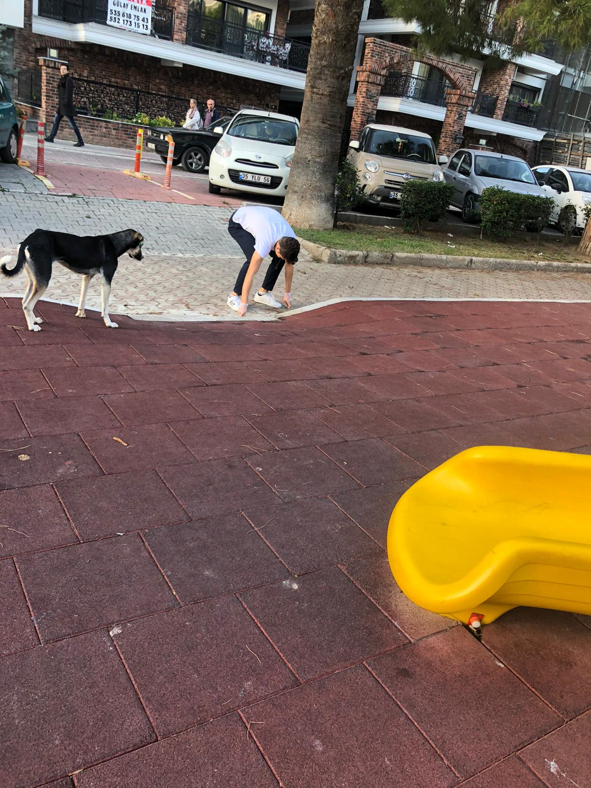

Slide 22
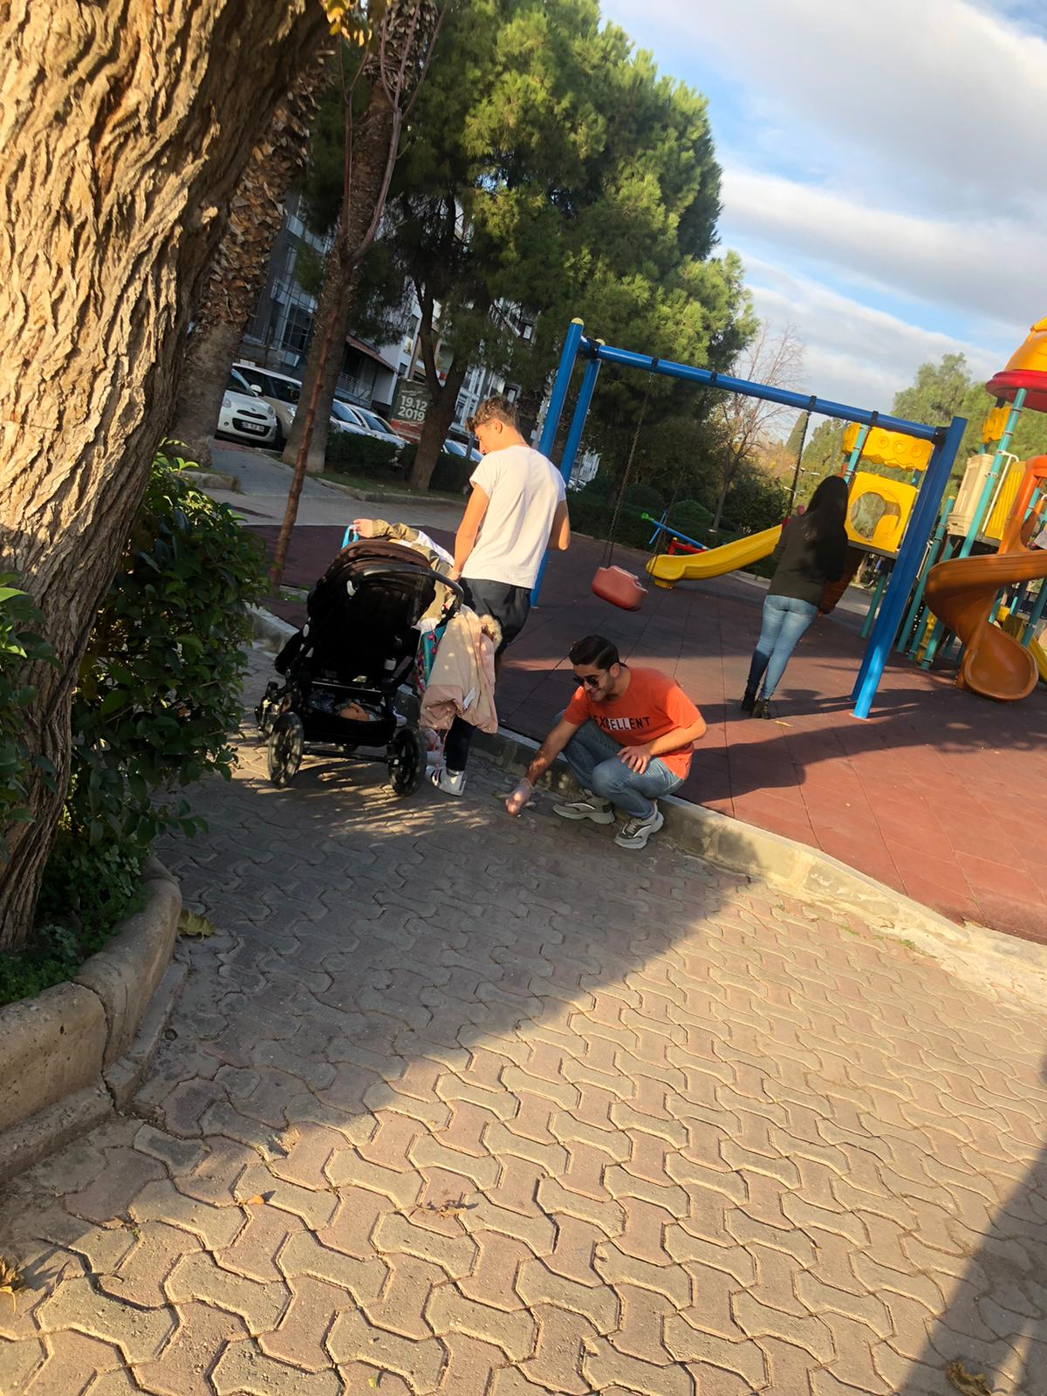

Slide 23
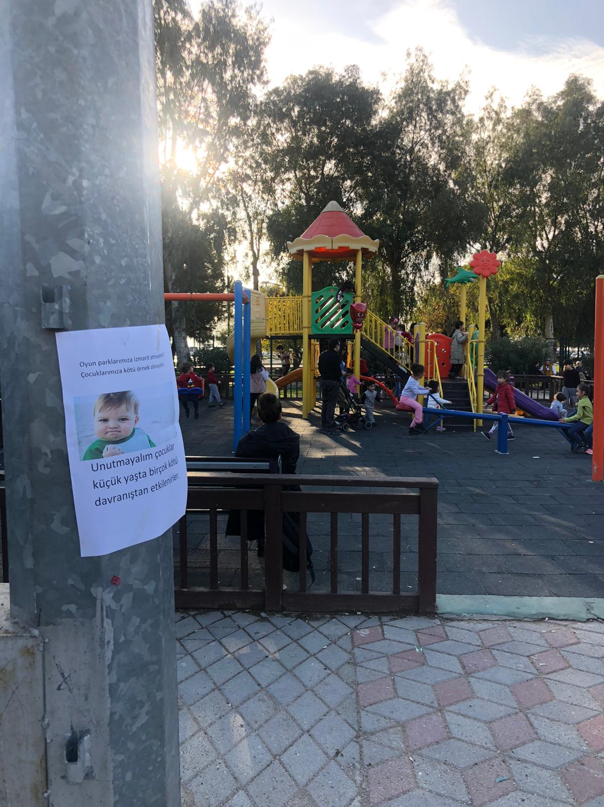

Slide 24
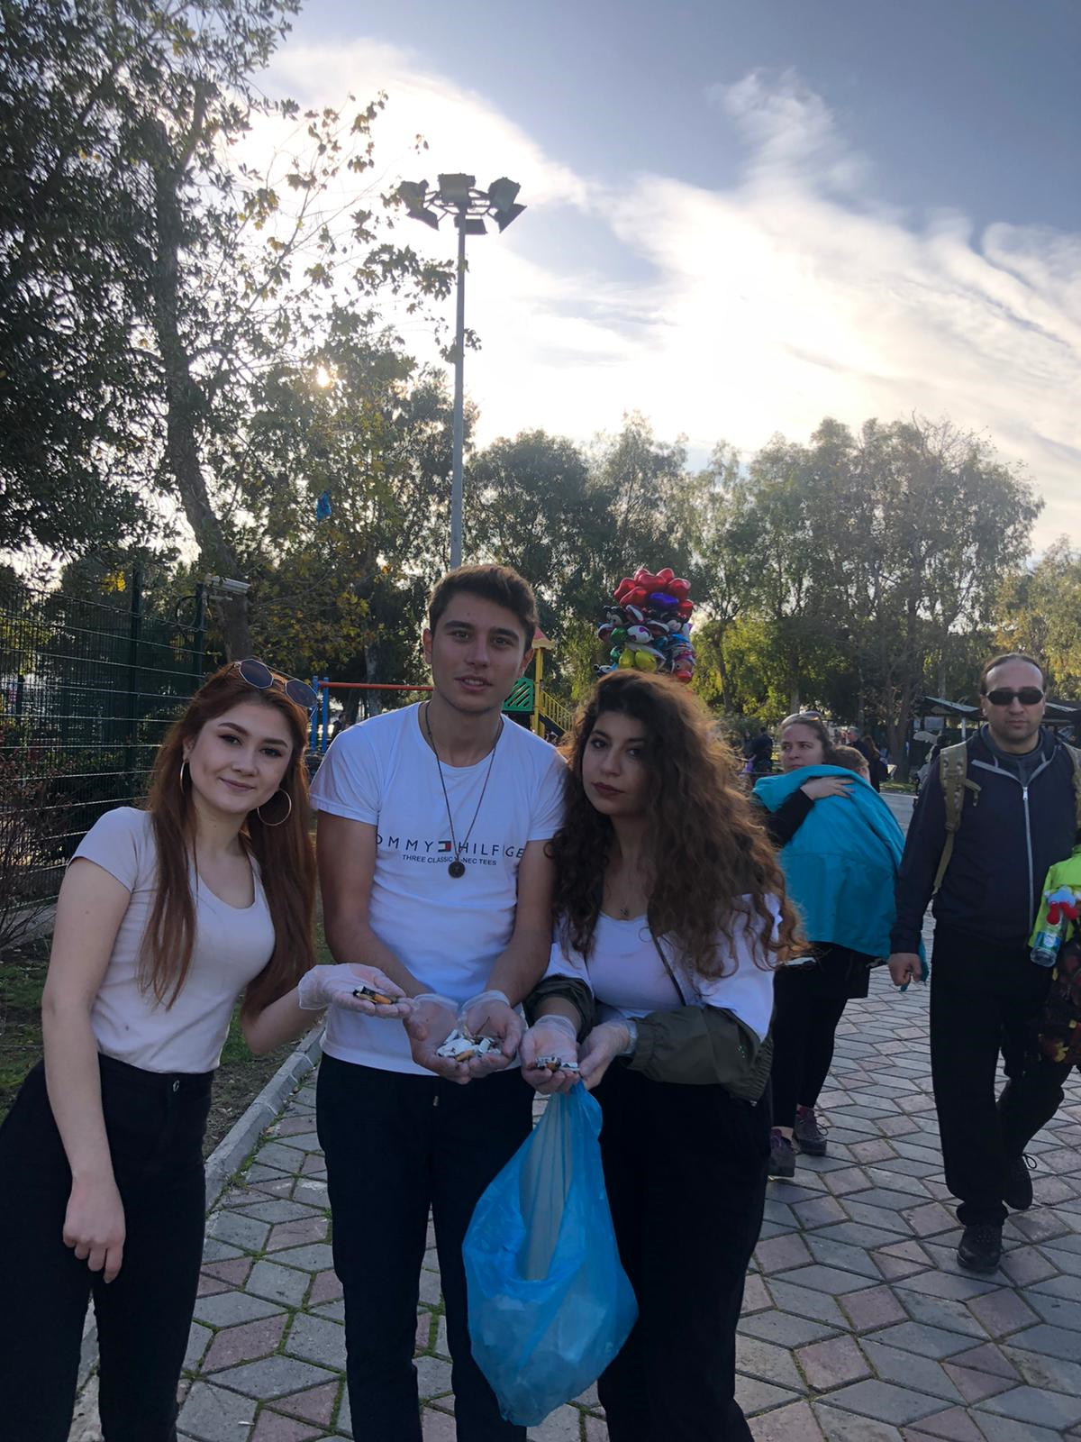

Slide 25
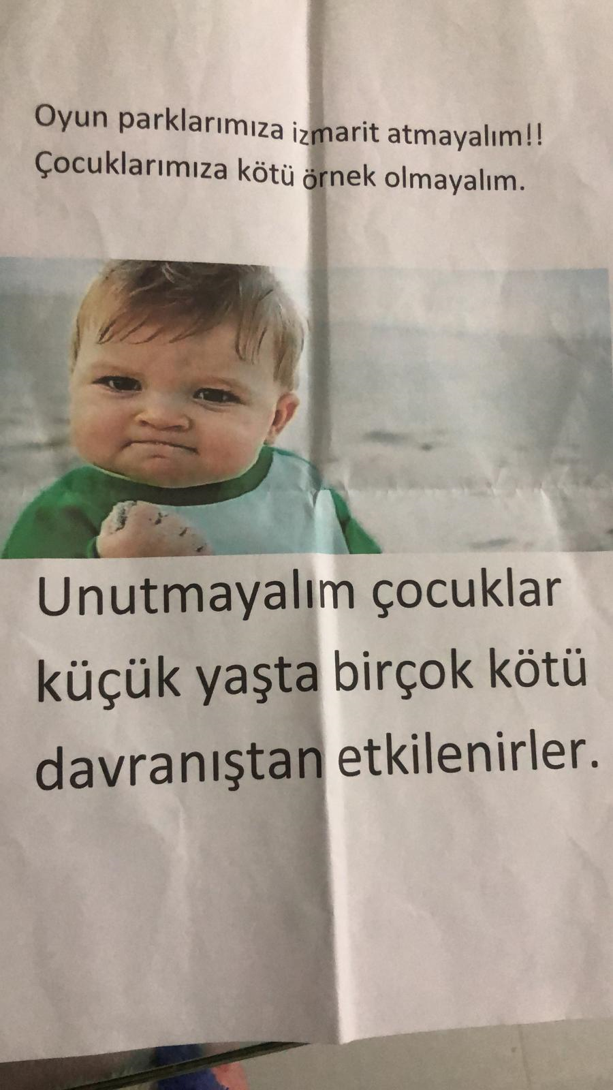

Slide 26
SUMMARY
As a result of the project:
We have cleaned our parks and we think that we will leave a cleaner park and more knowledgeable people for our future children. When the fieldwork of the project was completed, we found fewer butts in the parks where we went to check, but some posters we hung were dismantled and thrown away.

Slide 27
THANKS FOR WATCHING
Ensar ÖZDENIZER
Edanur ÖZYILMAZ
Hülya TURAÇ
Yusuf KARA

