Slide 1
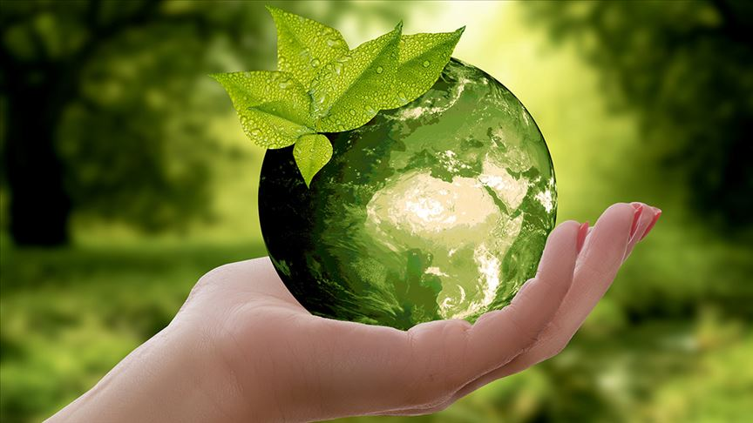
CLEAN ENVIRONMENT CLEAN FUTURE

Slide 2
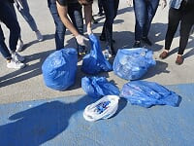
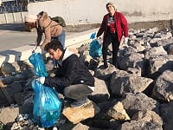
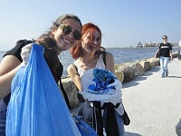
CONTENT
WHO ARE WE ?
PROJECT TEAM
WHAT’S THE AIM
IMPORTANCE OF ENVIRONMENTAL CLEANING
HOW DO WE CLEAN THE ENVIRONMENT?
WHERE DID WE CLEAN THE ENVIRONMENT?
CLEANED BEACHES WITHIN THE SCOPE OF THE PROJECT
RISKS AND MANAGEMENT
RESULT

Slide 3
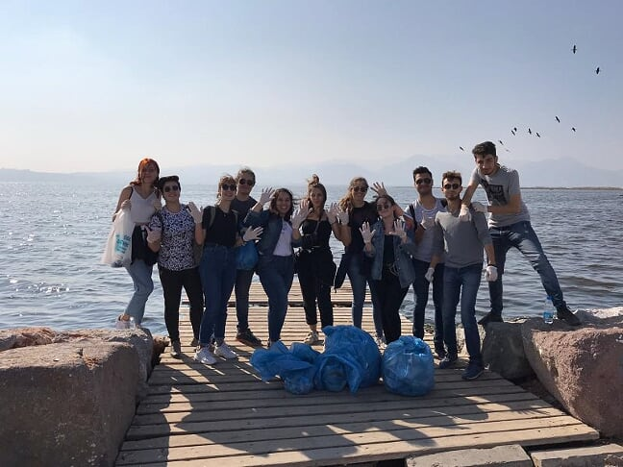
WHO ARE WE ?

Slide 4
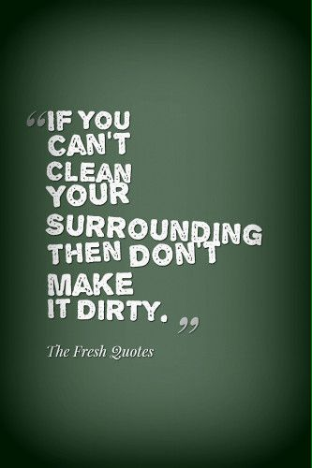
We are an environmental group established to increase public awareness about minimizing environmental pollution and disposing of waste in the right place.
This group was formed by the students of İzmir Katip Çelebi University Gastronomy and Culinary Arts 2nd grade students under the name of Social Responsibility course.

Slide 5
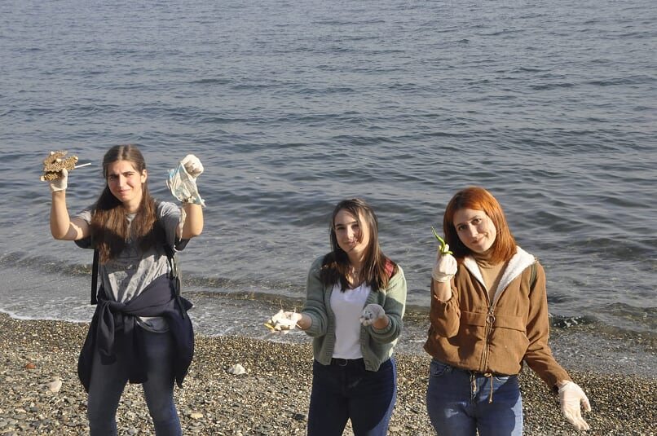
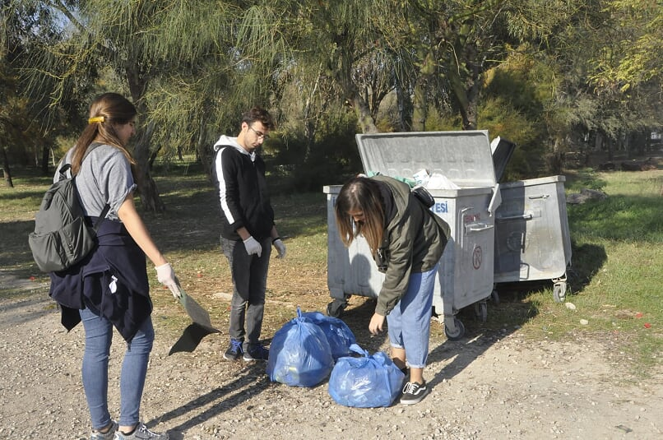
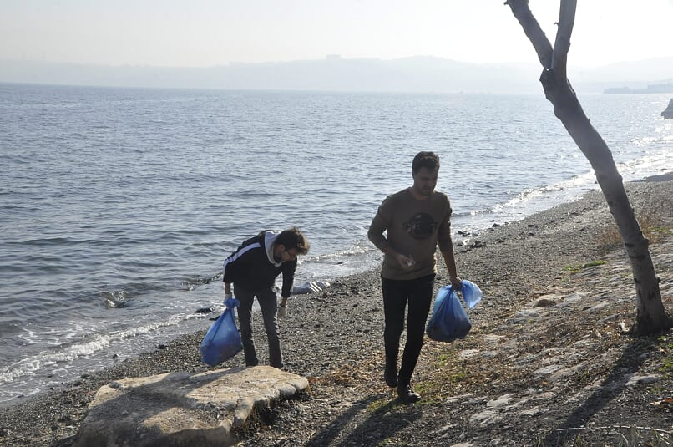
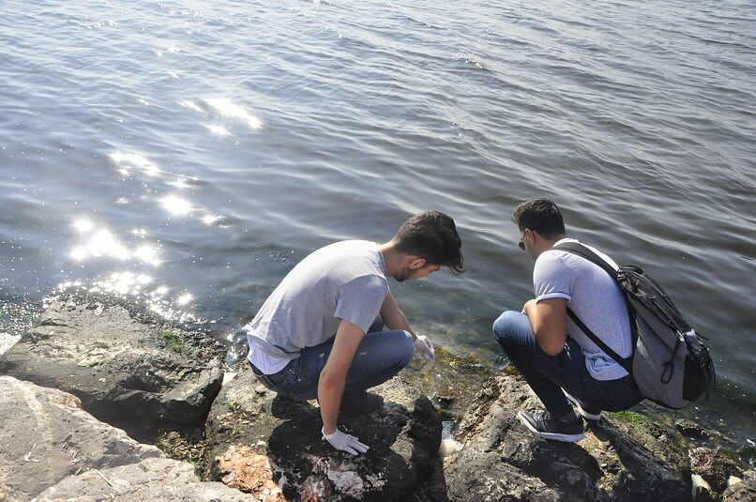

Slide 6
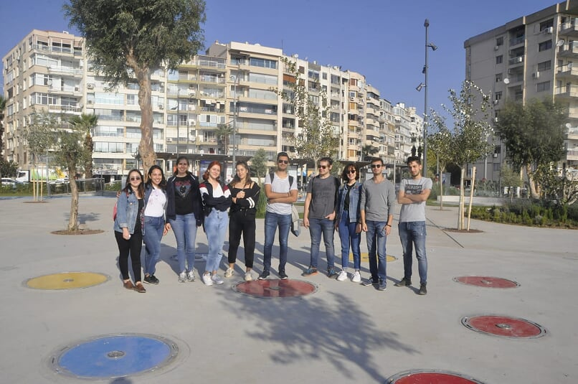
PROJECT TEAM
-AYSU TÜRKMAN ( plastic waste)
-BERİVAN ERİNCİK ( metal waste)
-BURCU SARITAŞ ( plastic waste)
-YAŞAR ASU TABANLI (plastic waste)
-AHMET HAMDİ NOGAY( plastic waste)
-İSMAİL AKGÜNDÜZ (out fitter)
-ZEHRA ÖZDOĞRU (paper waste)
-AYBÜKE GALİMANE ( take video and photos)
-BERKAY KINIK (plastic waste)
-SONGÜL AKÇAY( preparing report and power point)
-NAŞİDE TAŞDELEN ( metal waste)
-MUHAMMED BARAN ATİZ ( out fitter)
-KAMİLE GÖKÇE ŞENGÜL ( preparing report and power point)

Slide 7
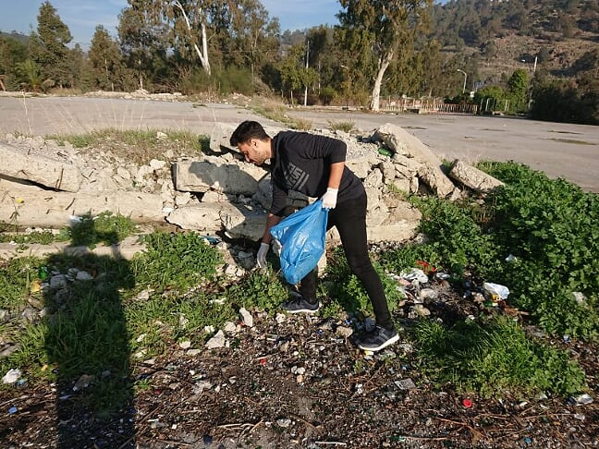
WHAT'S THE AIM?

Slide 8
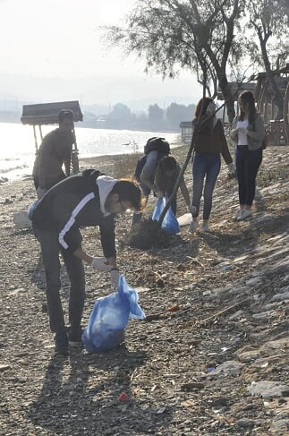
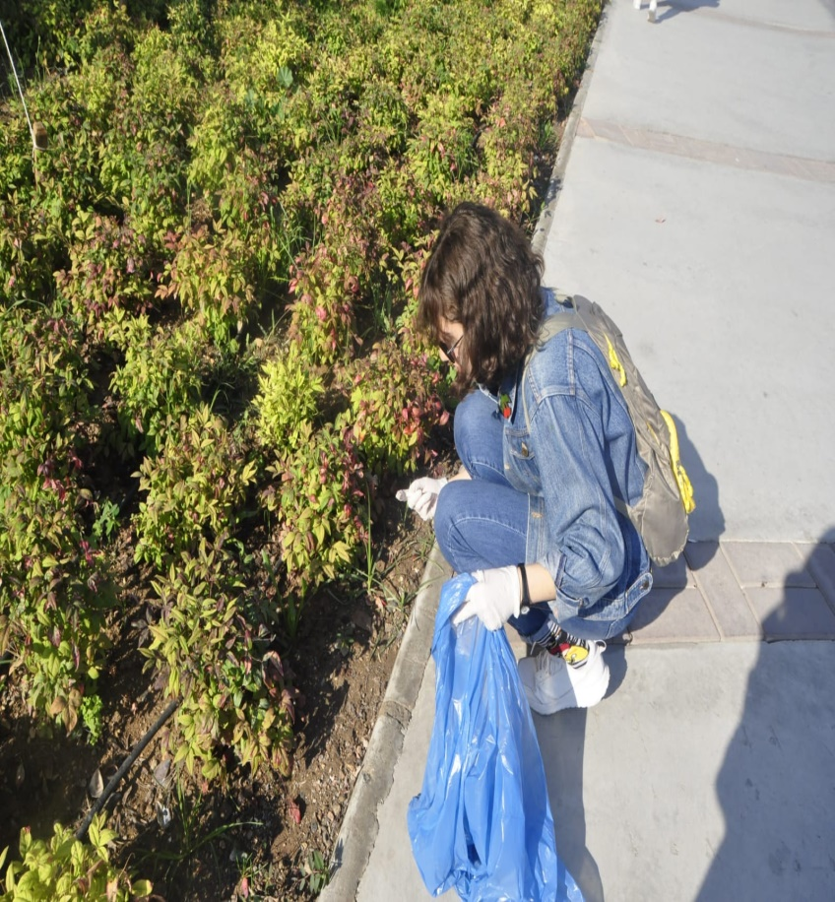
Volunteer team work to ensure the cleanliness of the coastal areas in Izmir.

Slide 9
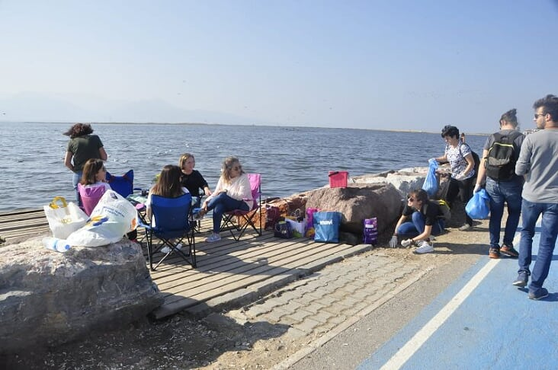
To raise awareness of people who benefit from the common public environment and to contribute to their behavioral transformation.

Slide 10
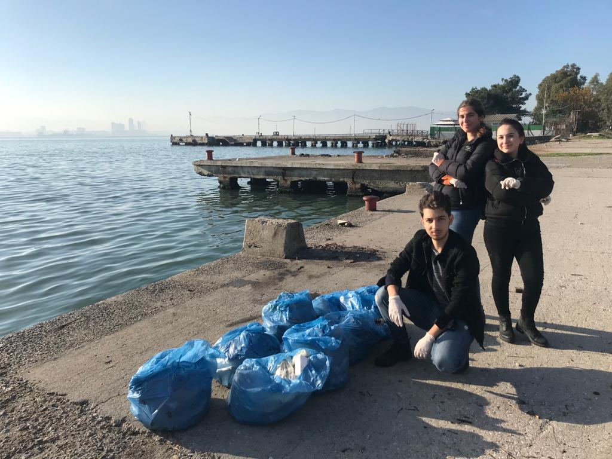
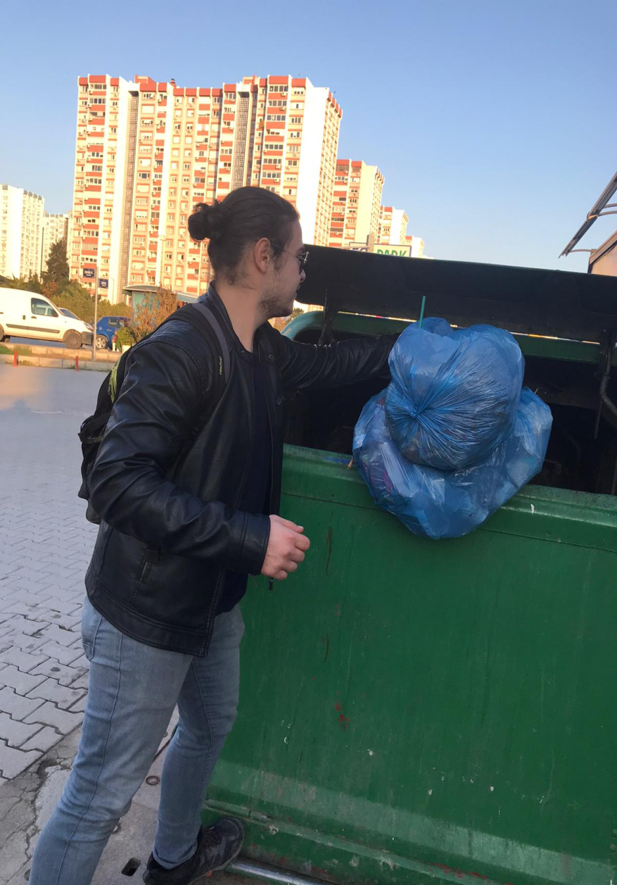
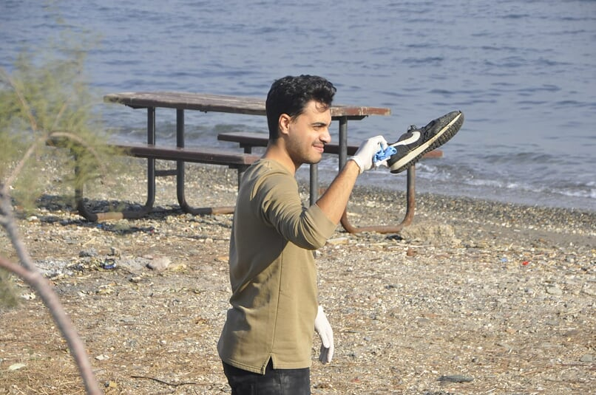

Slide 11
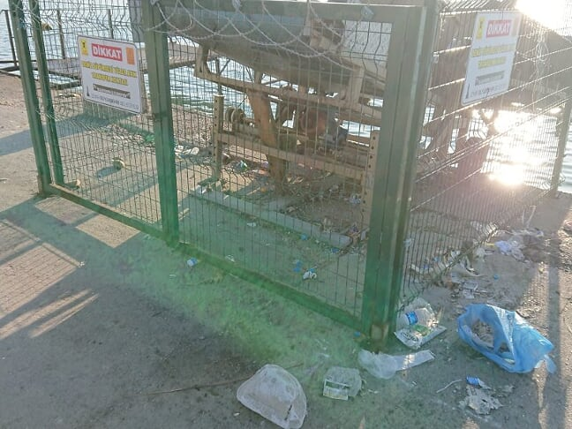
IMPORTANCE OF ENVİRONMENTAL CLEANİNG
Environment is the area where human beings and other creatures maintain their relationships throughout their lives.
The right to the environment is one of the fundamental human rights. Constitution 56.Md.

Slide 12
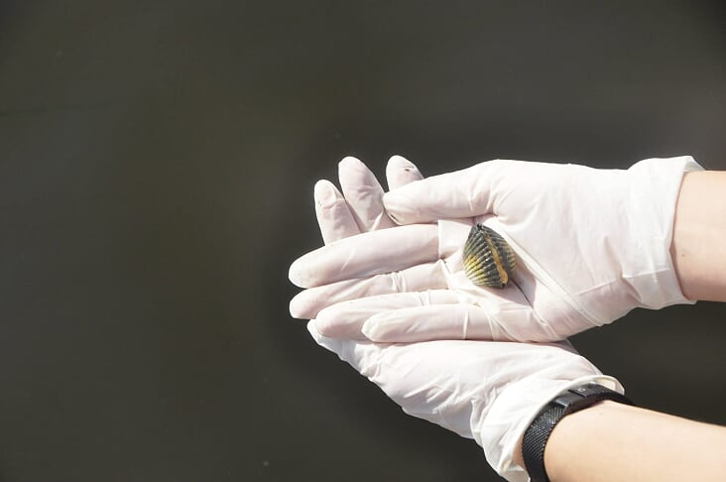
Approximately 2.2 billion tons of garbage is produced every year in the world and most of them is left to the environment instead of being sent for recycling.
We contribute to both the society and the environment by separating the garbage we collect during our field work.

Slide 13
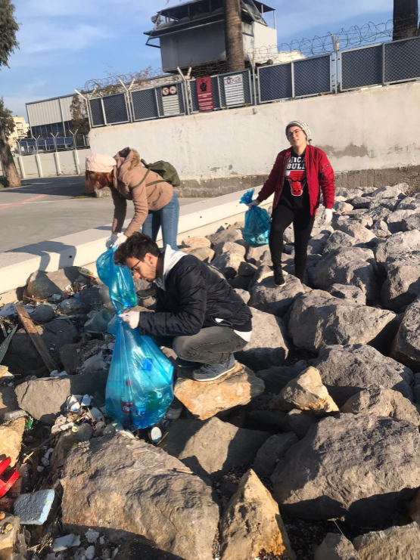
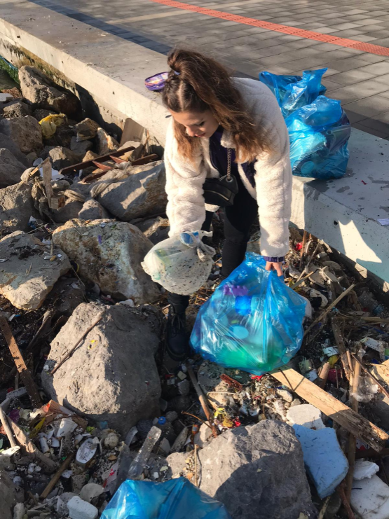
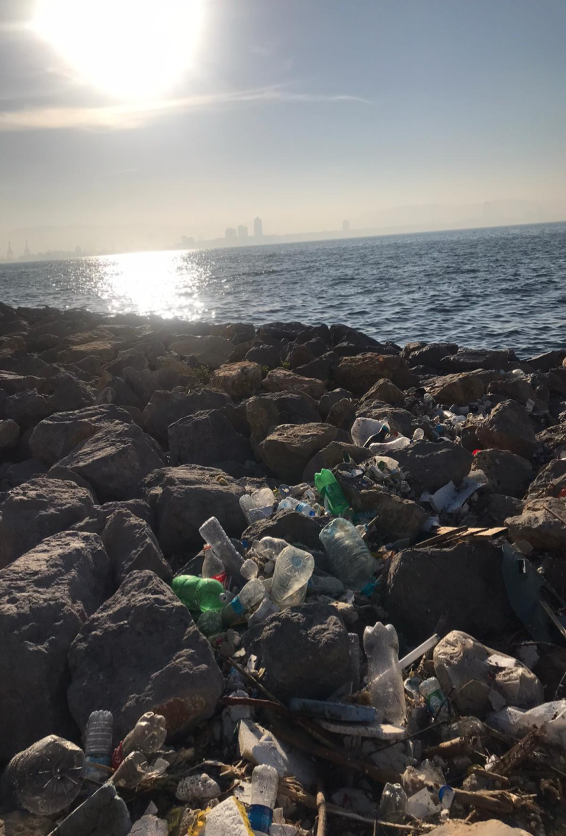
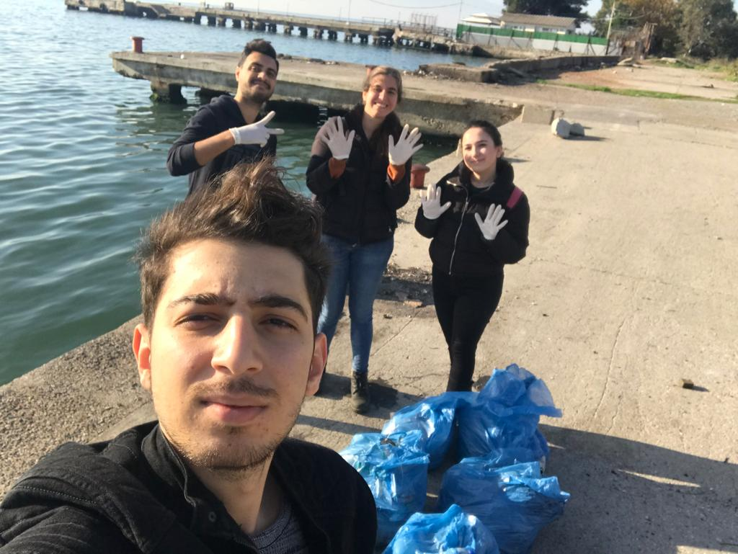

Slide 14
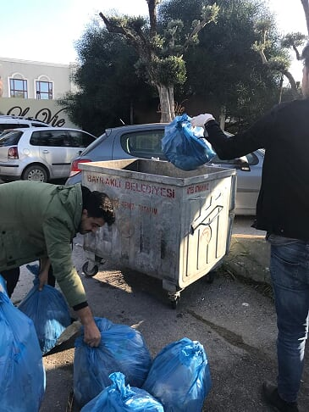
HOW DO WE CLEAN THE ENVİRONMENT?
After determining the area to be cleaned, if possible, we inform the local government where this area is connected, and learn the container or collection points where we can dispose of the garbage we will collect.

Slide 15
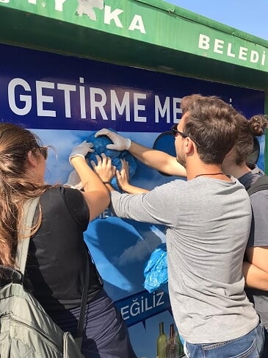
We use gloves for hygiene.
We do not touch cutting and hazardous materials such as glass and sharp-edged metals.

Slide 16
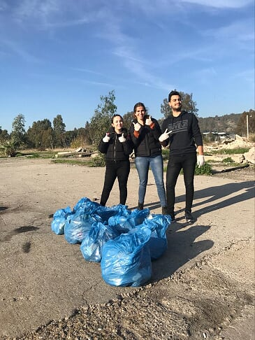
We do not touch organic wastes, food residues, which may pose a hygiene hazard, and we do not collect other wastes mixed with them.
We collect the garbage by tightly closing the mouth of the bags, throwing them into the nearest garbage containers or putting them in the place the municipality shows us. We never leave these bags in the field.

Slide 17
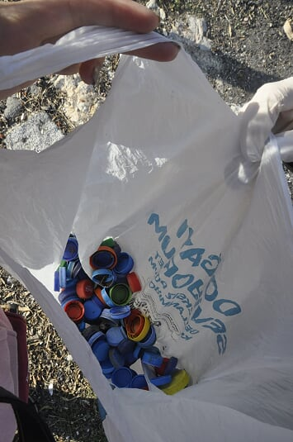
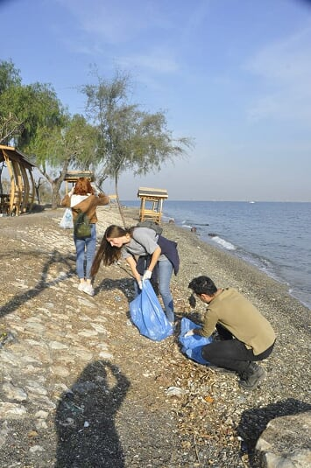
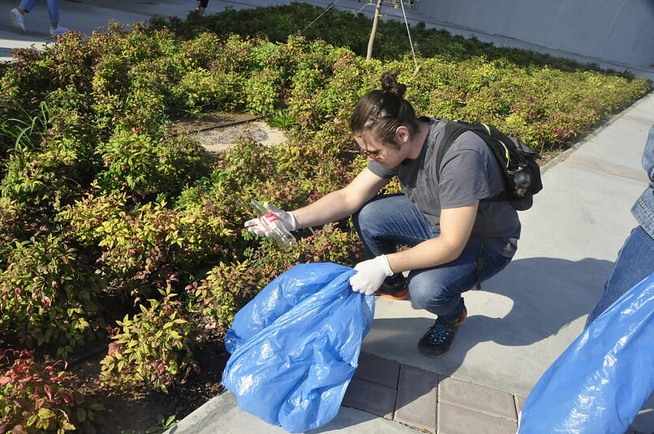

Slide 18
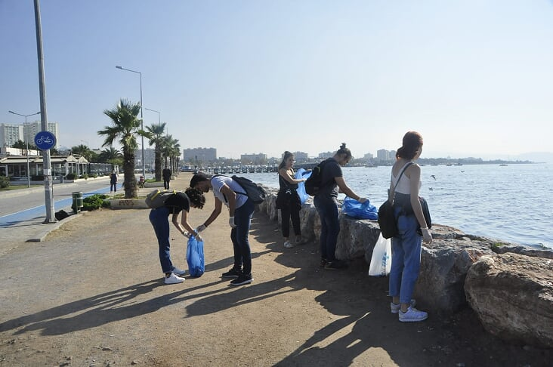
WHERE DID WE CLEAN THE ENVIRONMENT?

Slide 19
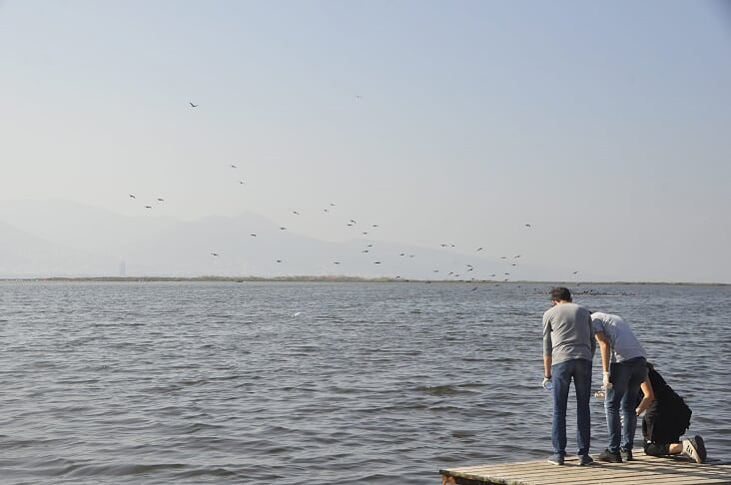
We tried to do environmental cleanliness in common areas where people use them intensively, when these areas are as crowded as possible in order to make people see us and think about the issue and encourage them not to pollute the environment. Therefore, it was decided that the coastal regions of Izmir would be suitable.

Slide 20
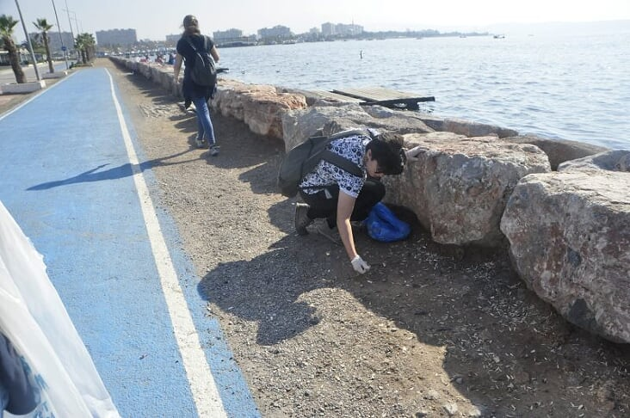
CLEANED BEACHES WITHIN THE SCOPE OF THE PROJECT
Alaybey Coast (Went twice.)
Mavisehir Coast (Went twice.)
Inciralti Coast (Went once.)
Turan Coast (Went once.)
Tersane (Went once.)

Slide 21
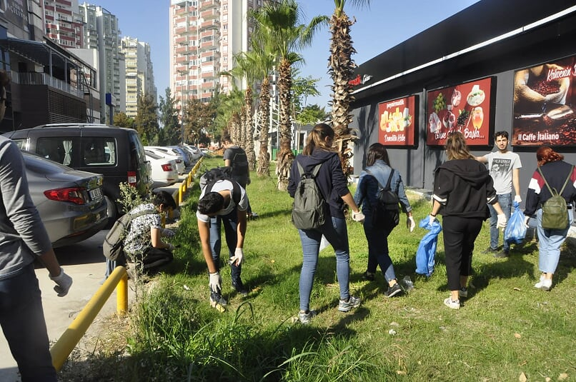
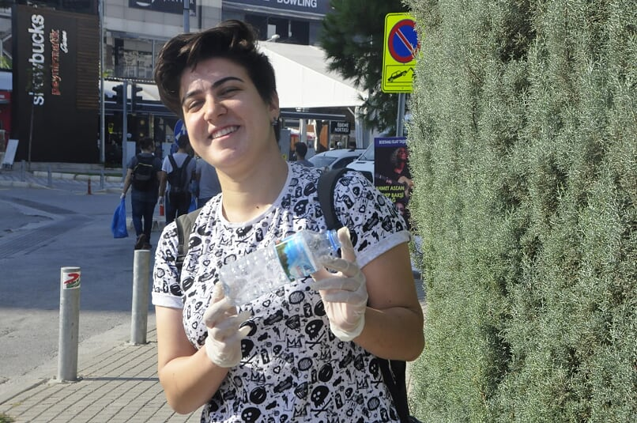

Slide 22
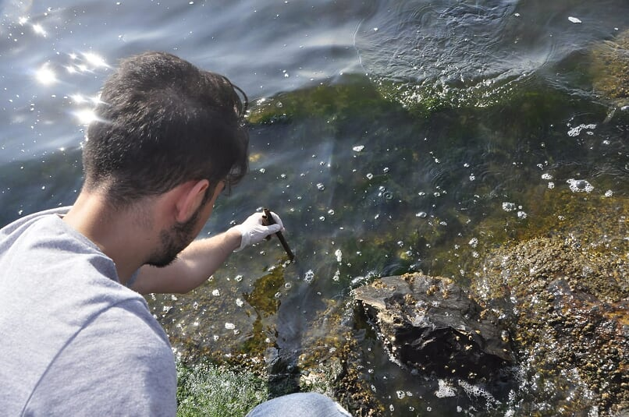
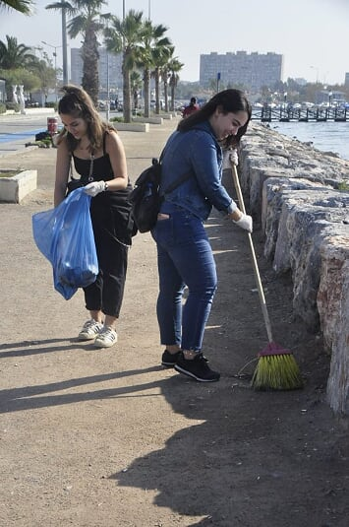
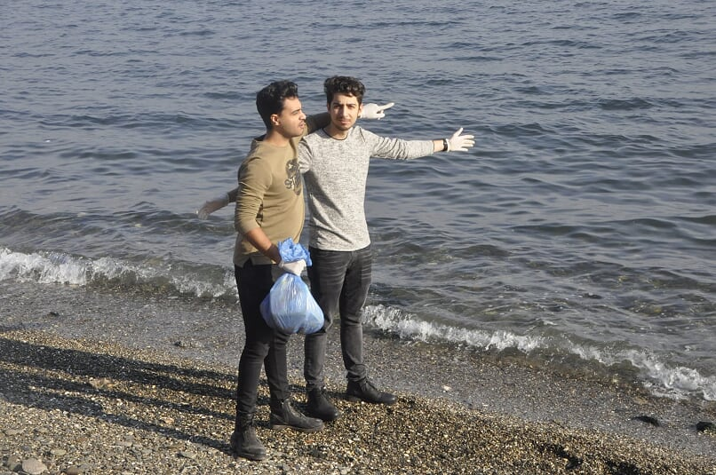

Slide 23
RISKS AND MANAGEMENT
1. No return was received from the relevant municipalities of the areas to be cleaned. This was done by the community members.
2. When the study area was visited, the area was found to be clean. Immediately a new place was identified and the area was cleaned.
3. Taking into consideration the situation of some of the members of the community working outside the school, groups were separated and cleaning activities were carried out on different days.

Slide 24
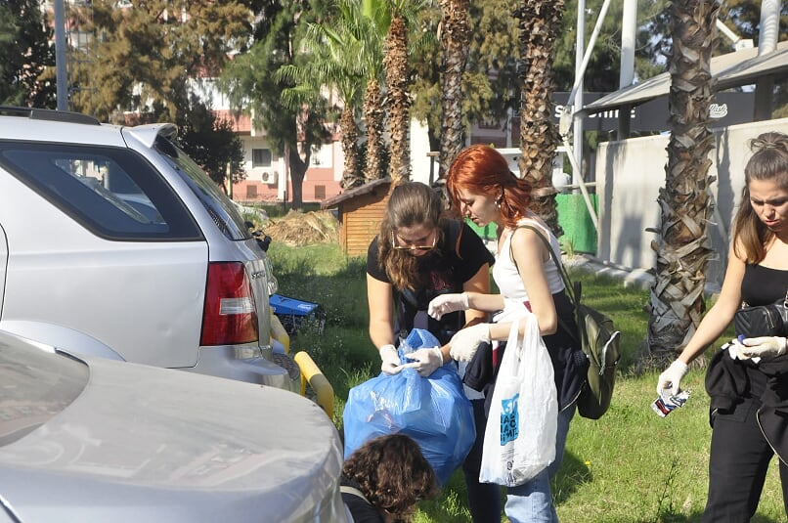
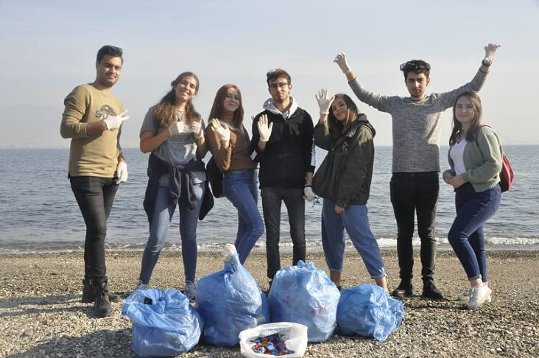
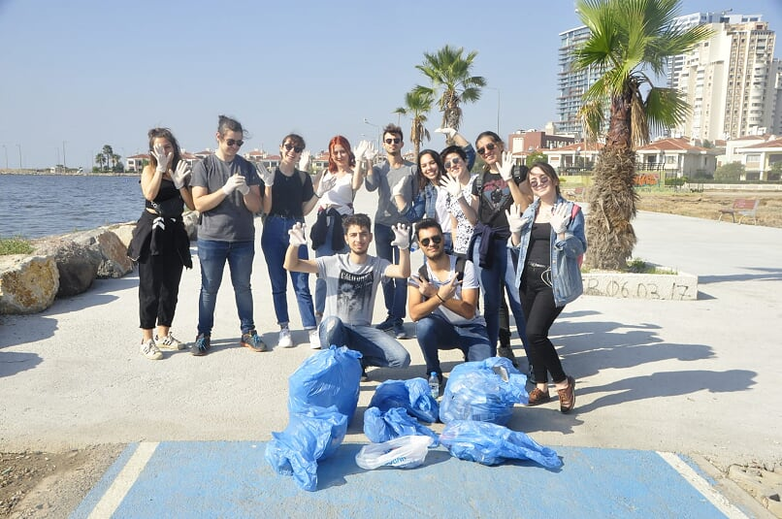
RESULT

Slide 25
Our wealth of nature is decreasing day by day. Industrialization and population densities in cities have led to an increase in environmental problems.
Environmental pollution has reached a level that threatens the health of human beings and many living things in nature today.

Slide 26
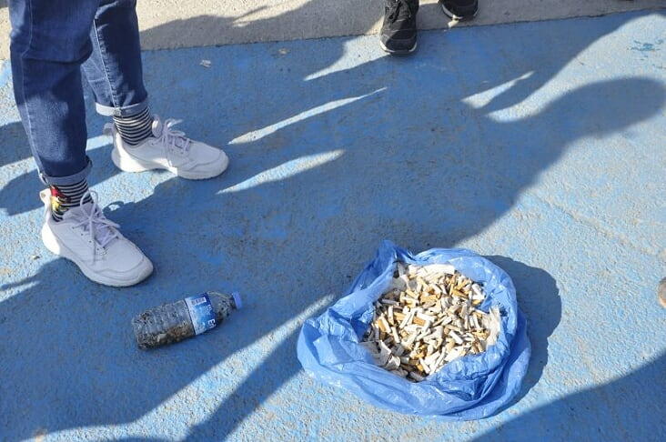
The most important factor that causes pollution is waste. Everyone should do their part about it. With this social work, it is aimed to create environmental cleanliness and awareness.
A conscious society means a clean environment. A clean environment will also come clean.

Slide 27
PLEASE PROTECT THE SEAS

Slide 28
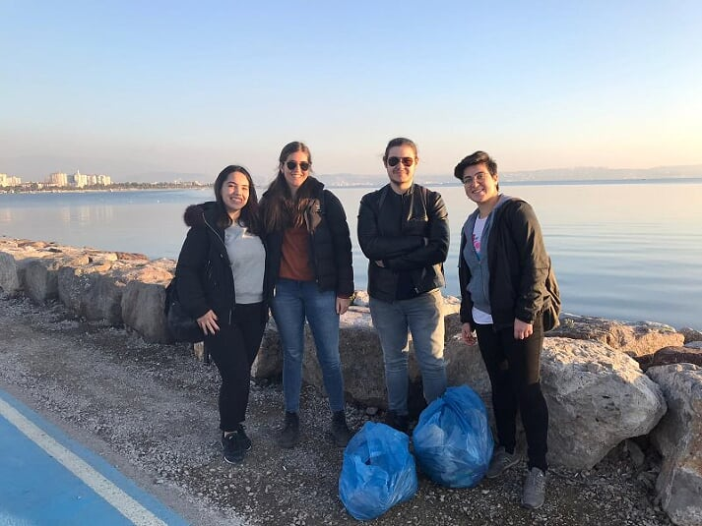
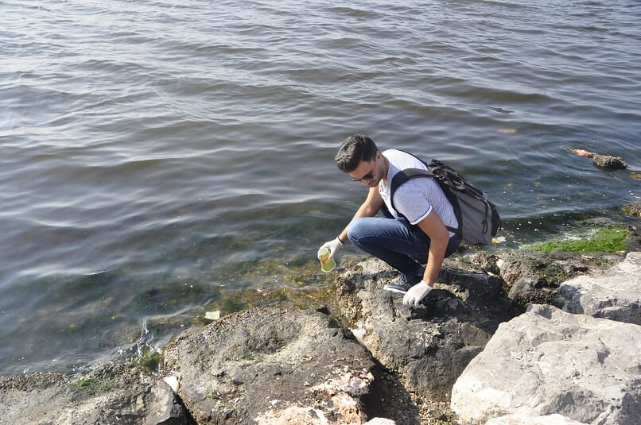
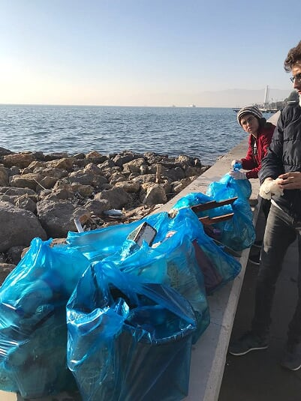

Slide 29
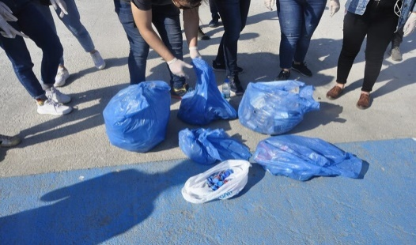
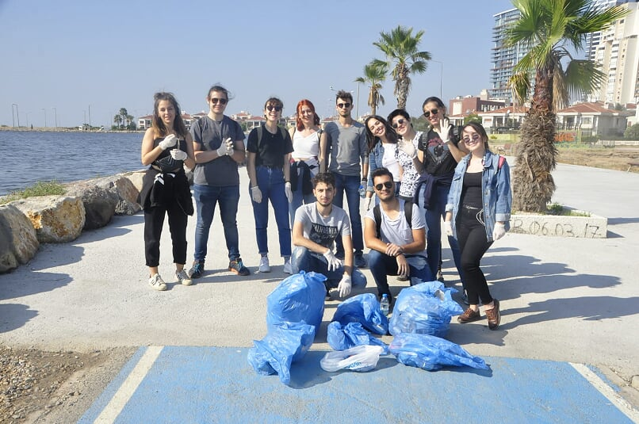
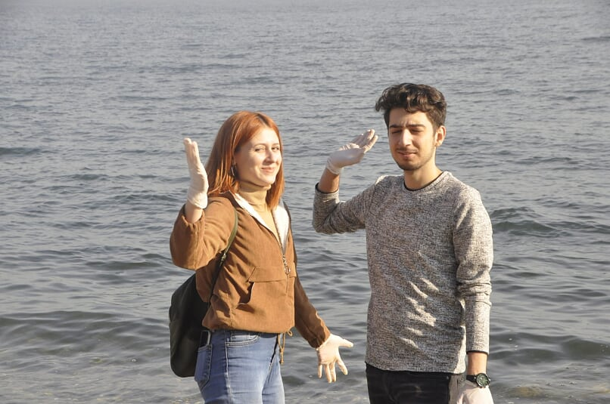
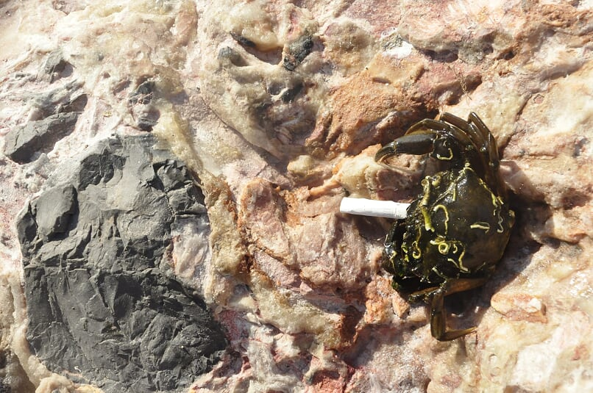
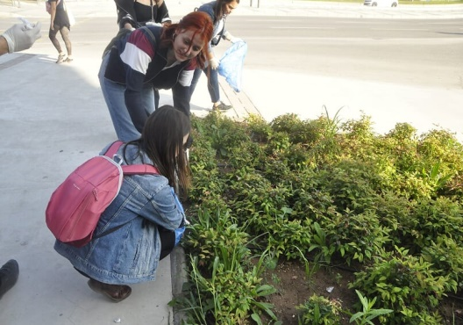
THAKS FOR LISTENING…

