Slide 1
PROTECTING NATURAL ENVIROMENT IN IZMIR

Slide 2
PROJECT MEMBERS
Bilal SAMUR
Ayberk KÖPRÜLÜ
Deniz ERCAN
Yiğit ÖZKAN
Esra KÜÇÜK

Slide 3
CONTENT TABLE
Project Description
Introduction
Destinations We Went
Life Water Documentary
Other Organizations We Support
Project Results

Slide 4
Project DescrIptIon
This is an environmental organization developed by university students. It aims to protect the natural environments in Izmir and to develop social sensitivity for living spaces of animals and plants. It is open to any individual who wants to volunteer.

Slide 5
IntroductIon to Project

Slide 6
In Turkey, forest pollution is a very important issue and day by day our forest become more dirty. Izmir is one of the biggest cities of Turkey which has many green areas in it but unfortunately people don't know how to protect it properly.
So we decided to make studies about this, we started to clean forests of İzmir and we attended symposiums about our enviroment and how to protect it.

Slide 7
DestInatIons We Are WorkIng On
Balçova Therapy Forest
İnciraltı City Forest
Foca
Life Water Documentary

Slide 8
BalCOVA THERAPY FOREST
Balçova Thrapy Forest is one of the biggest forests in İzmir, it hosts many kind of trees and herbs. It has a very long walking road in it . But this beautiful forest has a very big issue: Pollution.
People go to forest to brasier, picnic or tracking but unfortunately they leave their garbages in place they use because municipality collected all of the garbage cans from the forest and forest has a very long way so people dont bring their garbages all the way to the end of the forest.
This is one of the main reasons of pollution in this forest.

Slide 9
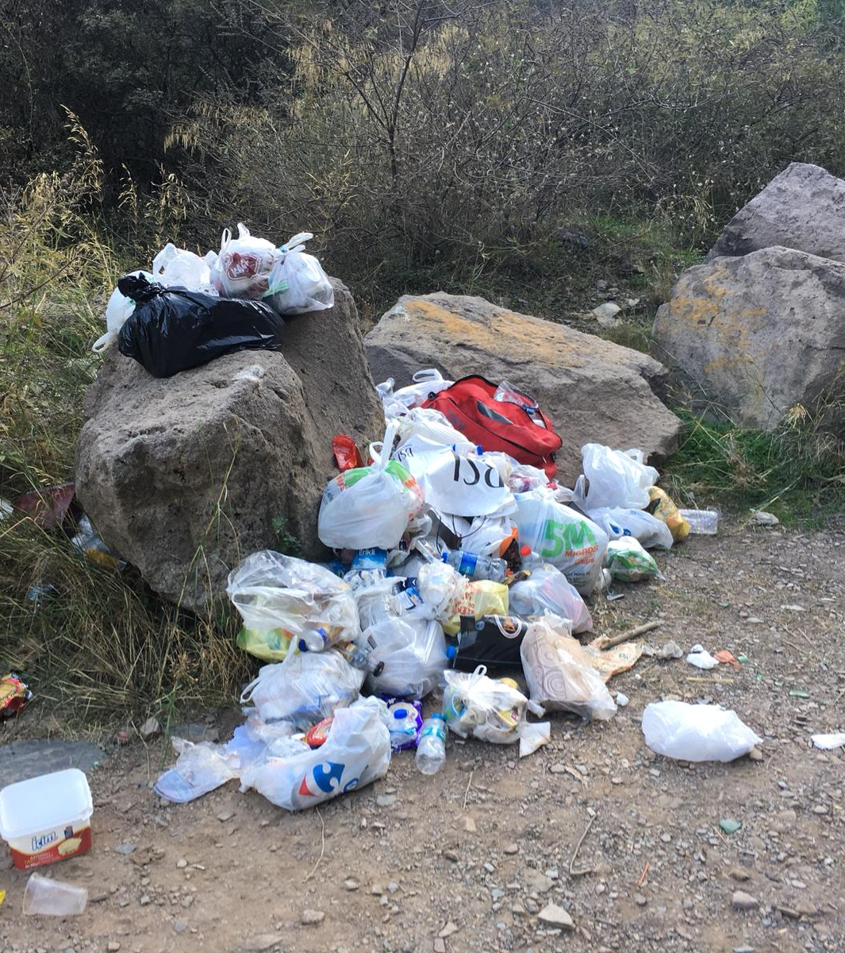
Balcova therapy forest

Slide 10
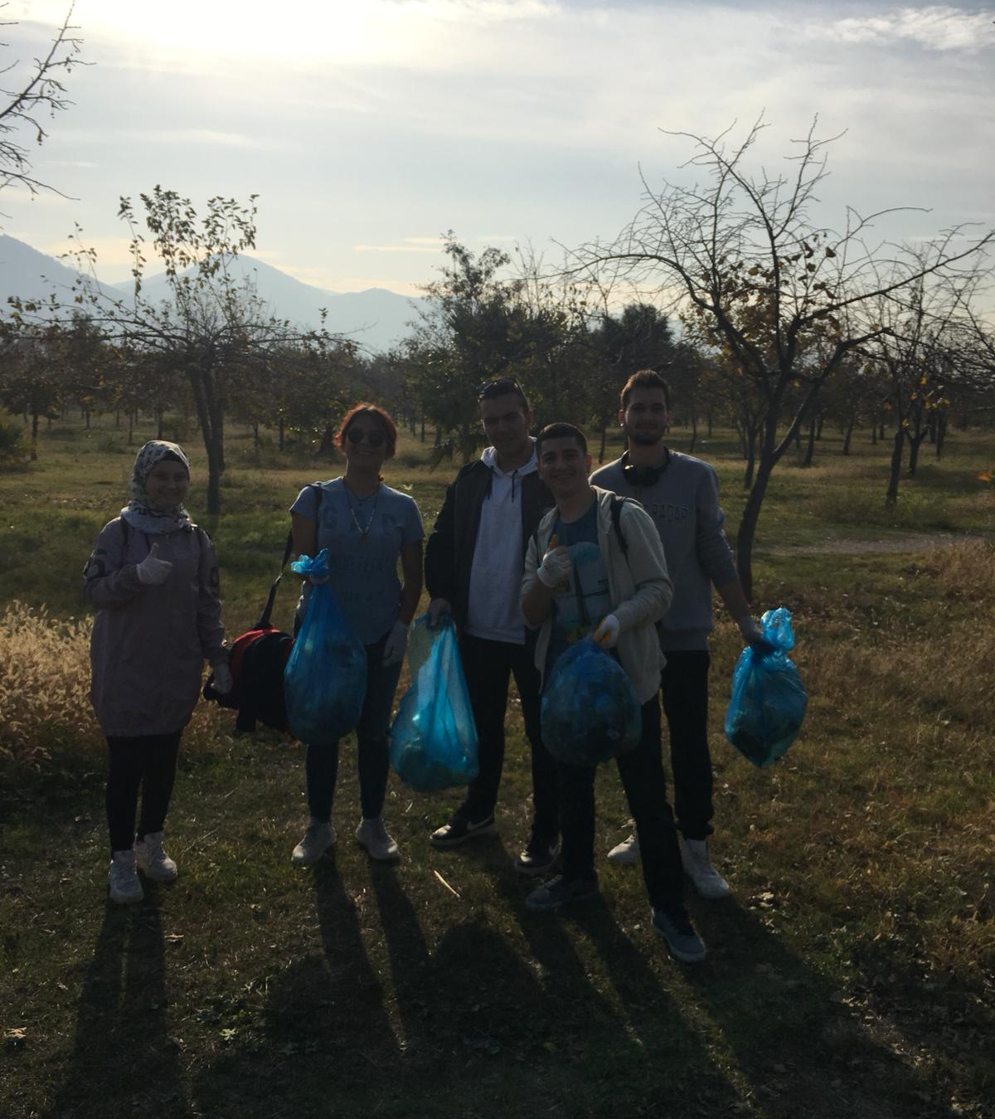
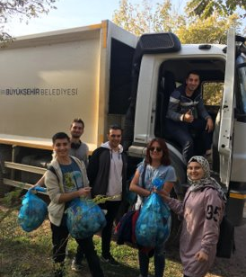
IncIraltı CIty Forest

Slide 11
IncIraltı CIty Forest
Inciraltı city forest is a place that contains many green areas, but this place has a same issue with Balçova Terapi Forest. People came to brasier lefts their garbage in forest too, municipality workers are cleaning the forest with garbage cars but there was still garbage in the forest and we cleaned them.

Slide 12
Foca
Eski Foca was the cleanest place we went in our project. People were protecting their enviroment very nicely. We found a few packs of garbage along the coastline.

Slide 14
LIfe Water Documentary
It is documentary which is about a project which aim to protect thrush and juniper tree. The project, which was first carried out in Denizli as a pilot project than applied in Usak and Isparta. It aims to regain the thrush which is leaved the territory. This is a very important project for the diversity of life. It meets the drinking water needs of many animals, especially thrushes.

Slide 15
Other OrganIzatIons We Support
TEMA Foundation
11 Million Saplings Event

Slide 16
In addition to the project, we donated saplings on behalf of each project member to support the TEMA foundation.
We promoted the 11 Million Saplings event in our social media accounts. Therefore, we donated saplings. We couldn't join the planting team because of bad weather conditions.

Slide 17
Project ResultS
We instilled the idea that the natural habitats in Izmir are decreasing to the point of extinction and that we need them like all living things. We cleaned the Balçova therapy forest which became a pile of rubbish. We have decided that the project needs to reach more people and raise awareness in order to be sustainable.

