Slide 1
Street Animals Protection Program

Slide 2
Abstract
Why we started this project?
- Due to the separation of cats and dogs from their natural environment.
What is our responsibilities to animals ?
- We have to protect, feed, save and we should pay attention to them.
What we earn after this project ?
- At the end of this project, we have learned that we are not just cooks or teachers but we are human beings and we must act like a human.

Slide 3
OBJECT
Teaching people that the animals have the right to live as much as we have.
Teaching people that we have to protect their rights.
Protecting, feeding and hosting the street animals which we can reach.
Neutering the street animals.

Slide 4
SCOPE
The main scope of the project is that, decreasing homeless and non-neutered and hungry street animals in our neighborhoods and campus (Balatcik, Harmandali, Karsiyaka etc.).

Slide 5
METHODS
First of all, the most important point is love. We pet street animals to rout up them their despairing state.
To satisfy their second compulsory need feeding, we fed them every day and night as we can afford.
To protect them from cold and rain, we built shelters that are vital for this project.

Slide 6
SUCCESS CRITERIA
-Seeing animals happy.
-Knowing that they're full.
-To make shelters to be protected from cold during winter.
-To raise awareness of the community.
-Getting a pet feeding machine from the municipality.

Slide 7
What barriers did we face ?
Time: We’re all working students and we don't have free time usually. If we don't plan correctly, we can't meet and we can't discuss “what to do”. So, time is a barrier for us but we can overcome it.
Connections: We believe that if we had better connections we can put pet feeder in our campus, but we didn't.
Neighborhood pressure: Some of our neighbors are don't like cats and dogs. They didn't want to feed them on the streets. They think that; the animals make streets grimy.
Financial supporters: As we said before, we’re students and we can't afford our vital needs completely. So, we need supporters to help animals.

Slide 8
What we achieve ?
Surely each individual person of our team experienced different things for sure.
First, we feel the love of nature in our self. We understand the hard circumstances for street animals. We Learned the mutual responsibility toward animals and humans.
And what we did?
We fed over 30 dogs and 5 cats.
They've built some shelter for them
Create a social responsibility towards them. Once you love, you can't quit.

Slide 9
We divided into two different groups to make it easier. The first was for feeding and second was for preparing shelters and correspondence with the municipality.

Slide 10
First group had quite fun

Slide 11
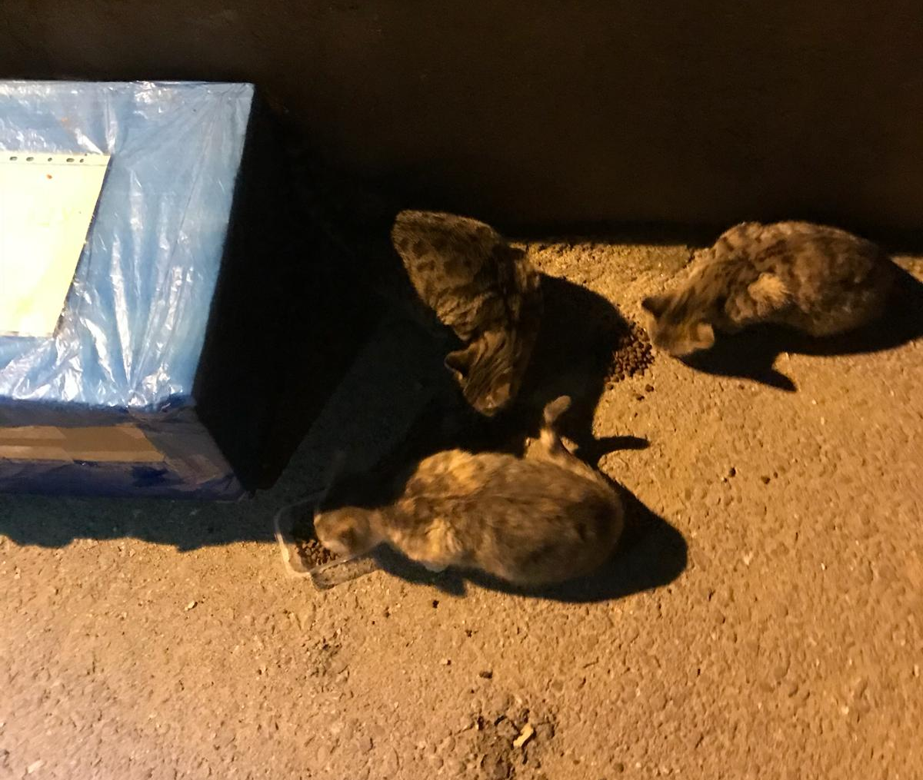
Firstly; We fed them

Slide 12
Fed more

Slide 13
We Realized That No One Adopts Them

Slide 14
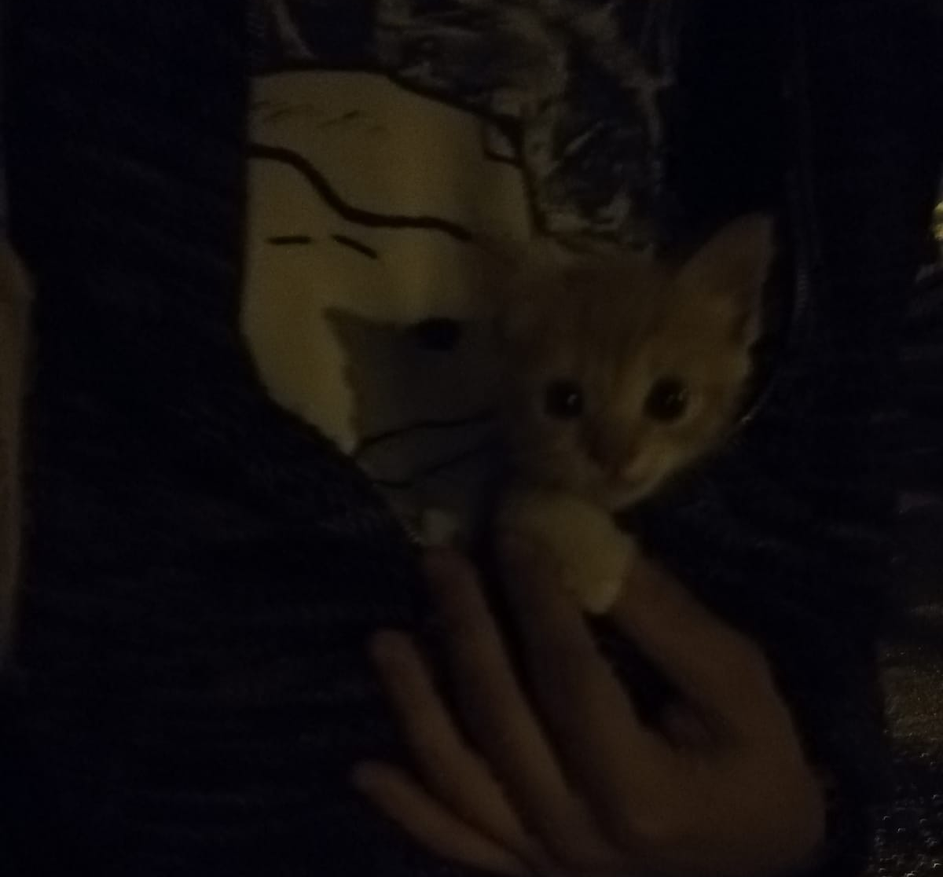
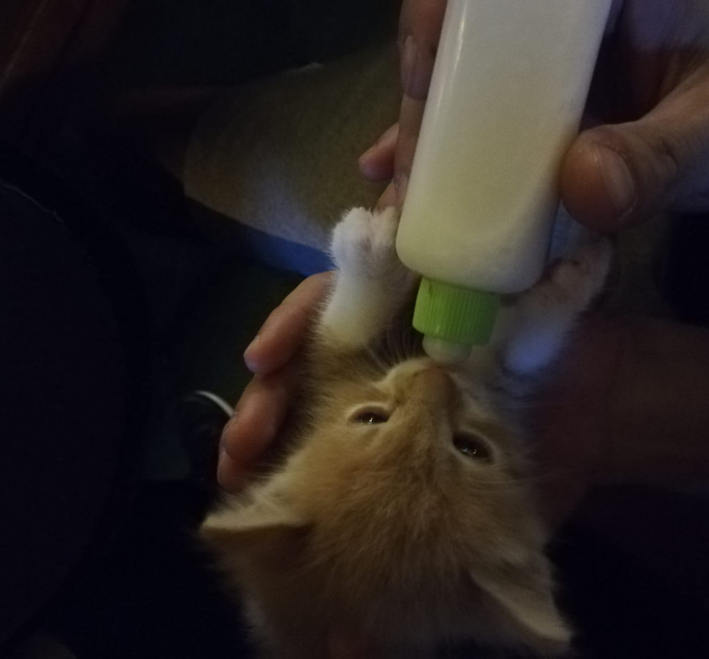
We said, "Why don't we adopt them?"

Slide 15
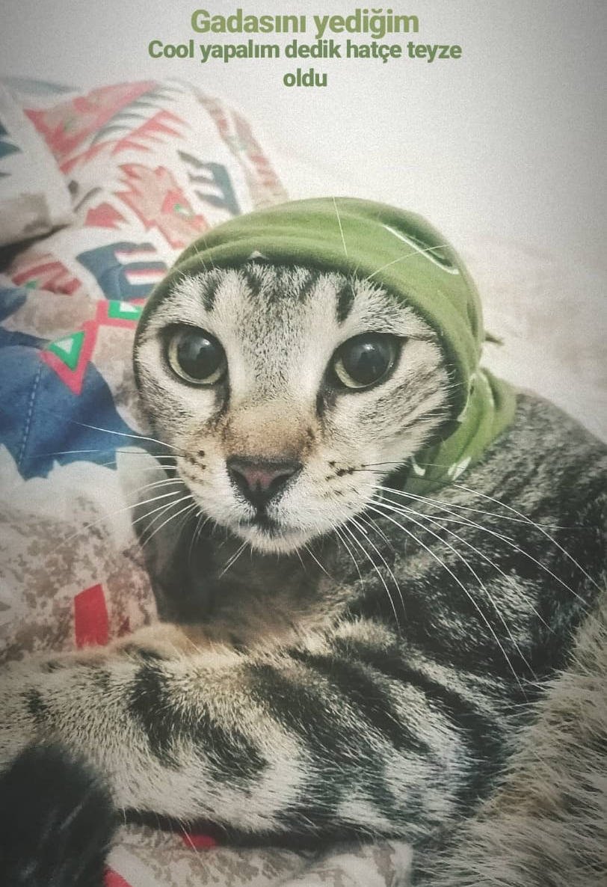
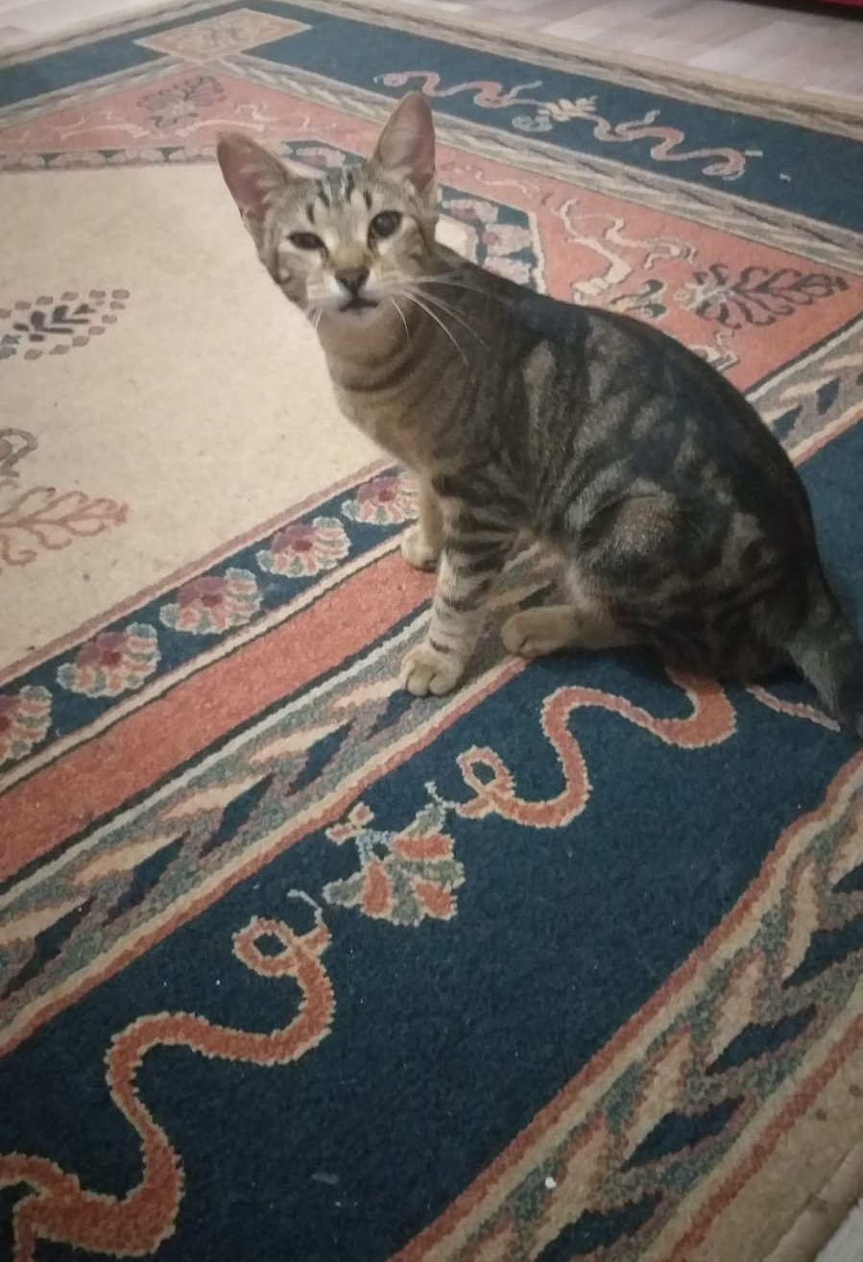
Then we adopt two beauty.

Slide 16
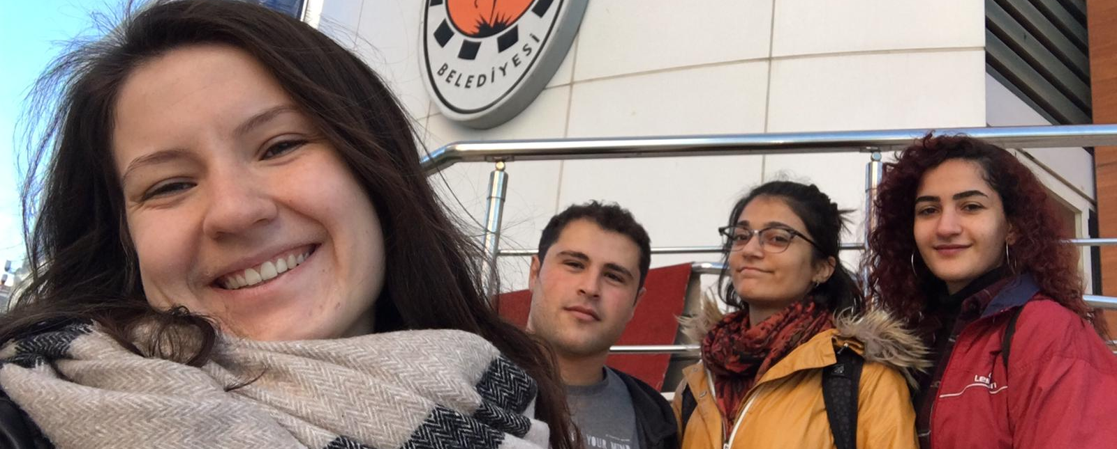
The second group also worked hard.

Slide 17
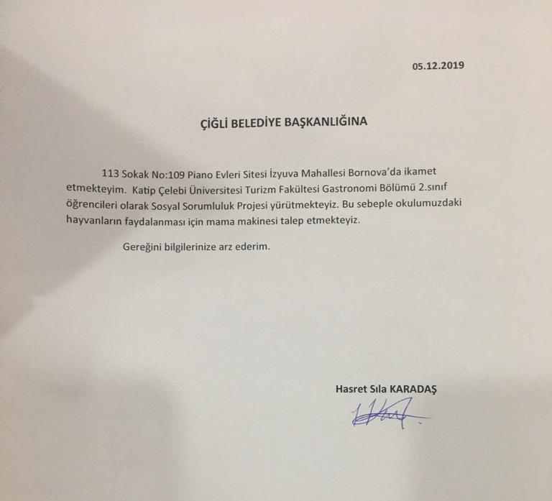
We tried to have a food machine from municipality. But, sadly we couldn't have for now.

Slide 18
Then we gift them a home

Slide 19
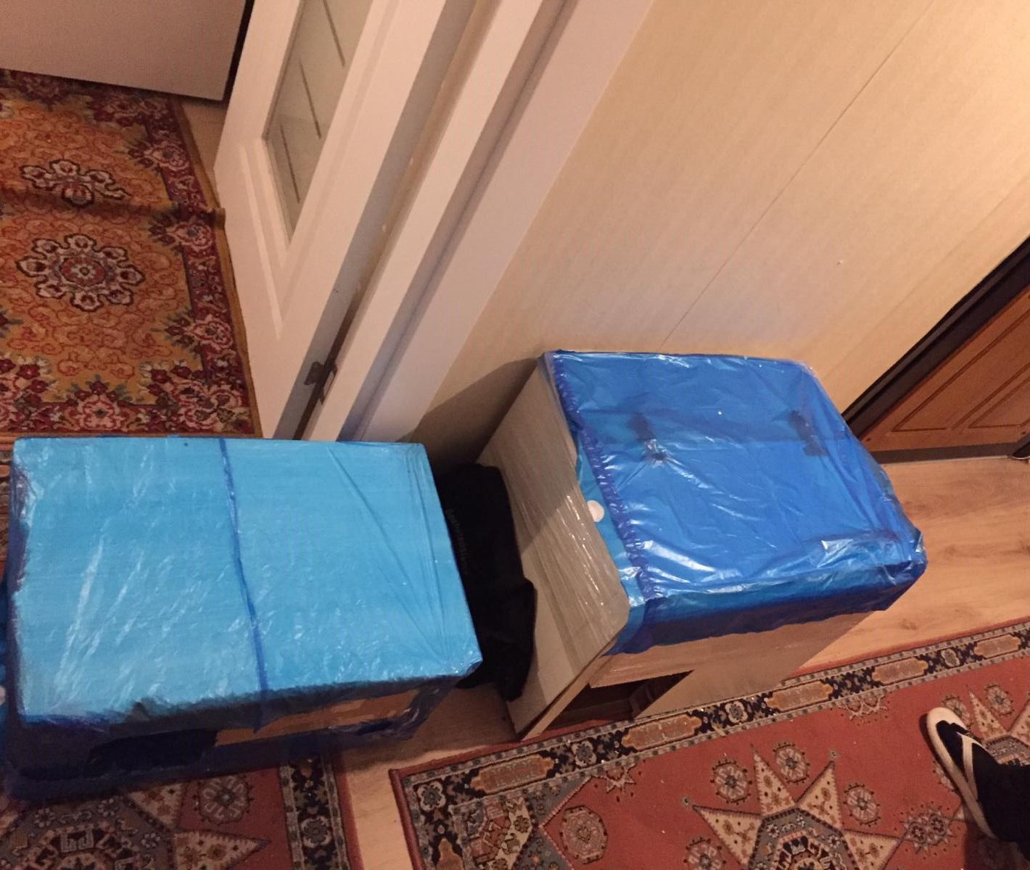
WHICH PREPARED BY OURSELVES.
It's not expensive!

Slide 20
WE KNOW, THEY LOVE IT.

Slide 21
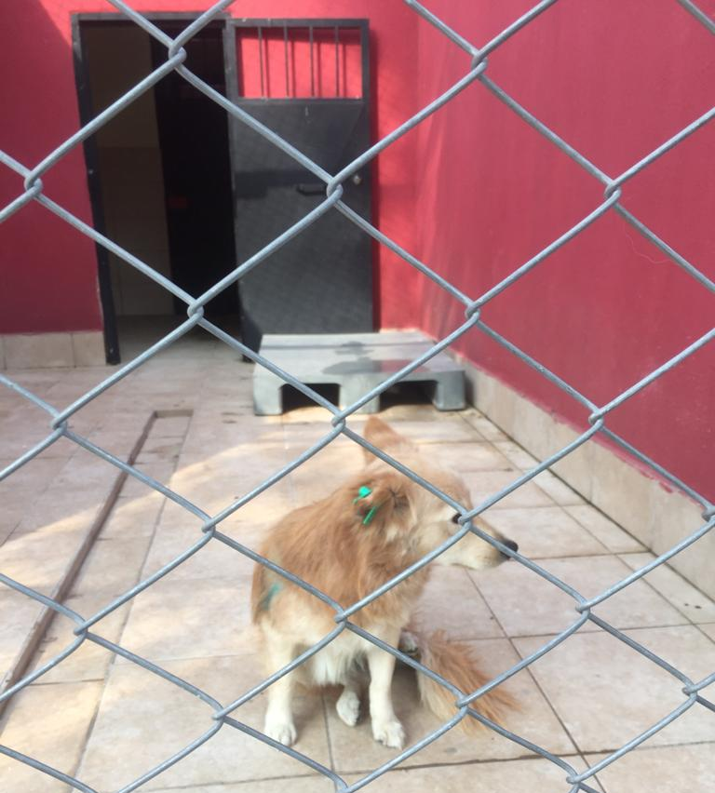
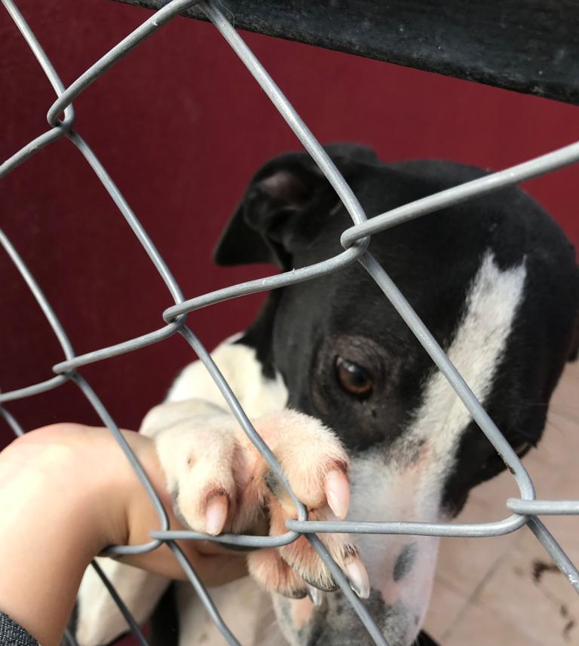
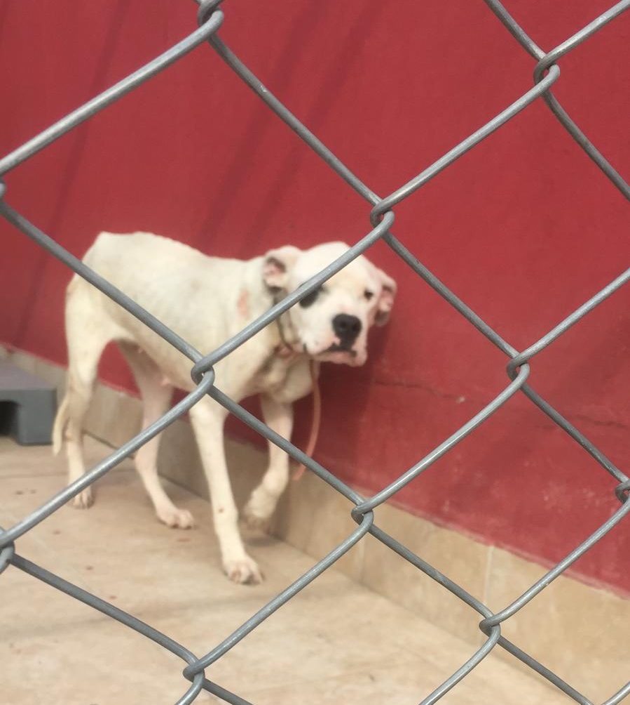
TRY TO CHANGE THEIR DESTINY

Slide 22
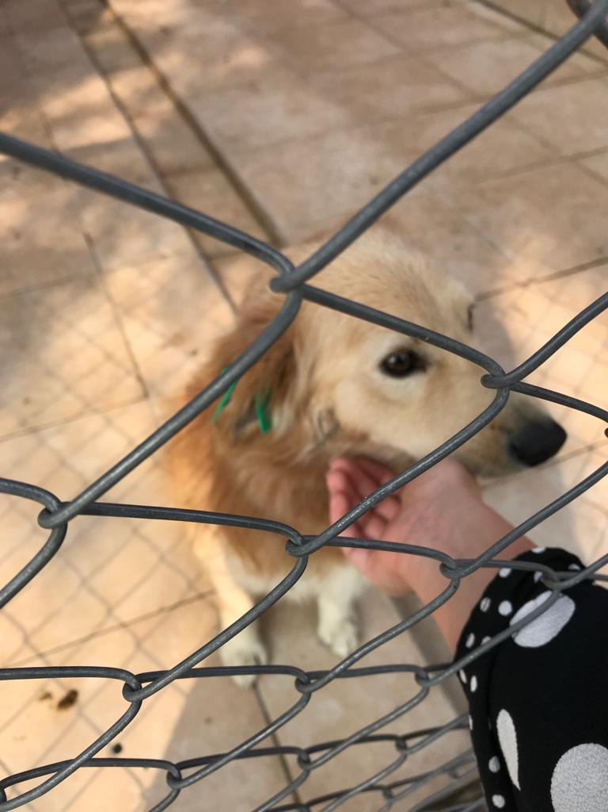
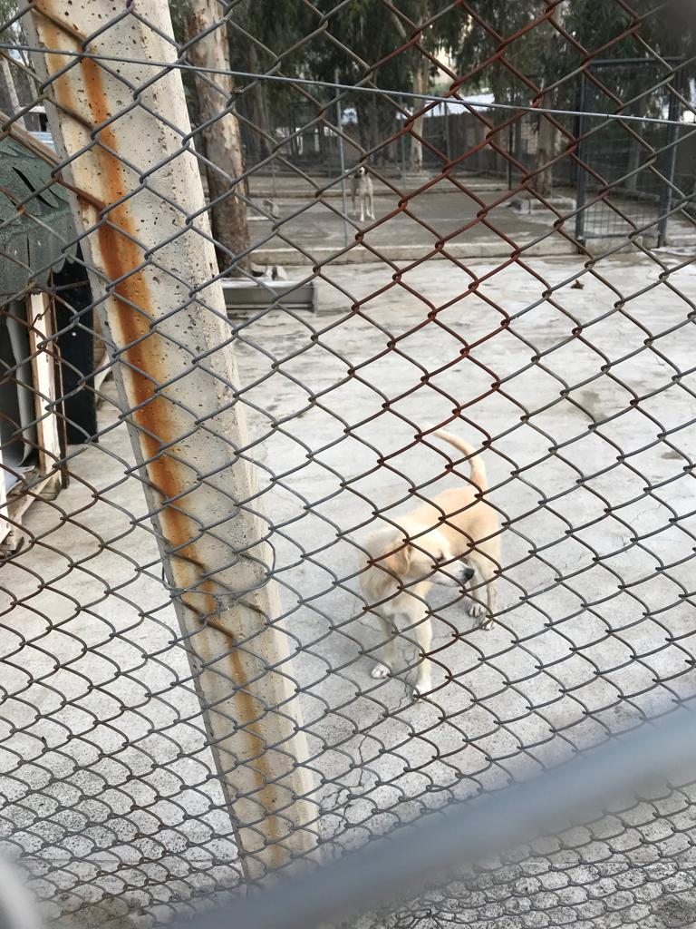

Slide 23
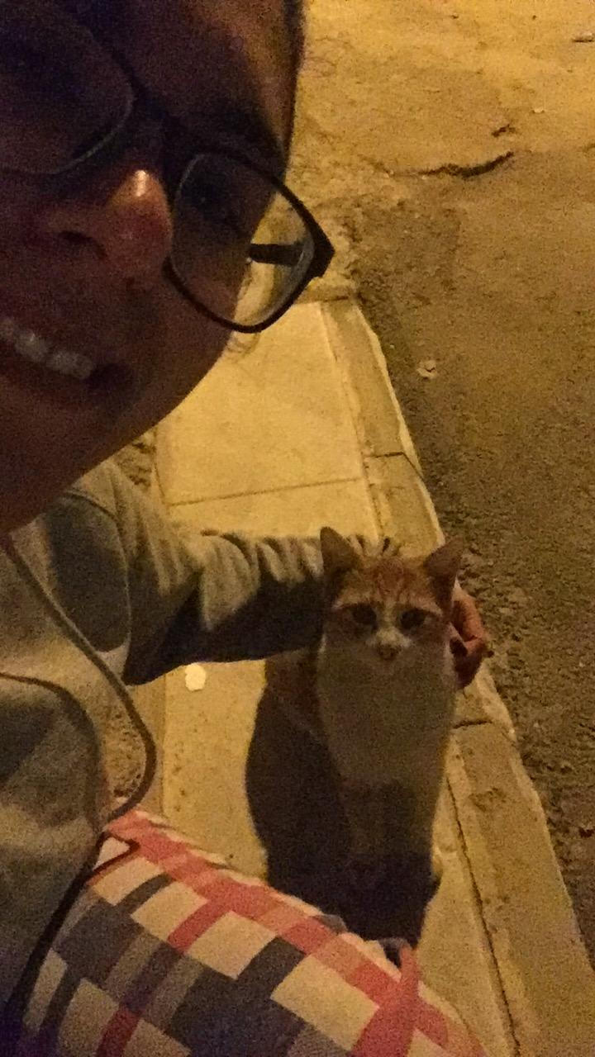
At least, try to love.

Slide 24
Project Mentor : Perihan KENDİRCİ
Şükrü Ziya KUTUCU- 160901011
Kalender DOĞAN - 160901023
Hasret Sıla KARADAŞ - 170901028
Umut Can KORU - 170901053
Cansel HANGÜL - 160901018
Rabiya KAYA - 170901042
İrem ASLAN - 170901032
Pınar YILDIZ - 170901047
Samet PİŞKİN - 170901017

