Slide 1
Environmentalists

Slide 2
Volunteers
Erhan Afanoğlu 170901016
Neşet Mert Dağdeviren 170901026
Faruk Çetin 170901037
Kadir Erol 170901006
Volkan Sayın 170901021
Emirhan Aktepe 170901013
Ali İhsan Kucur 170901056
Yılmaz Keskin 170901035
Ahmet İbişoğlu 170901010

Slide 3
What is our purposes?
The object of this project is saving the environment and beings and to keep them on exist better and liveable.
Within the scope of this project, we aim to protect our environment and plants.
During the project, weekly meetings were held to collect garbage in the areas such as Bornova Büyük Park, Bostanlı beach and Bayraklı beach.

Slide 4
Our motto is;
Conscious youth, clean future.

Slide 5
Harm of Garbages to the nature
Garbages that are not thrown to bin leads to pollute water and soil and to endanger beings life.
Pollution adversely affects air and water, and inorganic pollutants poison waters and soil.
Pollution of soil influence agriculture and forests too beside animals negatively.
75% of the marine fish are depleted due to pollution in water.

Slide 9
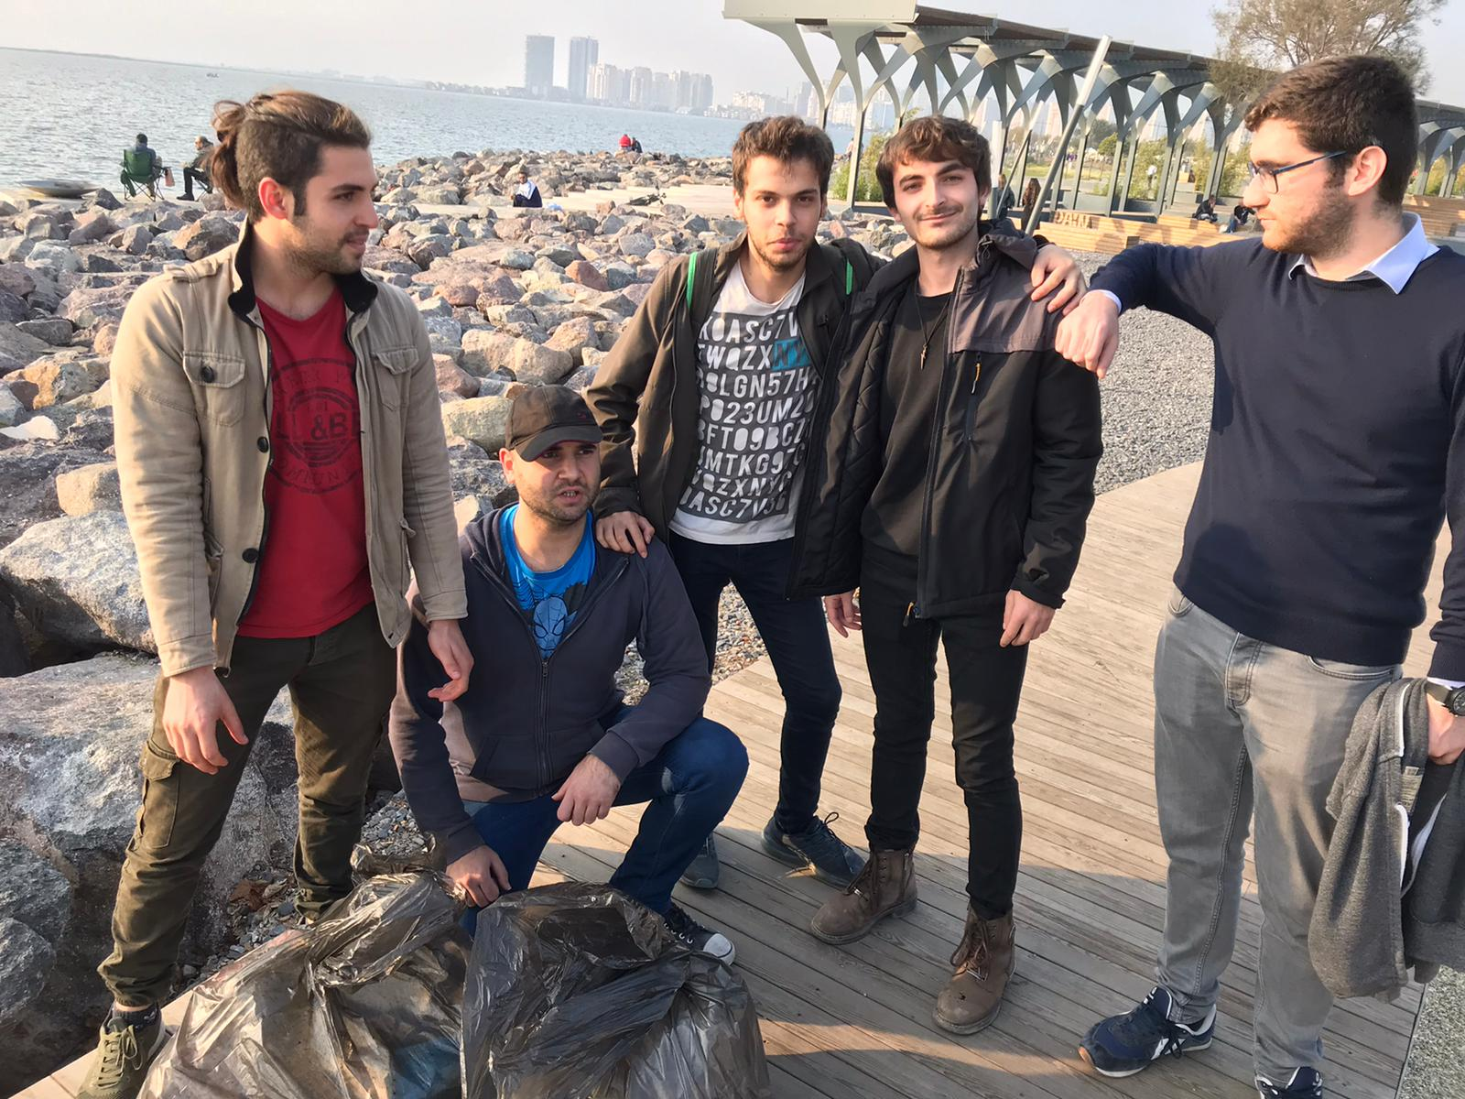
First stop was Bostanlı Coast

Slide 10
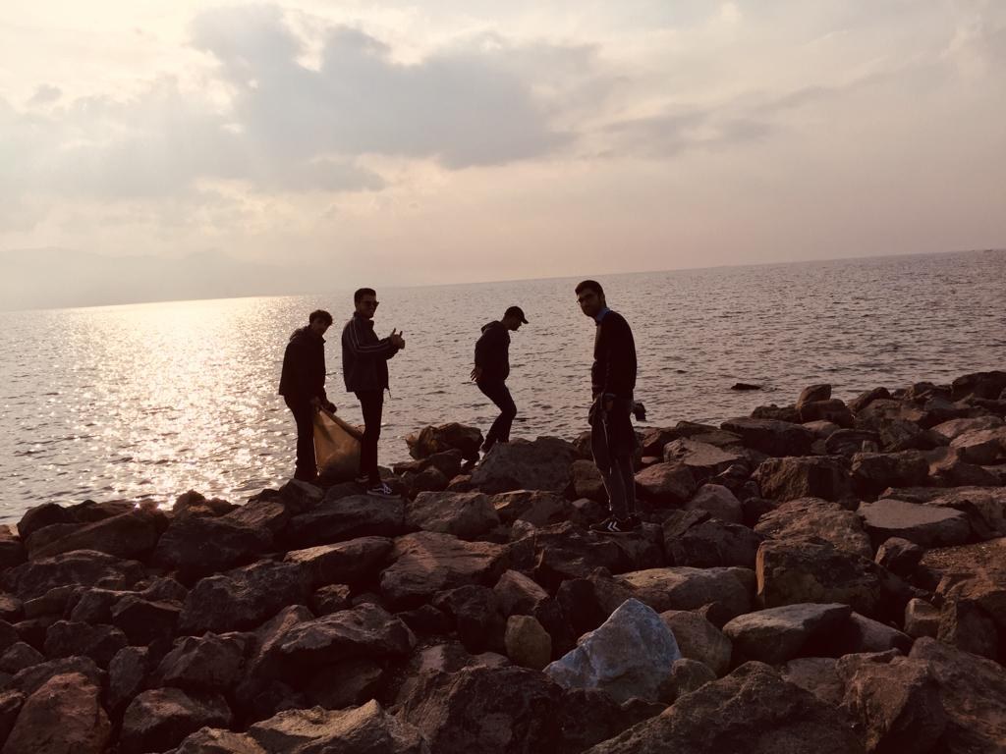

Slide 11
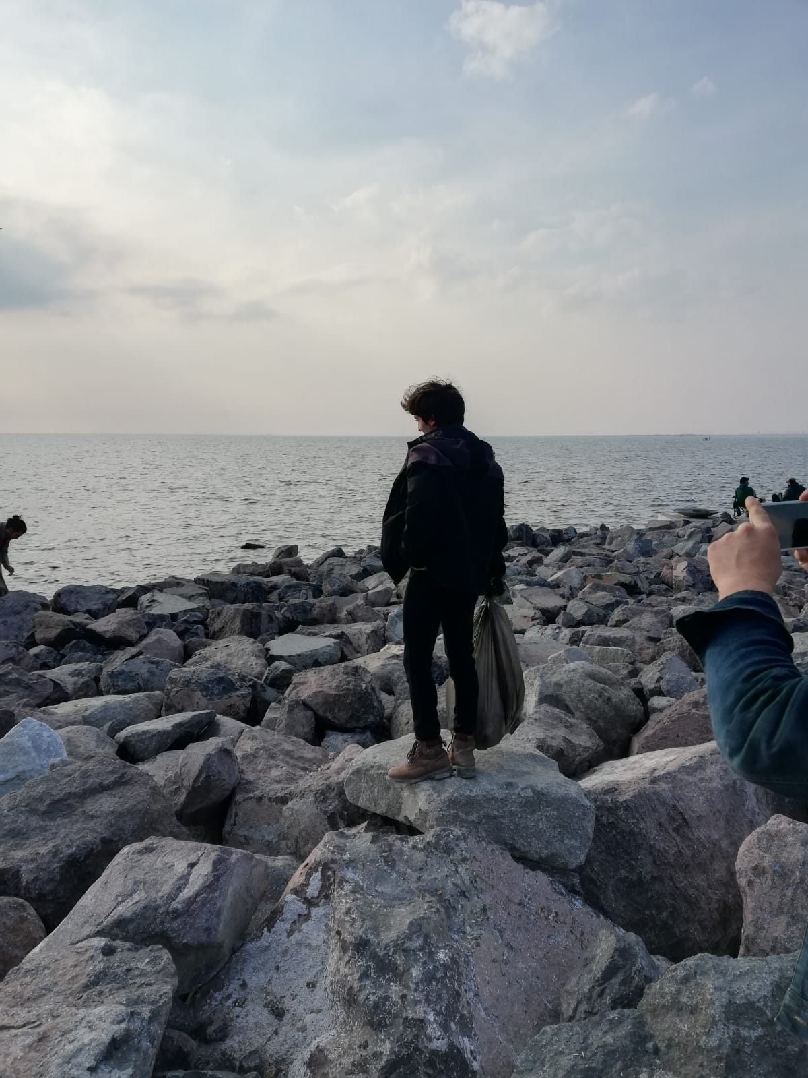

Slide 12
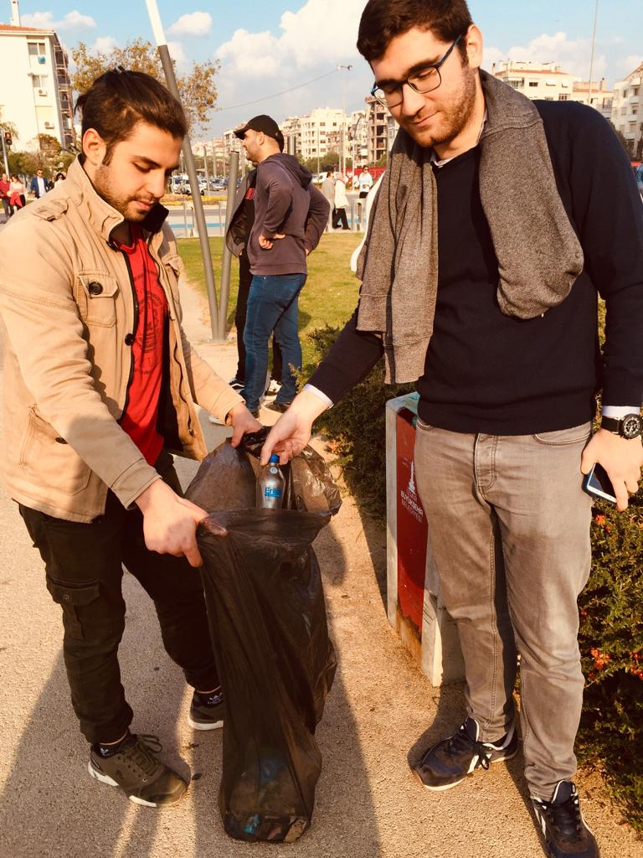

Slide 13
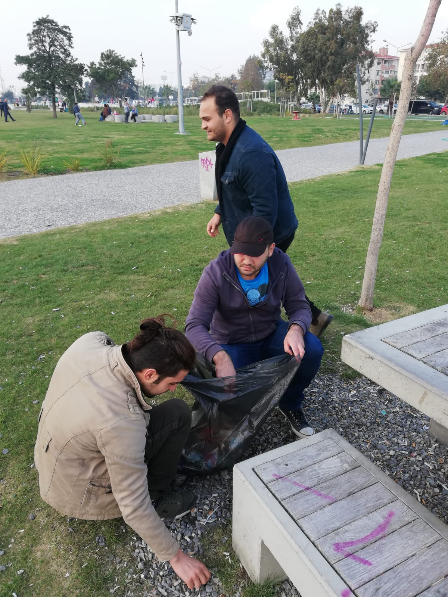

Slide 14
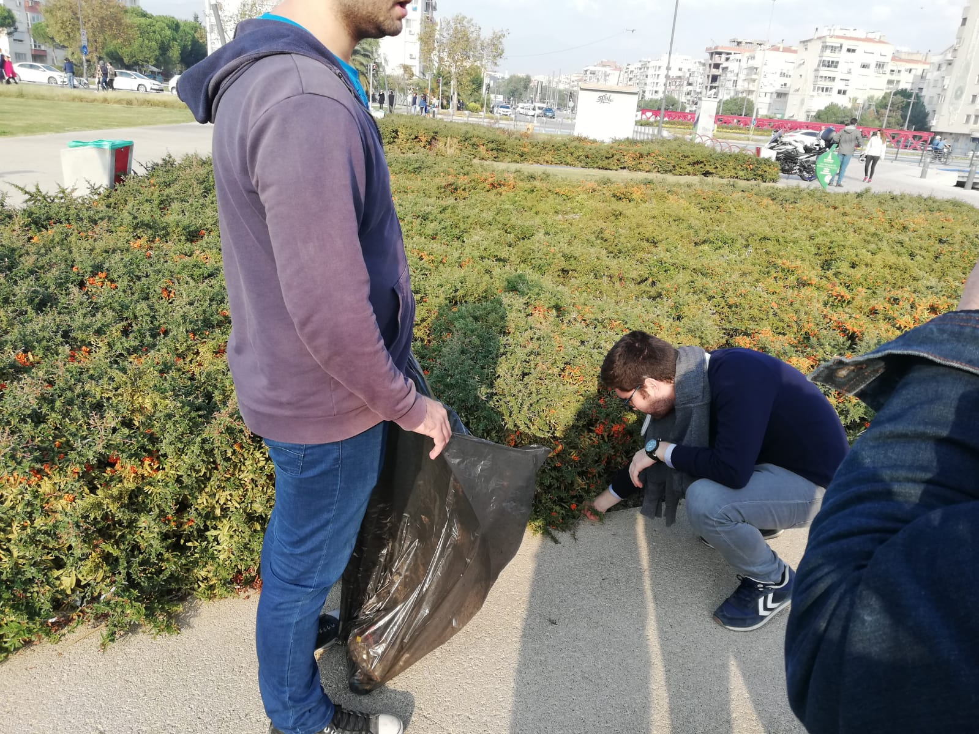

Slide 15
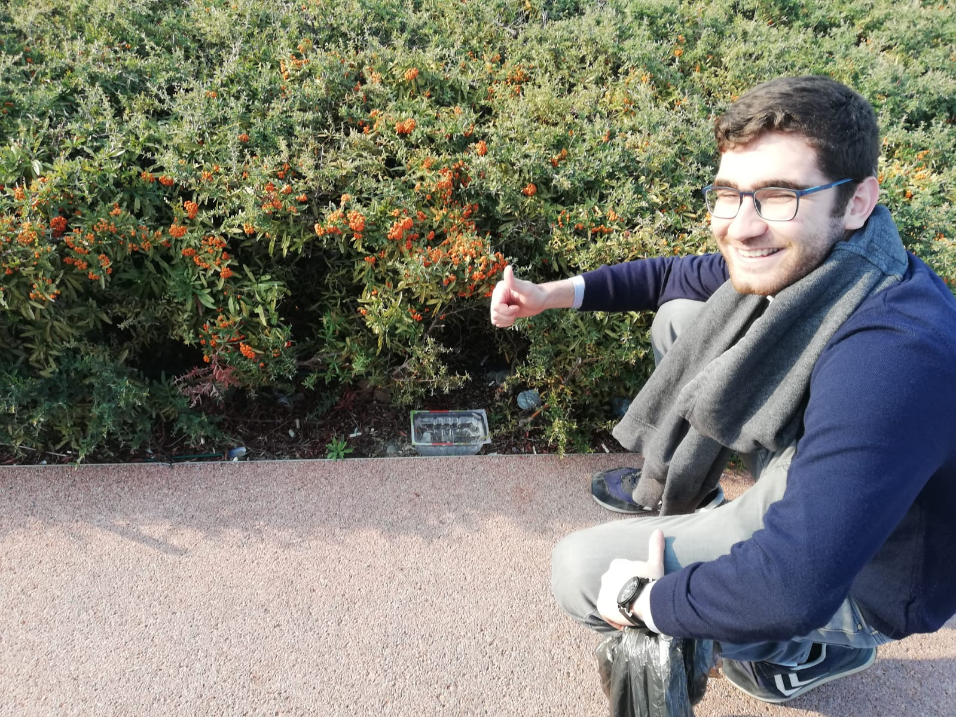

Slide 16
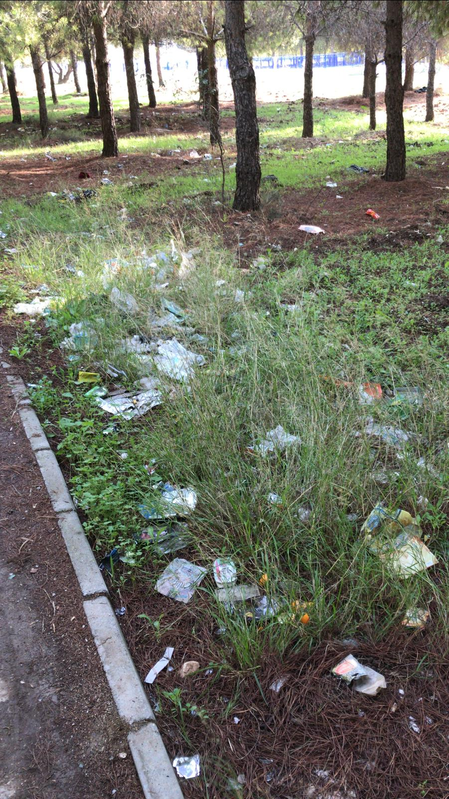
Second stop was Bornova

Slide 17
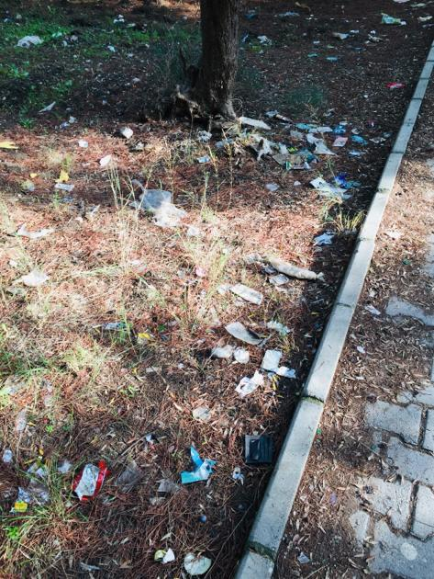
Before

Slide 18
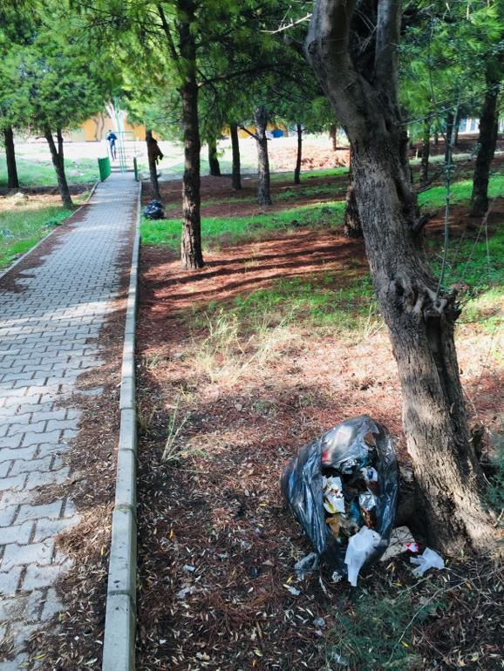
After

Slide 19
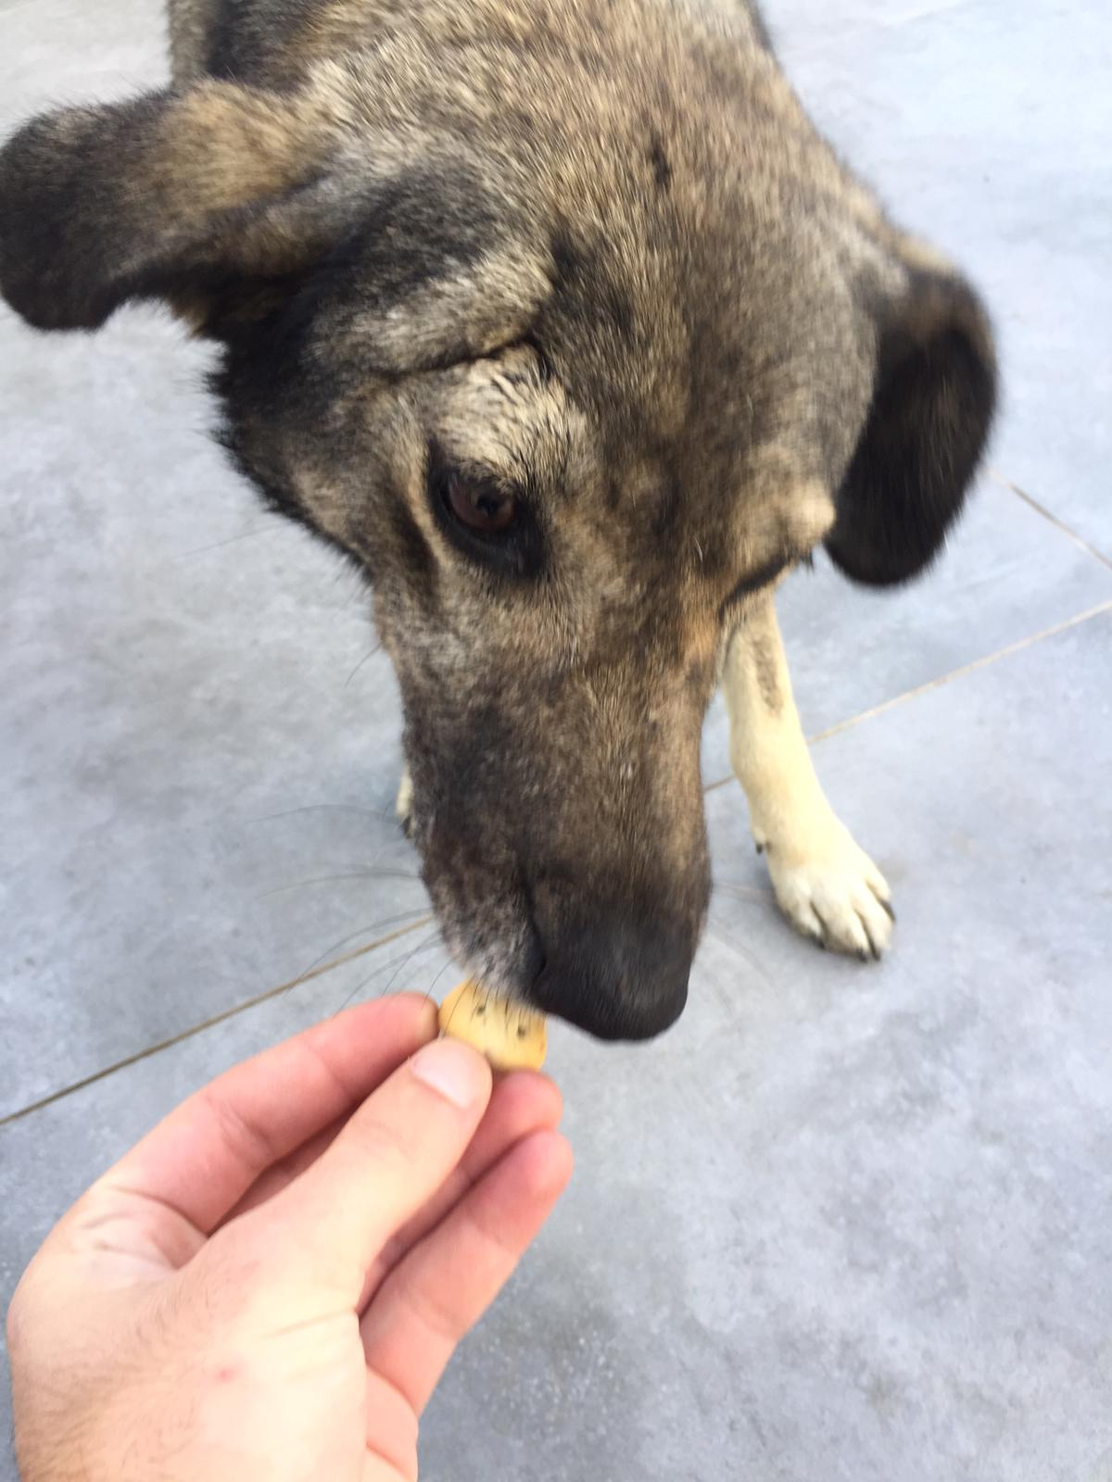
Third stop was Balatçık

Slide 20
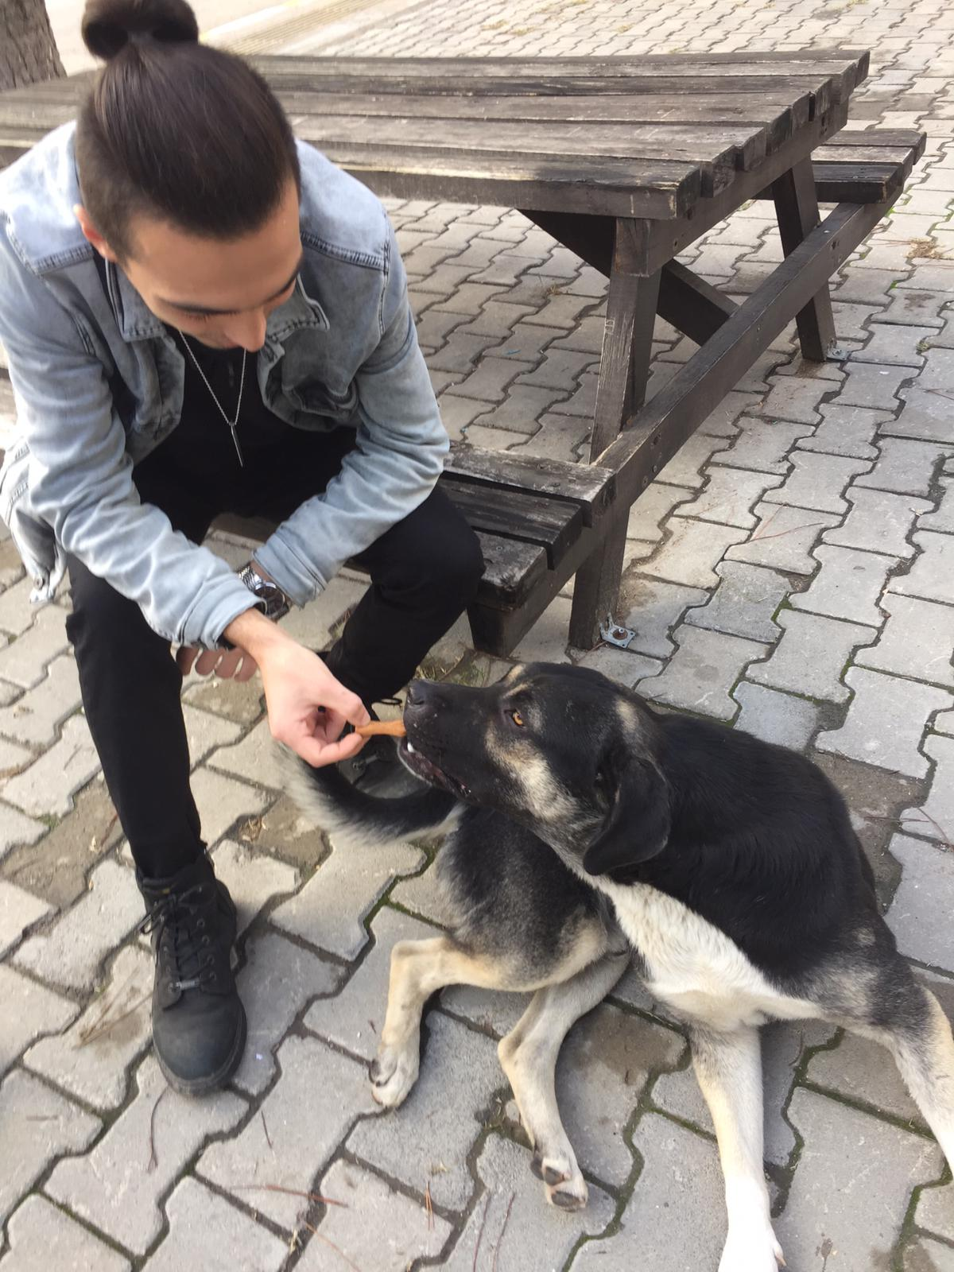

Slide 21
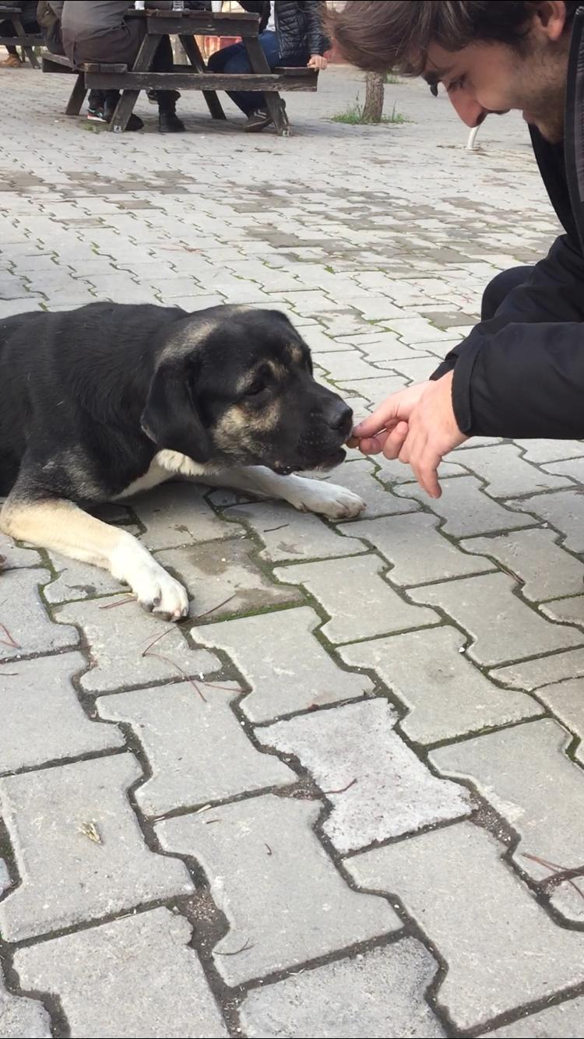

Slide 22
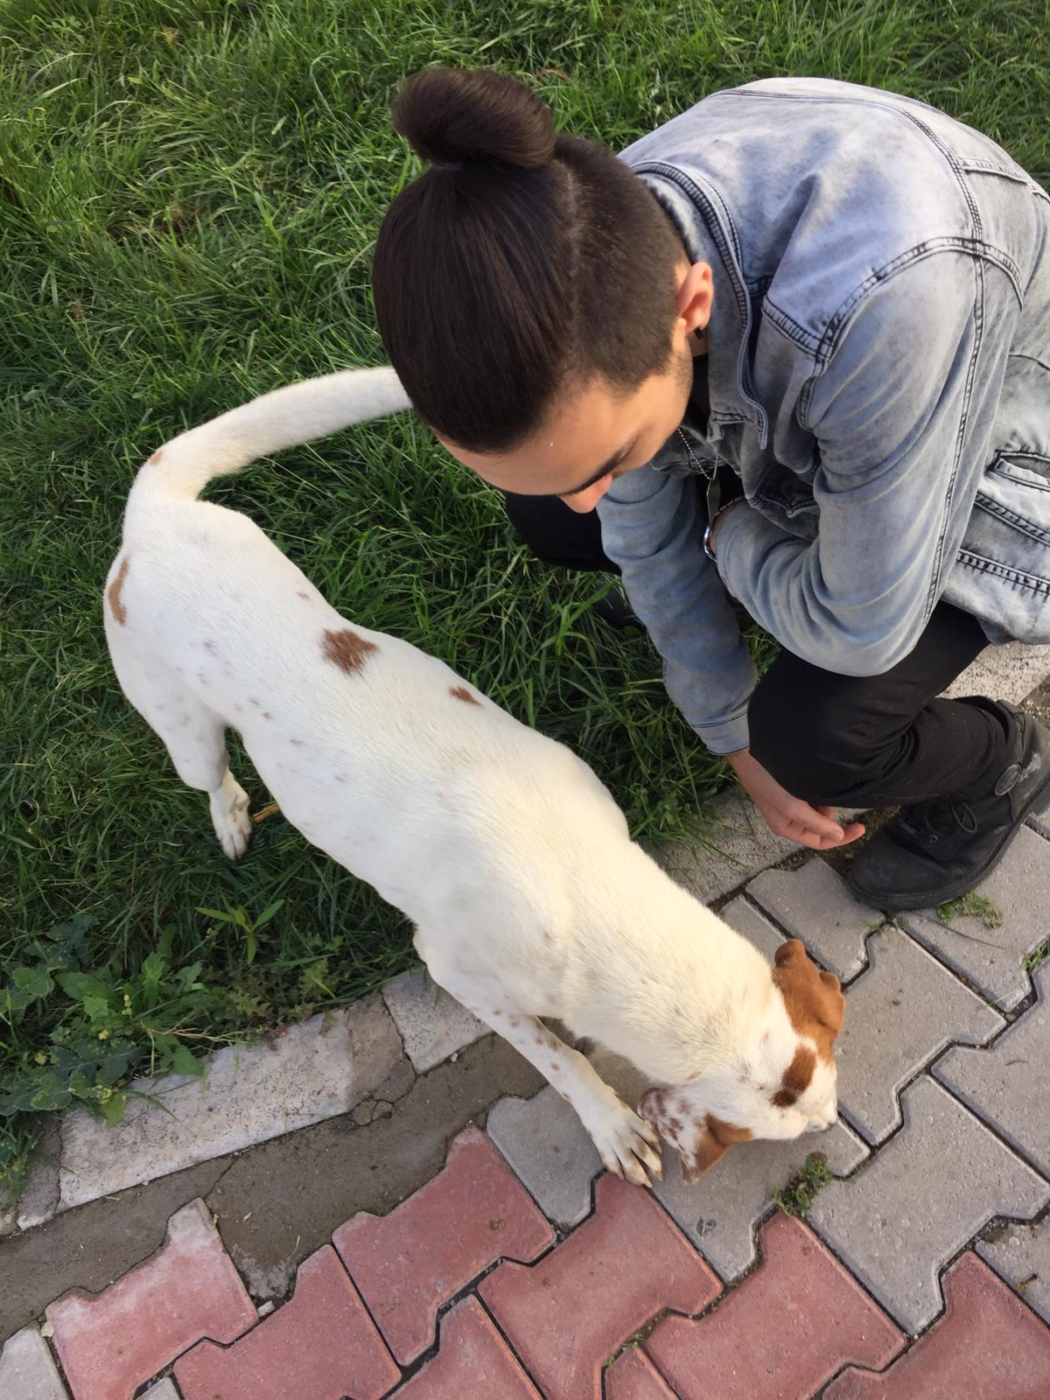

Slide 23
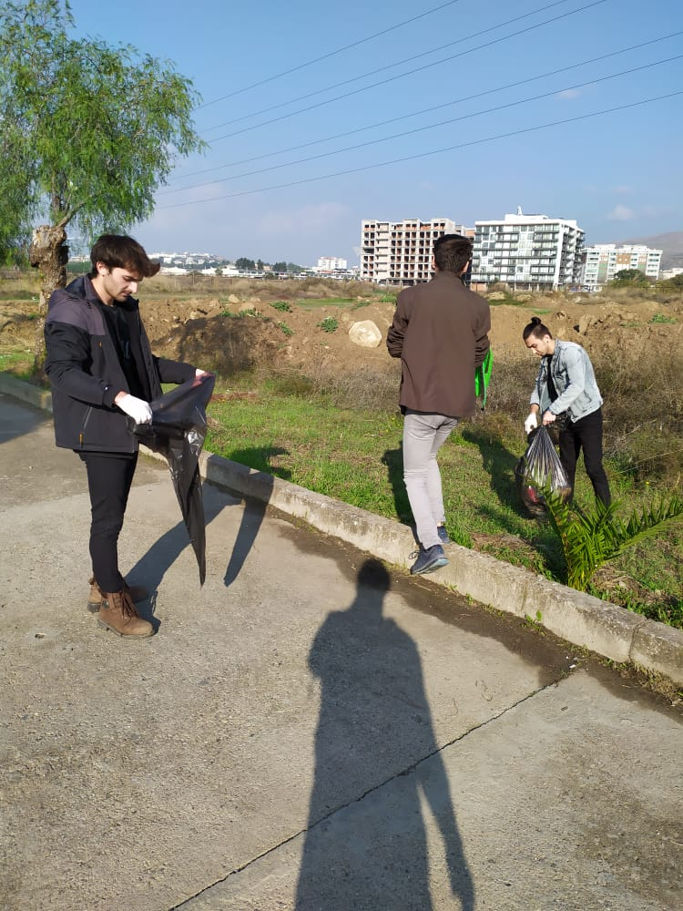
Fourth stop was İkçü

Slide 24
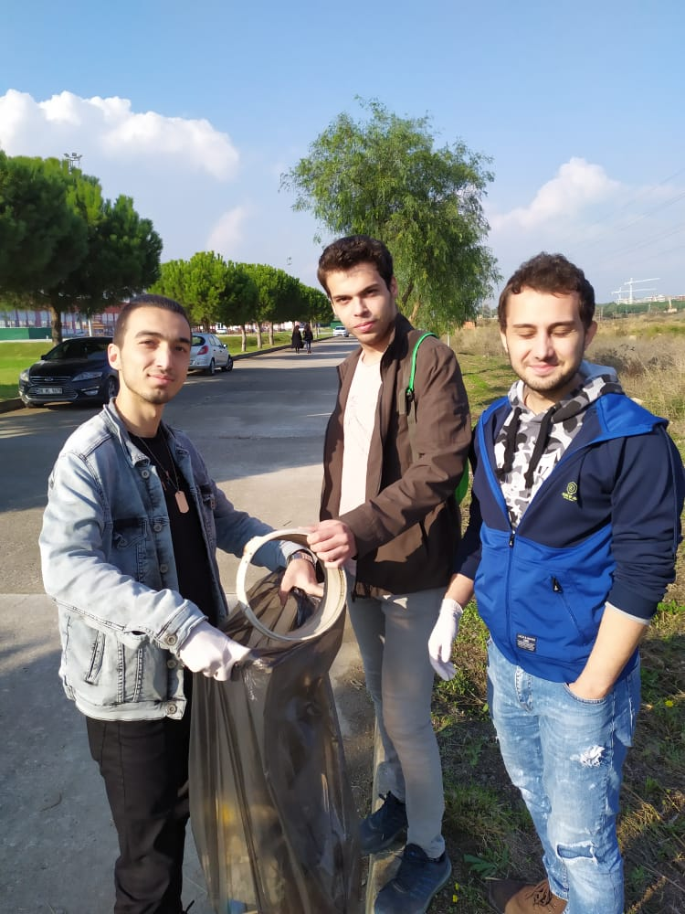

Slide 26
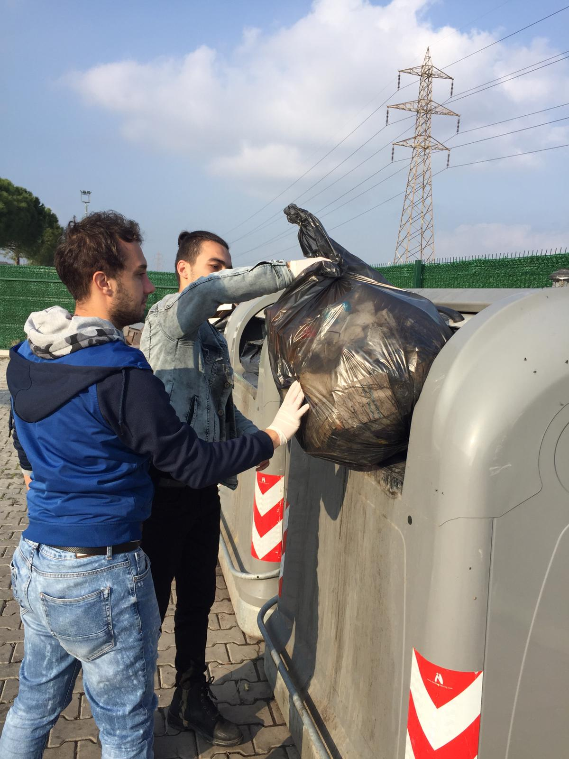

Slide 27
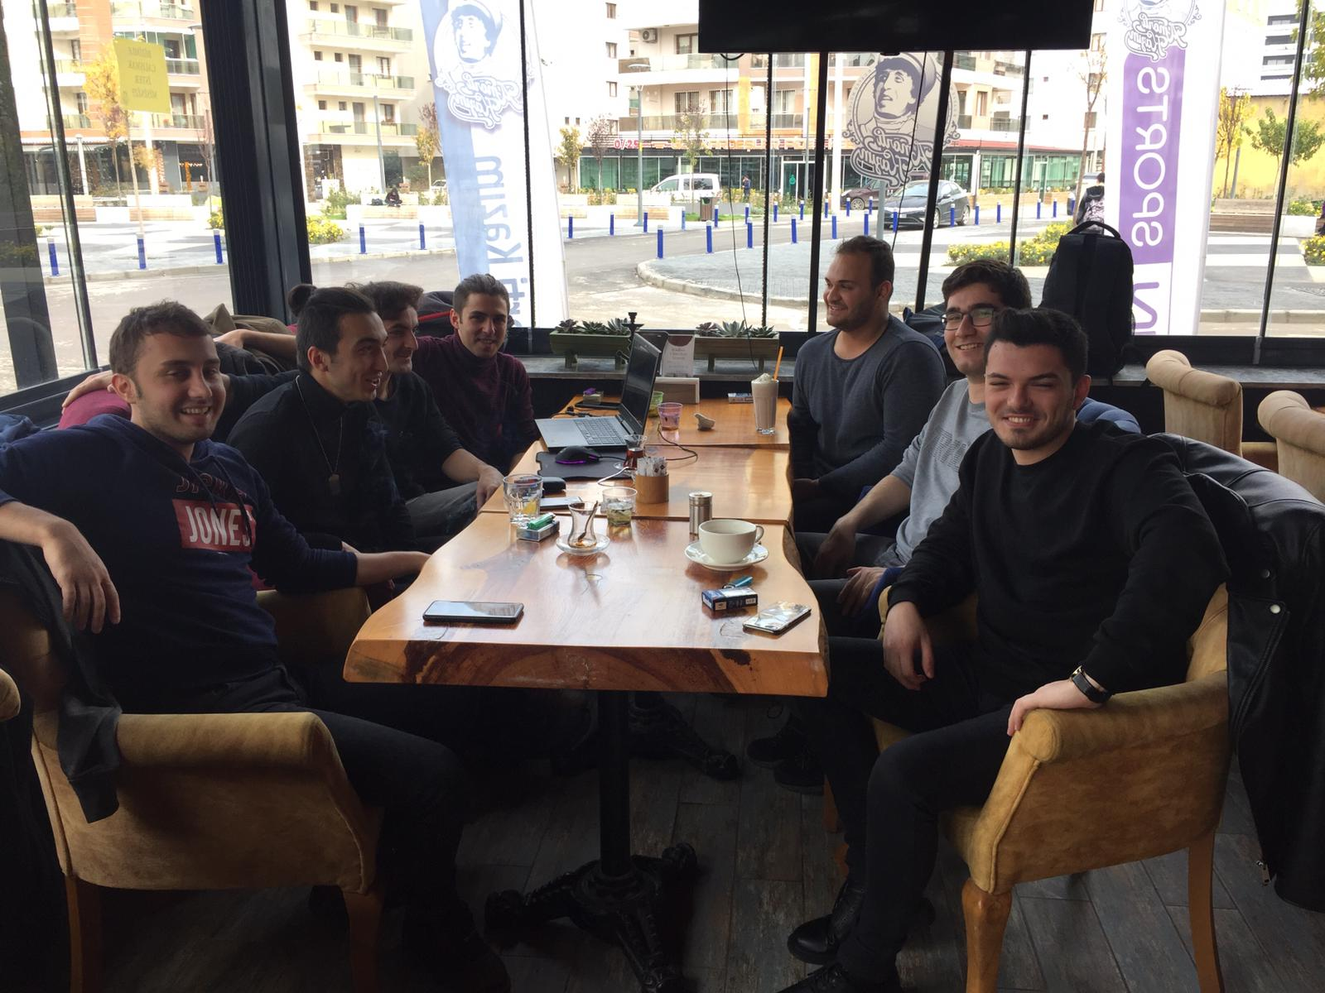
Final stop was in a cafe

Slide 29
What has this project contributed us?
Taught us to take responsibility
Improved our sensitivity to community issues
In summary, doing good things has taught us that we are responsible for our environment and those around us, shouldn’t pollute our common areas, help street animals living in these areas.

Slide 30
The End

